Slide 1
Chapter 29:
Investment Analysis of Investment in Real Estate Development Projects,
Part 2: Economic Analysis

Slide 2
29.1: The Basic Idea: Applying NPV to R.E. Development Projects…
Three considerations are important and unique about applying the NPV rule to evaluating investment in development projects as compared to investments in stabilized operating properties:
  “Time-to-Build”: Investment cash outflow occurs over time, not all at once up front, due to the construction phase. (➔ Forward purchase of asset)
  Construction loans: Debt financing for the construction phase is almost universal (even when the project will ultimately be financed entirely by equity).
  Phased risk regimes: Investment risk is very different (greater) between the construction phase (the development investment per se) and the stabilized operational phase. (Sometimes an intermediate phase, “lease-up,” is also distinguishable.)
We need to account for these differences in the methodology of how we apply the NPV Rule to development investments. . .

Slide 3
NPV = Benefits – Costs
The benefits and costs must be measured in an “apples vs apples” manner. That is, in dollars:
    As of the same point in time.
    That have been adjusted to account for risk.
As with all DCF analyses, time and risk can be accounted for by using risk-adjusted discounting.
Key is to identify: opportunity cost of capital
  Reflects amount of risk in the cash flows
  Can be applied to either discount CFs back in time, or
  To grow (compound) CFs forward in time
  e.g., to the projected time of completion of the construction phase.
Notes:
As always, and no matter in which direction the “discounting” is being done (e.g., forward in time growth or backward in time discounting), the rate that is used should be the opportunity cost of capital (OCC) relevant for the particular cash flows being discounted (or grown forward). That is, the rate should match the risk of the cash flows in question.

Slide 4
Hereandnow Place:
Twin buildings, $75,000/mo net rent perpetuity
OCC = 9%/yr (➔ 0.75%/mo, ➔ 1.0075¹² – 1 = 9.38% EAR)
in total, V₀ is:
Typical investment deal for this stabilized property:
NPV₀ = V₀ – P₀ = $10,000,000 – $10,000,000 = 0
Futurespace Centre:
Across the street from Hereandnow. Pre-leased to same tenant as Hereandnow, at same rent & lease terms.
Will be same asset as Hereandnow, complete in 12 mos
Constr cost $1,500,000 X 4 payable @ mos 3, 6, 9, 12.
First building complete in 6 mos.
This is definitely HBU of site; irreversible commitment to develop now is appropriate

Slide 5
Development investment valuation question :
What is the price that can be paid today for the FutureSpace land site such that the development investment will be NPV ≥ 0? . . .
This (such that NPV=0) is the value of the land, the price the FutureSpace land site would presumably sell for in a competitive market. Hence, equivalently ask:
What is the NPV of the development project investment apart from the land cost? . . .
Answer: NPV₀ (exclu land) = V₀ – K₀ = PV(V_{T} ) – PV(K_{T} )
Where K₀ is the PV of construction costs, V₀ is PV future completed asset.
So, what is V₀ ?, and what is K₀ ? For Futurespace Project . . .
If opportunity cost of land ≤ V₀ – K₀ , then dvlpt project investment makes sense (start construction), otherwise sell land or wait (don’t start construction yet).

Slide 6
First consider V₀ …
In 6 mos Furturespace One will be complete, expected to be worth:
And in 12 mos Futurespace Two is expected to be worth:
Thus, gross PV of project benefit (assets to be built) is:
Or, equivalently:
Why is Futurespace worth less than Hereandnow ? . . .
Why do we cut off the analysis at month 12 ? . . .
Notes:
Note: Futurespace’s lower PV is NOT because of leasing risk, as Futurespace is pre-leased.
If Futurespace were not pre-leased (i.e., if it did have leasing risk), then this would give it a higher OCC than Hereandnow Place (higher than 9% - see Section 29.3.2).
As it is, Futurespace is worth less than Hereandnow because Futurespace won’t exist until the future, whereas Hereandnow Place is already in existence and providing income (positive cash flow). Futurespace will not earn provide income until it is completed. The development project is a “forward purchase” of the underlying asset (the building).
We cut off the analysis at the end of month 12 because that is the end of the development phase of the investment, hence, the point where the nature of the investment risk changes, placing the asset into a different category or different market or sector within the capital market and investment industry.

Slide 7
Now consider K₀ …
Construction cost is 4 quarterly pmts of $1,500,000 each.
These CFs have very little “risk” as capital mkt defines “risk”:
Low beta, low correlation w financial mkts.
Hence: OCC for constr CFs near r_{f} , say 3% per annum (0.25%/mo, ➔ 3.04% EAR).*
So, PV of construction costs is:
* Note that by using a lower OCC for construction CFs, we discount them to a higher PV, thus causing construction costs to figure more prominently in the development investment decision (bigger negative item).
In this sense we are treating construction cost as a greater “risk” factor to be considered in the decision.
This is not the capital market definition of “risk,” but it is consistent with common parlance.
Notes:
Note that 3% is not the interest rate on the construction loan (if any).
The interest rate on the loan needs to consider the possibility of default and credit losses, to still provide the lender with an expected return of 3%.
To see how this might relate to a construction loan, suppose that the lender expects a 5% probability of default when the loan comes due at the end of construction in 12 months, and suppose that in the event of default the loss severity would be 25% (that is, 25% of the outstanding loan balance would not be recoverable through the foreclosure process). Then a contractual interest rate of 6.335% on the construction loan might well result in the loan issuance being a zero NPV event, as follows…
Assuming interest accrues from the time each construction draw is made, the OLB on the loan at the end of 12 months would be:
$1,500,000(1 + .0633/12)⁹ + $1,500,000(1 + .0633/12)⁶ + $1,500,000(1 + .0633/12)³ + $1,500,000 = $6,145,000.
The bank’s expected cash flow in month 12 from this credit, given the default probability and conditional loss severity would be:
(0.95)$6,145,000 + (0.05)(1 – 0.25)$6,145,000 = $6,068,000.
The bank’s expected future value of its construction cost liabilities evaluated as of month 12, based on the riskfree OCC of the construction cost outflows themselves, would be:
$1,500,000(1 + .03/12)⁹ + $1,500,000(1 + .03/12)⁶ + $1,500,000(1 + .03/12)³ + $1,500,000 = $6,068,000.
Thus, the projected NPV for the bank at month 12 would be: $6,068,000 – $6,068,000 = 0, which would also imply a zero NPV at the time of loan issuance at time zero, provided the default-based credit losses are uncorrelated with capital market returns (such that the expected month 12 inflow to the bank can be discounted to time 0 at the same 3% riskfree rate as the construction outflows).
If credit loss incidence in the loan is positively correlated with capital market variables, then the OCC appropriate for discounting the bank’s expected cash inflow of $6,068,000 at month 12 would be greater than the 3% rate applicable to the construction costs (because of the bank’s inability to diversify away all of the default risk). This would result in a lower present value for the inflow to the bank, and hence a negative time 0 NPV for the lender. This might be overcome by an up-front loan origination fee in addition to the interest charge in the loan. Alternatively, an interest rate higher than 6.335% could equate the time 0 values of the expected inflows and outflows on the loan.
It is important to note, however, that such credit losses on the loan are not deadweight losses to the construction project as a whole, but rather “internal” transfer payments from the debt investors to the equity investors in the project, as the borrowers exercise their “put option” right to default with limited liability (assuming lack of lender recourse).
In any case, competition in the construction lending market must result in an ex ante zero NPV for the loan transaction as of time 0 (when the loan decision is made). This implies a time 0 present value of the loan’s expected cash inflows (payments from the developer to the lender) equal to the present value of the loan’s expected outflows (payments from the bank to the construction contractor), which equals: $6,068,000/(1+.03/12)¹² = $5,889,000, based on the construction cost OCC of 3%. Thus, we arrive at the same time 0 present value of the construction costs faced by the developer, whether or not a loan is actually used to finance the construction.

Slide 8
Thus, excluding Land cost, we have Futurespace project valuation:
V₀ – K₀ = $9,352,000 – $5,889,000 = $3,463,000.
If the price of the Land is x, then:
NPV₀ = $3,463,000 – x .
For any Land price <= $3,463,000, the Futurespace project makes economic sense.
Because of the way we have defined economic value (based in market opportunity cost), if the project passes the above criterion, it should be possible to put together financial arrangements to make it happen (otherwise, $$$ are being “left on the table” – recall: NPV rule based on wealth-maximization).
If the project does not pass the above criterion, it will either be difficult to put together financing, or at least one of the parties is likely to regret it later on if they did contribute.*
*Or a party is in the business of purposely providing a subsidy.
Notes:
Recall from Chapter 28 that consideration of option value could make it optimal to wait before investing in the development project. Such “option premium” value and optimal waiting should normally be reflected in the market value of the land. Hence, in this case it would be reflected in a value of x greater than $3,463,000. However, recall that at the outset of our discussion of this example we posited that it was indeed optimal to commit irreversibly to immediate development of the FutureSpace Centre project. To relate this to the discussion in Chapter 28, the current underlying asset value of $9,352,000 (signaled by an observable comparable completed asset current value of $10,000,000 as seen in the value of Hereandnow Place) apparently equals at least the “hurdle value” that makes immediate development optimal as described in section 28.5.1 of the preceding chapter.

Slide 9
Three related investments must lie on same Security Mkt Line (SML)…
All investments have to provide the same E[RP] per unit of risk (as the market defines “risk”), or, what?...
E[r]
?
E[r_{V}] = 9%
E[RP]
r_{f} = 3%
Risk
Constr Contract CFs @ PV price $5.889M
Hereandnow Place @ PV price $10M
Futurespace Land @ PV price $3.463M
If these valuations do not hold, then there are “super-normal” (disequilibrium) profits (expected returns) to be made somewhere, and correspondingly “sub-normal” profits elsewhere, across the markets for: Land, Stabilized Property, and Bonds (“riskless” CFs).

Slide 10
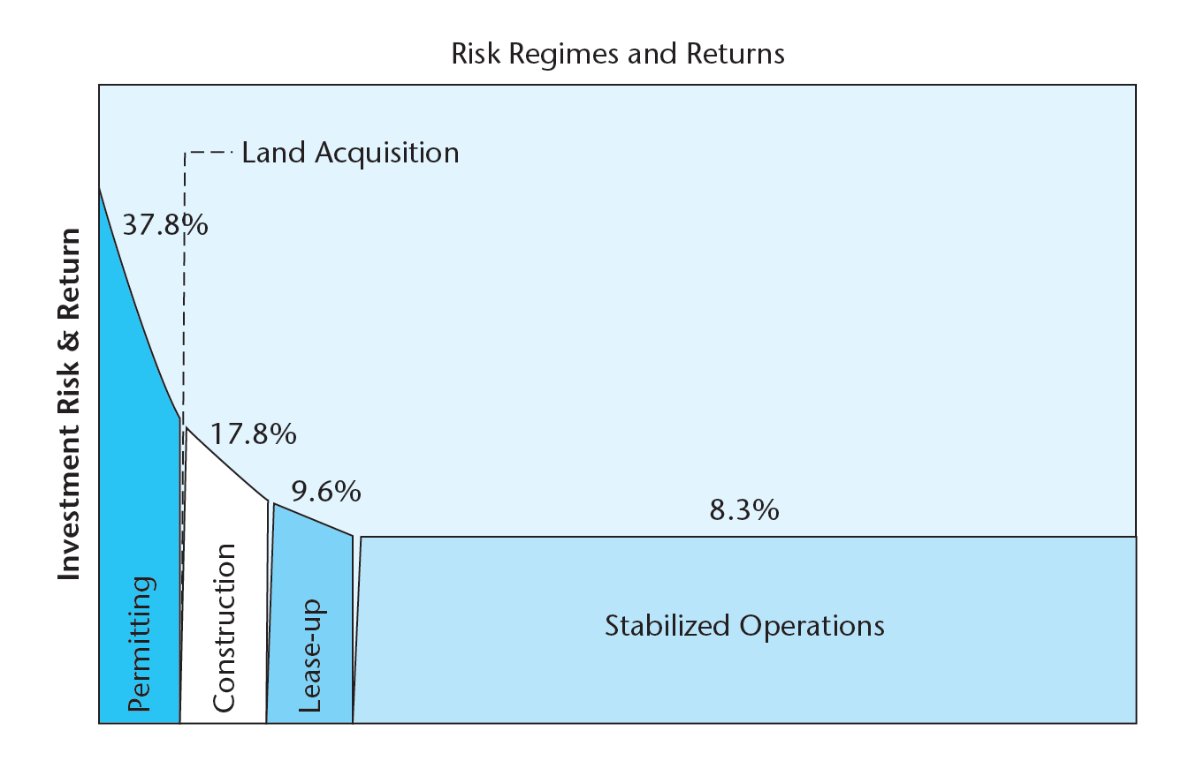
Further investment analysis . . .
29.1.2. Operational Leverage and Estimation of the OCC for Development Investments
Recall that we are dealing with a high-risk/high-return phase (“style”) of investment (the yellow or yellow and blue phases):
Construction
Stabilized Operations
Permitting

Slide 11
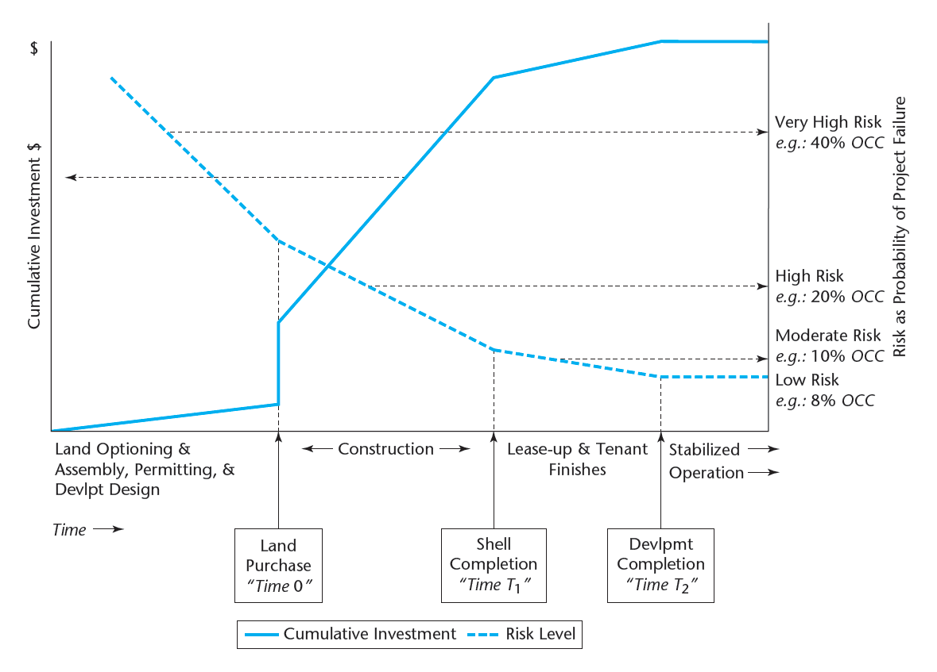
EXHIBIT 28-2 Development Project Phases: Typical Cumulative Capital Investment Profile and Investment Risk Regimes
We’re dealing with this phase:
From Time 0 to Time T…

Slide 12
How risky is this development project investment ? . . .
We can quantify the answer to this question.
Given that $3,463,000 is the market value of the development project:
The 16.59% going-in IRR for the development investment phase itself reflects the capital market’s required ex ante risk premium:
E[r]
16.59% = 3% + RP
r_{f} = 3%
Risk

Slide 13
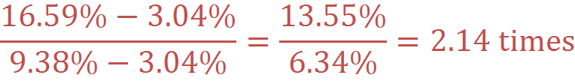
The Futurespace development project has…
E[r]
16.59% = 3% + RP
r_{f} = 3%
Risk
the investment risk of an unlevered investment in stabilized property like what we are building in the Futurespace project.

Slide 14
All investments have to provide the same E[RP] per unit of risk (as the market defines “risk”), or, what?...
E[r]
16.59%
9.38%
E[RP]
r_{f} = 3%
Risk
Hereandnow
Futurespace
If this relationship does not hold, then there are “super-normal” (disequilibrium) profits (expected returns) to be made somewhere, and correspondingly “sub-normal” profits elsewhere, across the markets for: Land, Stabilized Property, and Bonds (“riskless” CFs).

Slide 15
The added risk in Futurespace compared to Hereandnow:
reflects “operational leverage” in the development project.
Recall: NPV = V – P
Operational leverage arises whenever P (= K + Land) does not occur entirely at time zero and is not perfectly positively correlated with the subsequent realization of V.
Bigger K relative to V, and/or later K in time relative to the realization of V (at time T ), ➔Greater operational leverage.
Investments in stabilized properties have no operational leverage because the investment cost (P) occurs entirely at time zero.

Slide 16
Example of operational leverage:
Suppose asset values turn out to be 10% less than expected at time of purchase (Time 0). . .
Hereandnow realized return:
Ex post return is 9.38% − (−1.04%) = 10.42 points below ex ante.
Futurespace realized return:
Ex post return is 16.59% − (−13.42%) = 30.01 points below ex ante:
➔ 30.01 / 10.42 = 2.9 times the investment return risk.
Notes:
This ratio is greater than the 2.14 ratio in the ex ante risk premia computed earlier because here we are making a bit of “apples vs oranges” comparison. We are hypothesizing that the Hereandnow investment does not take the “hit” until 12 months from now in its asset value at that time, while the FutureSpace investment takes half of the hit (in the FutureSpace One building value) upon its completion in only 6 months and the other half in 12 months. The earlier registration of the loss causes a larger impact on the return. But of course, the value of the asset actually changed at the same moment for both properties, due to the arrival of some exogenous news that affects each property identically.

Slide 17
Same kind of impact on risk and return as in Ch.13 (“leverage”).
In Ch.13 the effect was due to financial leverage (use of debt financing of the investment).
Here no debt financing is being employed (hence, no financial leverage).

Slide 18
How did we compute the OCC of the Futurespace development project (the 16.59%) ? . . .
We backed it out, that is:
We first computed the NPV of the project exclusive of Land:
V₀ – K₀
Then we assumed market value for Land (i.e., NPV=0):
NPV₀ = V₀ – P₀ = V₀ – (K₀ + Land) = 0
Land = V₀ – K₀
And then we derived the IRR implied by this ($3,463,000) value for the Land (16.59%):

Slide 19
We did not need to know the OCC of the development project investment in order to compute the NPV of that investment,
or (therefore) to determine whether the investment made economic sense or not.
We only needed to know the OCC of the project benefit (the E[r_{V}] = 9.38%) and of the project cost (the E[r_{K}] = 3.04%), together with the projected CFs of each of those:
NPV[dvlpt] = PV[V] – PV[K] – Land .

Slide 20
Nevertheless, we still found it useful to compute the OCC of the development project itself (the 16.59%).
e.g., we used it to quantify the relative investment risk in the development investment vs a stabilized property investment (2.14 times, based on: (16.59−3.03)/(9.38−3.03)=2.14 ).
But here we face a problem of consistency in concept or practice, regarding how we quantify the development project OCC . . .
The specific numerical value of the development phase OCC depends on the particular cash flow and value realization timing assumptions employed in the IRR computation.

Slide 21
Suppose,
instead of assuming that each of Futurespace’s two buildings’ values would be realized upon the completion of each building (in months 6 & 12), as we did in computing the 16.59% IRR,
we assume that we hold the entire project until its complete realization in month 12:
Now it looks like the IRR (and hence the OCC) of this same development project is 13.58%, instead of 16.59%.
Which is the real (true) Futurespace OCC?...

Slide 22
Answer:
They can both be true!
(So long as they both represent realistic, feasible plans for disposition of the project.)
But this is not a very satisfying or practical answer for purposes where we need some consistency in quantifying development project investment OCC, for example,
For comparisons across different types of projects (e.g., for strategic planning purposes).
Also, this approach ignores the ubiquity of use of construction loans to finance the construction costs of development projects (even by deep-pocket institutions, such as pension funds).
The use of a construction loan pushes all of the construction cost cash outflows (from the developer/borrower’s perspective) to the end of the construction phase (“time T”). . .

Slide 23
The “Canonical Form” of the Development Project OCC:
The idea is to use the ubiquity of the construction loan (in its classical form, with interest accrued until the end), to develop a simplified “stylized” representation of development project cash flows as occurring at two and only two points in time:
Time “zero,” and Time “T”
Time 0 = The moment when the irreversible decision to commit to development (construction) is made (opportunity cost of the land is incurred);
Time T = The time when the construction phase is completed (and/or when lease-up is projected to be completed), resulting in a stabilized asset.
And then compute the standardized (“canonical”) IRR of the development project investment based on this 2-point cash flow assumption.

Slide 24
The canonical formula for the OCC of development investments can be expressed by the following condition of equilibrium across the markets for developable land, built property, and contractually fixed cash flows (debt assets):
Where:
V_{T} = Gross value of the completed building(s) as of time T.
K_{T} = Total construction costs compounded to time T.
E[r_{V}] = OCC of the completed building(s).
E[r_{D}] = E[r_{K}] = OCC of the construction costs (usually ≈ r_{f} ).
E[r_{C}] = OCC of the development phase investment (“Canonical Form”).
T = The time required for construction.
Notes:
Note that we’ve made a slight change of notation, from r_{K} to r_{D} .
As described previously, it is probably good to think of construction cost cash flows as having “debt-like” characteristics, relative to real estate asset based cash flows.

Slide 25
The “Canonical” Formula:
LHS represents the investment in developable land.
RHS represents a way to duplicate this development investment:
  by investing in a combination of:
      a long position in built property of the type being developed and
      a short (i.e., negative) position (borrowing) in an asset that pays contractually fixed cash flows (debt) in the amount of the construction costs of the project.
Notes:
In constructing the duplicating portfolio, you would actually have to purchase a forward claim on the existing stabilized building T periods from now, using borrowed money in a zero-coupon loan that will owe K_{T} dollars at time T.

Slide 26
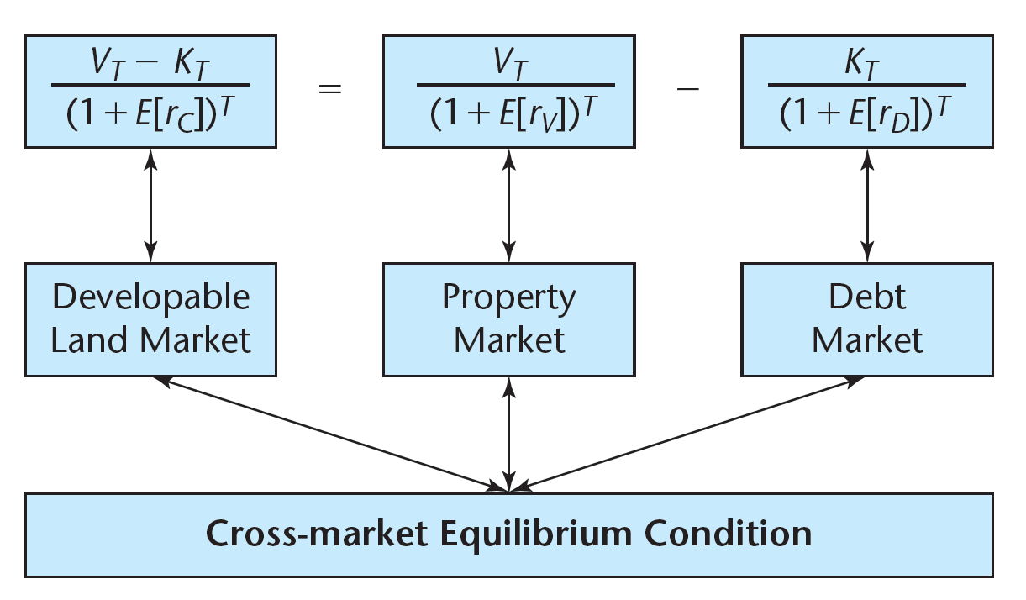
The “Canonical” Formula:

Slide 27
The “Canonical” Formula:
As noted before, if this formula does not hold, then there will be “super-normal” (disequilibrium) profits (expected returns) to be made somewhere, and correspondingly “sub-normal” profits elsewhere, across the markets for: Land, Stabilized Property, and Bonds (“riskless” CFs).
All investments have to provide the same E[RP] per unit of risk (as the market defines “risk”), or, what?...

Slide 28
In most cases, all of the variables in the canonical formula can be observed or estimated with relatively high confidence except for the OCC of the development phase investment, E[r_{C}]. Solving for E[r_{C}] we obtain:
If you prefer, a simpler more intuitive (and equivalent) way to derive E[r_{C}] is to first compute V₀ – K₀ using the previous method, and then derive the canonical development phase OCC as:

Slide 29
Numerical Example of the Canonical Formula
Derivation of the canonical OCC for the Futurespace Project:
First compute the forward V_{T} value of the project benefit as of Time T:

Slide 30
Numerical Example of the Canonical Formula
Next compute the forward K_{T} value of the project construction cost as of Time T:
To obtain the projected net development profit as of month 12:
V_{T} – K_{T} = $10,229,000 – $6,068,000 = $4,161,000.
Then substituting into the Canonical Formula we obtain the canonical OCC of the Futurespace Project:
Canonical OCC = 20.16% / year.

Slide 31
Numerical Example of the Canonical Formula
Alternatively (and equivalently):
Canonical OCC = 20.16% / year.

Slide 32
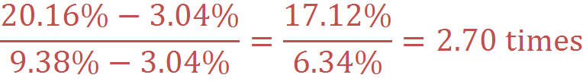
Numerical Example of the Canonical Formula
(Futurespace Project)
This canonical 20.16% exceeds the previously derived 16.59% and 13.58% OCC numbers because the canonical assumption involves more leverage, due to the assumption, in effect, of the use of a construction loan (all CFs at only Time 0 and Time T).
Returning to our risk comparison between the development project and the stabilized property, from the canonical perspective, Futurespace Centre has…
the risk of Hearandnow Place.

Slide 33
Relation of the Canonical Formula to the WACC:
As the Canonical Formula reduces the development project to a single-period investment (between Time 0 and Time T ), the Canonical OCC can be equivalently derived using the “WACC” Formula that we introduced in Chapter 13:
E[r_{C}] = E[r_{D}] + LR(E[r_{V}] – E[r_{D}])
Defining LR as the leverage ratio: V/(V-K), based on the Time Zero valuations of the asset to be built and the land value:
we have the development (land) OCC given as:
E[r_{C}] = 3.04% + 2.70(9.38% – 3.04%) = 20.16%.
Thus further illustrating how a development project investment may be thought of as like a levered investment in a stabilized property like the one being built.

Slide 34
In whatever manner the canonical OCC is determined, it will of course yield the same NPV of the development project (land value) as we derived originally:
However, prior knowledge of this NPV is not necessary to ascertain the canonical OCC of the development project, as E[r_{C}] is determined solely by the variables on the right-hand side of the Canonical Formula equation:
It should also be noted that the Canonical Formula is completely consistent with the real options valuation of the development project investment, once the option is at the point where immediate exercise (development) is optimal (our original assumption here).

Slide 35
Summarizing the advantages of the recommended procedure:
Consistent with underlying theory. (i.e., consistent with NPV Rule, based on Wealth Maximization Principle. Based on market opportunity costs, equilibrium across markets. Consistent w option theory.)
Simplicity. Avoids need to make assumptions about permanent loan or form of permanent financing (equity vs debt).
Explicit identification of the relevant OCC. Identifies explicit expected return (OCC) to each phase (each risk regime) of the investment: Development, Lease-up (if appropriate), Stabilized operation.
Explicit identification of land value. Procedure results in explicit identification of current opportunity value of the land.
“Front-door” or “Back-door” flexibility possible. Procedure amenable to “backing into” any one unknown variable. E.g., if you know the land value and the likely rents, you can back into the required construction cost. If you know (or posit) all of the costs and values, then you can back into the expected return on the developer's equity contribution for the development phase. Or you can back into the implied land value (supportable price).
Notes:
The procedure described here is also consistent with real options valuation theory as described in Chapter 27, provided that the opportunity value of the land incorporates the development option value. As noted, this will normally be the case as far as market value is concerned, the so-called “second best developer” valuation of the land. Depending on the degree of uniqueness in a developer’s ability to use a given land parcel, it may be necessary for the “first best” developer to explicitly consider the value of waiting to build. In other words, a “first best” developer who obtains an apparent positive NPV from development at time zero using the procedure described in this section based on the market value of the land should also consider the NPV of the mutually-exclusive alternative of waiting to build the same (or better) project at a future point in time. (See sections 27.2 and 27.3 in Chapter 27.)
By quantifying the developer's total return we are developing a measure which can be easily compared with the returns one can expect to earn in other risky ventures, such as investment in small growth stocks or venture capital funds. Returns in the 15% to 30% range are not uncommon for such risky investments. Viewed from a macro-level investment allocation perspective, real estate development should provide expected returns that are comparable on an "apples-to-apples" basis with the expected returns provided by other high-risk alternative allocations of capital.

Slide 36
Do developers really use the “NPV Rule”?
Most don’t use NPV explicitly.
But remember: NPV ⬅ Wealth Maximization.
By definition, successful developers maximize their wealth.
Thus, implicitly (if not explicitly), successful developers must (somehow) be employing the NPV Rule:
    e.g., in deciding which projects to pursue,
    An intuitive sense of correctly rank-ordering mutually-exclusive projects or designs by NPV, and picking those with the highest NPV (they may think of it as “best profit potential”), must be employed (by the most successful developers).
Suggestion in Ch.29 is that by making this process more explicit, it may be executed better, or by more developers (i.e., making more developers “successful”),
The NPV approach also should improve the ability of the development industry to “communicate” project evaluation in the “language of Wall Street” (e.g., “NPV,” “OCC,” phased risk regimes, risk/return “styles”).
Notes:
In any case, clearly the NPV Rule is based on rational, rigorous economic decision principles, and therefore serves as the basic normative framework for development investment evaluation and decision making.
Proof that Wealth Maximization implies the NPV Decision Rule:
Suppose not.
Then I could maximize my wealth and still contradict NPV Rule.
I could choose a project with NPV < 0, or with NPV less than that of another mutually-exclusive feasible alternative.
But if I did that I would be “leaving money (i.e. “wealth”) on the table," taking less wealth when I could have more.
This would not be wealth-maximization.
Hence: Contradiction.
QED (“Proof by Contradiction”).

Slide 37
Note that in this approach, there is no need to pre-assume what type of permanent financing will be used for the completed project.
There is no assumption at all about what will be done with the completed project at time T. It may be:
      Financed with a permanent mortgage,
      Financed or sold (wholly or partly) tapping external equity, or
      Held without recourse to external capital.
Project evaluation is independent of project financing, as it should be.*
* Unless subsidized (non-market-rate) financing is available contingent on project acceptance: Recall Chapter 14, the “APV” (Adjusted Present Value) approach to incorporating financing in the investment evaluation.
Another important reason for this approach:
  Risk characteristics of development phase different from risk characteristics of stabilized phase.
  Thus, different OCCs, therefore:
  Two phases must be analyzed in two separate steps.
Notes:
It is important to break down investment analysis into separate components that correspond to different risk regimes. Otherwise, blending of different risk regimes “muddies the waters” of the analysis, makes it difficult to rigorously identify the appropriate opportunity cost of capital (OCC) beforehand (ex ante), and difficult to “benchmark” achieved investment performance (compare against comparable risk alternatives) afterwards (ex post). Development investments should provide expected returns appropriate to development investments (not to stabilized investments or some mixture), and stabilized investments should provide expected returns appropriate to stabilized investments. “Apples” should be compared to “apples,” not to “oranges.” More and more, the capital markets are organized along such lines, to group similar risk type investments together in specialized pools of capital and investment management. The real estate industry must conform to this trend or risk losing out to other uses of capital.

Slide 38
*29.2 Advanced Topic:
The Relationship of Development Valuation to the Real Option Model of Land Value
The NPV & canonical OCC development project investment valuation and analysis procedure previously described is
Consistent with the real option model . . .
To see this, consider a binomial model of the preceding Hereandnow / Futurespace example . . .

Slide 39
To see this, consider a binomial model of the preceding Hereandnow / Futurespace example . . .
Suppose that risk in the property market is such that the ex ante expected value of the project at Time T, what we have labeled and quantified as:
V_{T} = $10,229,000
is actually based on a binomial outcome possibility of a 50/50 chance of either $11,229,000 or $9,229,000 value:
V_{T}^{up}=
$11.229M
p = .50
PV[V_{T}]=
$9.352M
1-p = .50
V_{T}^{down}=
$9.229M
With in any case the construction cost having a K_{T} value of $6,068,000 (as before), and recalling that we have previously determined that the PV of this 1-yr forward claim is $9,352,000.

Slide 40
Then applying the certainty-equivalence form of the DCF present value model that we first introduced in Chapter 10 Appendix C and which formed the basis of the binomial option value model we described in Chapter 28, we have the following present value computation for the FutureSpace project as of time zero:
Which is identical to the PV of the project (land value) that we found before.

Slide 41
Note that in percentage terms the development project investment outcome spread (which may be viewed as a measure of risk) is:
Whereas that in (the T-period forward purchase of) the stabilized property is:
The ratio of these outcome spreads (risk):
57.75 / 21.38 = 2.70,
is exactly the same as the ratio of the ex ante risk premia between the development project and its underlying asset (using the Canonical OCC):
(20.16%-3.04%) / (9.38%-3.04%) = 17.12% / 6.34% = 2.70.

Slide 42
The “price of risk” (the ex ante investment return risk premium per unit of risk) must be the same across the relevant asset markets:
E[r]
20.16%
E[RP]
9.38%
r_{f} = 3.04%
Risk
Hereandnow
21.38% range
Futurespace
57.75% range
If this relationship does not hold, then there are “super-normal” (disequilibrium) profits (expected returns) to be made somewhere, and correspondingly “sub-normal” profits elsewhere, across the markets for: Land, Stabilized Property, and Bonds (“riskless” CFs).

Slide 43
29.3.1 How Developers Think About All This
Developers don’t usually explicitly apply the NPV Rule.
But remember . . .
Proof that Wealth Maximization implies the NPV Decision Rule:
Suppose not.
Then I could maximize my wealth and still contradict NPV Rule.
I could choose a project with NPV < 0, or with NPV less than that of another mutually-exclusive feasible alternative.
But if I did that I would be “leaving money (i.e. “wealth”) on the table,” taking less wealth when I could have more.
This would not be wealth-maximization.
Hence: Contradiction.
QED (“Proof by Contradiction”).
Thus, if our definition of a “successful” developer is one who maximizes wealth, then successful developers must be applying the NPV Rule (implicitly if not explicitly).

Slide 44
What sort of quantitative performance measures do developers look at ?
Sometimes, just the SFFA described earlier in 29.4 (but that is only a feasibility analysis, not an evaluation). Other times:
Profit Margin Ratio
Enhanced Cap Rate on Cost
Blended Long-run IRR
But developers must apply these approaches in a manner that gives the same result as the NPV Rule, or else they are not maximizing wealth.
And their evaluations must be consistent with market equilibrium, or they “won’t be able to play the game.”

Slide 45
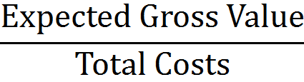
Profit Margin Ratio
Definition:
(undiscounted)
Evaluation is then based on some conventional but ad hoc “Rule of Thumb,” such as 20% (for a relatively quick project, when land is included in the cost).
e.g., for our Futurespace example project:

Slide 46
Profit Margin Ratio
e.g., for our Futurespace example project:
But we have seen that this answer is wrong, if the OCC of the built property is 9% and the riskfree rate is 3%.
The margin that would give the correct answer is 5.7%:
(This will provide the canonical expected return of 20.16% as we have seen.)
(A land price of $2,333,000 will provide the developer with a (canonical) expected return of 78% ! )

Slide 47
Profit Margin Ratio
e.g., for our Futurespace example project:
But perhaps the developer is applying the 20% margin with the historical cost of the land.
And perhaps the land was acquired some 1.77 years before, for the $2,333,000 price, and has earned a speculative (real option based) return of 25%/year since then:
$2,333,000*(1.25)^{1.77} = $3,463,000

Slide 48
Enhanced Cap Rate on Cost
Definition: Expected Initial Stabilized NOI/yr
---------------------------------------------
Total Cost inclu Land (undiscounted)
Evaluation is then based on a required cap rate that is somewhat greater than what currently prevails in the market for stabilized properties of the type to be built.
e.g., for Futurespace example:
Market cap rate for stabilized is 9% (see Hereandnow),
so developer might require 10% cap rate for the Futurespace development project:
NOI / 10% = $900,000 / 0.1 = $9,000,000.
So, if total costs <= $9,000,000, project looks good:
Land value = $9,000,000 – $6,000,000 = $3,000,000.

Slide 49
Blended Long-run IRR
Definition:
Append a projected multi-year (usually 10 years) operating phase cash flow projection to the development phase cash flow projection, including land cost (e.g., a 10+T year projection), and apply a hurdle IRR requirement that is greater than that for stabilized investments, by some ad hoc amount (e.g., maybe 100bps or so, for unlevered holding).
e.g., in our Futurespace example, if we extended the CF projection out another 10 years (120 months), and applied a 10% discount rate (instead of the 9% OCC for stabilized property) across the entire 11-year projection, we would get a PV of $3,049,000, suggesting that this could be paid for the land.
However, from a capital markets perspective, this muddies the waters by mixing two very different investment styles together.
And from a development decision perspective it concatenates two different decisions that need not be fused.

Slide 50
29.4 & Appendix 29:
The Phasing Option
The ability (and need) to break the development project into two or more sequential phases rather than committing to its complete construction all at once complicates the option model of development and land value (but is an important aspect of large projects).
The phased option can be modeled as a “compound option” :
An Option on an Option
Building the first phase gives you the option to build the second phase, and so on…

Slide 51
The Phasing Option
The phasing option can be modeled using the binomial procedure as before, applying the same formulas as before (with time-to-build as appropriate), repeatedly, starting with the last phase (as a simple option), then the next-to-last phase is modeled as an option on the last phase, and so on…
That is, the next-to-last phase is an option whose “underlying asset” is another option, namely, the last phase.
Let’s walk through a simple numerical example . . .

Slide 52
Roth Harbor
The following numerical example will demonstrate all of the option modeling techniques presented in this lecture
Roth Harbor is a strategically and scenically located former brownfield site on the shore near the center of Wheatonville, ME.
Wheatonville is a former shipbuilding city now booming with high-tech startups and an influx of young professionals and empty-nesters, creating a serious housing shortage.
The 50 acres of former industrial and warehouse property in Roth Harbor are currently zoned to allow 500 market-rate apartments to be developed.
The property is owned by Ciochetti Enterprises LLC (CEC), which has plans to build the 500 units in a single project, to be called Rentleg Gardens.
The Planning Commission of Wheatonville “has a better idea…”

Slide 53
Roth Harbor
Rentleg Gardens:
Current apartment rents in Wheatonville suggest that the Rentleg Gardens apartments could charge gross rents of $1100/mo, with operating expenses of $6533/year per occupied unit, and average vacancy of 4%. Cap rates (y_{V} ) on such properties are currently 8%.
If the 500 Rentleg Gardens units existed today, the property would be worth:
[ (1100*12 – 6533)*0.96 / .08 ] * 500 = $40,000,000
based on a projected current NOI of $3,200,000/yr and an average unit value of $80,000.
Construction cost as of today would be $32,000,000, with a projected deterministic (riskless) growth rate of 2%/yr. Construction would take 1 year (implying a bill due next year of: (1.02)$32 million = $32.64 M).
(Environmental cleanup of the site has already been done by CEC, and the site is now ready for development.)

Slide 54
Roth Harbor
The Planning Commission’s “Better Idea”
“Roth Harbor Place”:
The PC would approve a Special Zoning Exemption that would allow much greater density, in a two phase development to be called “Roth Harbor Place” (RHP). In return, the landowner would commit to:
Provide mixed-income housing (approximately 25% of units below-mkt rent).
Start construction on Phase I ( “Frenchman Cove” ) no later than 3 years from now.
Start construction on Phase II ( “Fisher Landing” ) no later than 5 years from now.
Phase II cannot be started until Phase I is complete, and if Phase I is not started within 3 years the special exemption expires and the land reverts to its previous as-of-right based value based on a project like Rentleg Gardens.

Slide 55
Roth Harbor
Here is a decision tree representation of the RHP Project:
Build Phase I of RHP
Is Phase I a success?
Build Phase II of RHP
w/in
5 yrs
Yes
Initial Decision
Abandon RHP Allow Phase I option to expire, Build Rentleg or Sell Land for As-of-Right Val
No
Allow Phase II option to expire, Hold or Sell with Phase I only
w/in
3 yrs
w/in
5 yrs
Notes:
Obviously, this is a simplified tree. A more complete representation would allow, in essence, that the decisions represented here could be taken anytime during the first three years in the case of the decision to build Phase I, or anytime between the completion of Phase I and the end of year 5 in the case of the decision to build Phase II. Across time between each of the decision nodes that are under the control of the landowner (rectangular boxes) there occurs an outcome node (circles) that is not under the landowner’s control that reflects the movements in the market for apartments in Wheatonville. Our real options based methodology will allow the consideration of all of these possibilities.
Note also that if Phase I is built but the Phase II option expires unexercised, then the value of the property is based purely on the Phase I build-out, without any further residual land value, as the Phase I build-out already exceeds the density allowance in the as-of-right zoning.

Slide 56
Roth Harbor
The economics of the Roth Harbor Place proposal are as follows:
Phase I (Frenchman Cove):
    900 units, At today’s rents NOI = $4,800,000/yr
    At today’s cap rate of y_{V} = 8%, ➔
    Current value V₀ = $60,000,000
    Construction cost as of today would be K₀ = $48,000,000 and time-to-build is 2 years.
Phase II (Fisher Landing):
    1600 units, At today’s rents NOI = $8,000,000/yr
    At today’s cap rate of y_{V} = 8%, ➔
    Current value V₀ = $100,000,000
    Construction cost as of today would be K₀ = $80,000,000 and time-to-build is 2 years.
In both cases (as also with Rentleg Gardens):
    Market OCC for stabilized apartments (plus small lease-up risk premium) = 9%/yr, a 5% risk premium over r_{f} = 4%.
    Growth in construction costs g_{K} = infla/yr = 2%/yr (riskless).
    Volatility of built property = 15%/yr.
Notes:
These NOI estimates include the effect of the below-market units.

Slide 57
Roth Harbor
Important questions:
What is the current value of the Roth Harbor site based on its current as-of-right development option as typified by the Rentleg Gardens project? . . . This question is important because:
    This value suggests how much the city might have to pay the current landowner to take over the site if they don’t want to work together to create the RHP Project or if the city feels the project should be put out to an open bid.
    This is the opportunity cost for the RHP Project, necessary to compute the NPV of the project.
    Future values of this as-of-right asset represent the “abandonment value” of the RHP Project (if the developer decides not to pursue the project).
    If the as-of-right project currently equals or exceeds its Samuelson-McKean “hurdle value” (V*), this suggests urgency in getting the alternative RHP Project to supersede Rentleg Gardens, as the landowner should optimally immediately proceed with the as-of-right development in the absence of the special zoning exemption.

Slide 58
Roth Harbor
Important questions (cont.):
What is the value of the proposed special zoning exemption for the 2-phase RHP Project? This question is important because:
    It suggests how much someone (either the current landowner, or another entity via an open bid process if the city takes over the site) could profitably bid (to make their NPV = 0) for the RHP Project (e.g., how much the city could sell the site for with the special zoning exemption if the city takes the land).
    It allows computation of the additional value created by the special zoning for the RHP Project, necessary to compute the NPV of the project.
Do the economics of the RHP project make it realistic for immediate start of Phase I construction? That is, will an immediate construction start be sufficiently profitable (optimal) so that a private sector developer would not delay starting the project? . . . This question is important because:
    The city for political reasons wants the site developed soon.
Notes:
All of these questions can be answered rigorously using the real options framework presented in this lecture. Arguably, these questions can only be answered rigorously by using the real options theory.

Slide 59
Roth Harbor
Step 1: Compute the as-of-right land value.
Clearly a job for the Samuelson-McKean Formula;
Based on the Rentleg Gardens Project as the underlying asset;
With 1-yr time-to-build . . .
y_{V} = 8%, y_{K} = (1+r_{f} )/(1+g_{K})-1 = 1.96%, σ = 15%, K₀ = $32, V₀ = $40,
➔ η = {y_{V} – y_{K} + σ²/2 + [(y_{K} – y_{V} – σ²/2)² + 2y_{K}σ²]^{1/2}} / σ²
= {.08-.0196+.15²/2+[(.0196-.08- .15²/2)²+2(.0196).15²]^{1/2}}/.15²
= 6.63.
V* = K₀(1+g_{K})/(1+r_{f} )[η/(η-1)] = $31.38[6.63/(6.63-1)]
= $31.38(1.178) = $36.96.

Slide 60
Roth Harbor
Step 1 (cont.): Computing the as-of-right land value
In this case:
Therefore:
The as-of-right land value (based on Rentleg Gardens) is $5.65 million.
Furthermore, Rentleg Gardens exceeds its hurdle and so is ripe for immediate development. ➔ Urgency in dealing with CEC.
Notes:
Note:
$37.04 also equals $40.37/1.09, the expected value of the completed project in 1 year discounted to PV at the 9% OCC.
$31.38 also equals $32.64/1.04, the construction cost in 1 year discounted to PV at its 4% (riskless) OCC.
Implied OCC of devlpt project: (40.37-32.64)/5.65 - 1 = 37%.

Slide 61
Roth Harbor
Step 2: Develop the as-of-right land value binomial tree, to provide the “abandonment value” contingencies in the RHP Project analysis
This is done by applying the preceding Samuelson-McKean Formula to V_{i,j} and K_{j} in each i, j of a binomial tree.
The next slide shows binomial trees for seven years of (annual) projections of V , K , and LAND based on Rentleg Gardens (T/n = 1 year).
Note: Use of such a small n (long period) will tend to bias the option valuation downward. In real world analysis a shorter period length (such as monthly rather than annual) would be preferable. Annual periods are used here for clarity of presentation.

Slide 62
Roth Harbor

Slide 63
Roth Harbor
Step 3: Compute the value of the option to build Phase II (Fisher Landing), by:
First build the Fisher Landing underlying asset value tree forward in time, through Year 7 (the latest it can be obtained, if the option is exercised at its expiration time in Year 5, given the 2-year time-to-build requirement), starting from time 0 where V₀ = $100M.
Build the corresponding Fisher Landing construction cost tree forward in time, through Year 7, starting from K₀ = $80 million.
Then build the call option value tree through Year 5 (option expiration), working backwards from Year 5 to time 0. Option exercise gets completed Fisher Landing 2 yrs after exercise.
Note: The Fisher Landing option cannot be obtained prior to Year 2, the earliest possible completion date of Phase I. Thus, we won’t end up using the Year 0 and Year 1 values of this option, but we might as well calculate them anyway.
The next slide shows these three trees.

Slide 64
Roth Harbor

Slide 65
Roth Harbor
For example
V_{0,1}=
$106.48
p = .786
V₀=
$100
1-p = .214
V_{1,1}=
$80.52

Slide 66
Roth Harbor
And the option value is given by:
For example:
Notes:
Note: The Phase II option does not include a residual land sell-out abandonment option, because Phase I would already have been built (otherwise the Phase II option would not exist), and Phase I already includes a density greater than the As-Of-Right allowance on the land. If Phase II is not built, the value of the property will be based on either Phase I alone (if it is built) or the As-Of-Right value (if Phase I not built). In any case, these sources of value will be fully accounted for in the valuation of the overall Roth Harbor Place option as described in the Phase I option value in the following slides.

Slide 67
Roth Harbor
Step 4: Compute the value of the compound option to build Phase I, which obtains both Frenchman Cove and also the option to build Fisher Landing, by:
First step the Phase II option value we just calculated back two periods in time, to obtain its present value in each period as a part of the underlying asset for the Phase I compound option, reflecting the Phase I time-to-build. (i.e., if you exercise the Phase I option, you will get the Phase II option only after a 2-yr lag. We want to know the PV of the Phase II option as of the time when the Phase I option may be exercised.)
Then develop the other part of the Phase I option’s underlying asset value by building the Frenchman Cove value tree forward in time, through Year 5 (the last year it could be obtained, as the Phase I option expires in Year 3 and the project takes 2 years to build), starting from V₀ = $60 million.
Build the corresponding Frenchman Cove construction cost tree forward in time, through Year 5, starting from K₀ = $48 million.
Finally build the Phase I compound call option value tree working backwards in time from Year 3 (option expiration) to time 0. Option exercise gets completed Frenchman Cove + Phase II option, both 2 yrs after exercise. Abandonment for as-of-right land value is always an alternative to either holding or exercising the Phase I option.

Slide 68
Roth Harbor
Here we are simply applying the certainty-equivalence valuation formula 1 period at a time to the Phase II option value (previously calculated).
For example . . .

Slide 69
Roth Harbor
PV in the 0,1 node of Year 1 of the Phase II option in Year 2 is:
PV in the 0,0 node of Year 0 (the present) of the Phase II option in Year 2 is:
This PV_{t} of the Phase II option as of time t is part of what one obtains in time t by exercising the Phase I option in time t.
The other part of what one obtains is the PV_{t} as of time t of the Frenchman Cove development project (which would be completed 2 years later):

Slide 70
Roth Harbor
Here are the Frenchman Cove underlying asset value and construction cost trees, obtained in the usual manner:

Slide 71
Roth Harbor
The value of the Phase I option is then calculated working backwards in time from its expiration in Year 3.
The value in Year 3 is the maximum of either: (i) the as-of-right land value (land value based on the Rentleg Gardens Project, which is the “abandonment value” of the RHP Project); or (ii) the value of immediate exercise of the Phase I option (which obtains the completed Frenchman Cove Project plus the Phase II option, both 2 years later):
C₃ = Max { As-of-right Land Value₃ , PV₃[V₅ – K₅ ] + PV₃[Ph.II Opt₅ ]}
The value in any earlier year is the current value of the maximum of either of the above two alternatives (i) and (ii) plus the third alternative of holding the “live” option unexercised for at least one more year:
C_{t} = Max { As-of-right Land Value_{t} , PV_{t}[V_{t+2} – K_{t+2} ] + PV_{t}[Ph.II Opt_{t+2} ] , PV_{t}[C_{t+1}]}
Notes:
Note: Since the option includes the right to sell the land, and the PV today of the right to sell the land next period equals the Sam-McK PV of the land today, the value of holding the option is the MAX of either the cert-equiv option valuation or the current Sam-McK land value. However, the future sell-out option in the MAX function in the option value is redundant with the ability to sell the land directly today, which also exists and is already accounted for in the first term of the MAX function, and so can be ignored.

Slide 72
Roth Harbor
Here is the Phase I option value tree:
The Phase I option is worth $11.46 million:
This $11.46 million is in fact the value of the Roth Harbor land with the special zoning exemption, the value of the RHP Project option.
All of these calculations are available in a downloadable Excel file.

Slide 73
Roth Harbor
Note that since the $11.46 million valuation of the Phase I option is in fact the value of immediate exercise of the option, our model of option value is telling us that it is in fact optimal for the landowner to immediately begin construction on Phase I of the RHP Project.
Our real options analysis has therefore now allowed us to answer rigorously all three of the important questions that we set out to answer:
The current value of the site based on its pre-existing as-of-right development option (Rentleg Gardens) is $5.65 million.
The value of the site with the proposed special zoning exemption for the 2-phase RHP Project is $11.46 million. The incremental value added over the pre-existing land value by the special zoning for the RHP Project is: $11.46 – $5.65 = $5.81 million.
The RHP Project (like the Rentleg Gardens Project) is “ripe” for IMMEDIATE DEVELOPMENT.

Slide 74
Roth Harbor
The preceding analysis included in a rigorous manner both the opportunity cost of capital (OCC) and the value of flexibility and phasing in the possible development projects.
The analysis allows us to say:
A fair price for a “taking” of the Roth Harbor site based on its pre-existing rights would be $5.65 million.
A fair bid for the site with the proposed special zoning exemption for the two-phase RHP Project would be $11.46 million.
Our best guess of the NPV of the special zoning exemption is $5.81 million.
A recipient of the site with the special zoning exemption would likely seek to immediately begin construction on Phase I.
There is some urgency in closing an agreement with the current landowner, as the as-of-right project is also ripe for immediate development (the current owner is suffering an opportunity cost by not proceeding with that development).

Slide 75
Roth Harbor
Here is the Phase I option optimal exercise tree*:
Corresponding to the following Frenchman Cove value contingencies:
Which have the following probabilities of occurrence as of time 0:
Notes:
*Since the equilibrium (Sam-McK) value of the as-of-right land today equals the PV of holding the as-of-right land for sale later, there is decision indifference between selling the land today vs holding it for future speculation.

Slide 76
Roth Harbor
Here is the Phase I option opportunity cost of capital tree:
Based on the following formula introduced earlier:
For example, for the initial OCC:

Slide 77
Roth Harbor
Thus, the RHP Project currently has over 5 times the amount of investment risk (as evaluated by the capital market) as does an unlevered investment in a completed apartment property, as indicated by:

Slide 78
Roth Harbor
How would the RHP Project be evaluated according to typical current practice in the real estate investment business?
Typically, a conventional DCF analysis would be applied:
  Ignoring the flexibility (but not ignoring the expected phasing) in the project;
  Using a non-rigorous ad hoc OCC as the discount rate.
Thus:
  A particular phasing scenario is assumed (e.g., each phase will begin as soon as possible);
  A particular discount rate is assumed (e.g., “20%,” because it’s a nice round number and consistent with the “conventional wisdom” for required returns on development projects.)
Let’s see how this might be done for our RHP Project example . . .

Slide 79
Roth Harbor
If both Phase I and Phase II are built as soon as possible, the net cash flow from the liquidation of each phase would be obtained in Years 2 and 4 respectively.
Using the projected values of E[V₂] and K₂ , and of E[V₄ ] and K₄ , in years 2 and 4 for Frenchman Cove and Fisher Landing respectively, we get the following net cash flow projection for the RHP Project as a whole:
Year: | 1 | 2 | 3 | 4
Net Cash: | 0 | $61.12 – $49.94 = $11.18 | 0 | $103.76 – $86.59 = $17.16
Discounting these cash flows @ 20% gives a gross PV for the RHP Project of:
Thus, the conventional procedure would suggest a bid price of $16.04 million for the RHP site with the special zoning exemption. As compared to $11.46 million using the real options approach.

Slide 80
Roth Harbor
In this example the conventional approach has substantially over-estimated the more rigorously estimated value, due primarily to*:
  Using a discount rate that is too small (20% vs OCC = 30.85%).
  Assuming the most optimistic project schedule (both phases implemented, and each as soon as possible).
While in the above example the conventional approach over-values the development project, in general, the conventional approach may either over- or under-estimate the project value, relative to the real options valuation . . .
Our point is not that the conventional approach is systematically biased.
Notes:
*In this case, because of our simplification using relatively few, long periods (annual periods) in our binomial model (for illustrative purposes), the difference between the conventional value estimate and the real options estimate may also be due to some extent to “discreteness bias.” If we had constructed the model with shorter periods (T/n smaller, larger number of periods n ), we might have obtained a higher value for the option (and a corresponding lower implied OCC). (See Omberg, JF, June 1987: Unlike the case of simple options, the binomial model of compound options converges from below to the continuous time valuation.)

Slide 81
Summarizing Real Options vs Conventional DCF
While a systematic bias (in one direction) in the conventional approach may exist, . . .
Well functioning investment markets for land, built properties, and real estate debt instruments, should cause the conventional practice to tend to get valuation about right on average.
Otherwise opportunities for “super-normal” profit (excess investment returns) would be widespread.
The fact that our real options model is based fundamentally on the elimination of super-normal (“arbitrage”) profit, suggests that the options approach and the conventional approach should tend to agree on average (across projects and over time).

Slide 82
Summarizing Real Options vs Conventional DCF
The key difference between real options vs conventional valuation, however, is that:
  The options approach is more rigorous, providing a valuation that is less error-prone, more likely to be “more correct” in more individual instances (even if not on average across all projects). And through this rigor, . . .
  The options approach provides a deeper understanding of: (i) the sources of the project value; and (ii) the true nature of the project investment risk and return;
  The conventional approach is based on ad hoc assumptions regarding project execution and OCC, ignoring important realities of the project such as its flexibility.
  Even if the conventional approach gives a correct answer in a given case (i.e., the same valuation as the options approach), there is no way in itself to know whether the valuation is correct, or why it is correct if it is correct (except by basing it on the more rigorous options approach).
Notes:
In other words, the real options approach presents an evaluation and analysis methodology that is both normative (“correct” based on fundamental economic principles), as well as positive (should be empirically accurate), because the cross-market equilibrium condition that forms the basis of the model (e.g., our earlier “arbitrage” analysis with the replicating portfolio) is fundamentally realistic in a market economy where markets are relatively complete (widespread) and competition tends to drive away super-normal profits.

Slide 83
Summarizing Real Options vs Conventional DCF
The previous conventional DCF valuation approach used net cash flows and an ad hoc discount rate.
An alternative approach to applying conventional DCF valuation uses gross cash flows and rigorous OCC discount rates:
Year: | 1 | 2 | 3 | 4
Gross Cash: | 0 | E₀[V₂] = $61.12 K₂ = $49.94 | 0 | E₀[V₄] = $103.76 K₄ = $86.59
Although the OCCs and cash flow projections used in this procedure are well justified, this procedure implicitly assumes an irreversible commitment at time 0 to complete the entire project as scheduled. It thus ignores the flexibility that actually exists, and thereby systematically under-estimates the project present value (in this case: $4.75 million versus $11.46 million.

Slide 84
Back to the “Big Picture”: Types of Development Options
We have now presented an in-depth and practical methodology for addressing two of the common types of options found in development projects:
  “Wait Option”: The option to delay start of the project construction;
  “Phasing Option”: The breaking of the project into sequential phases rather than building it all at once;
The third type:
  “Switch Option”: The option to choose among alternative types of buildings to construct on the given land parcel.
Requires much more advanced technical capability. Suffice it to say at this point that: optionality (rights without corresponding obligations) never reduces value.

Slide 85
The “Big Picture”: Project Design “Architecture”
Step back and look at the bigger picture of the Roth Harbor Place Project. Recall our decision tree representation of the RHP Project…
Build Phase I of RHP
Is Phase I a success?
Build Phase II of RHP
w/in
5 yrs
Yes
Initial Decision
Abandon RHP Allow Phase I option to expire, Build Rentleg or Sell Land for As-of-Right Val
No
Allow Phase II option to expire, Hold or Sell with Phase I only
w/in
3 yrs
w/in
5 yrs
Project design “architecture” refers to how this overall structure of the project is designed . . .

Slide 86
The “Big Picture”: Project Design “Architecture”
Project design “architecture” refers to how the overall structure of the project is designed. For the RHP Project:
Why were there 2 phases, not 3, or 1, or 4?
Why did the options have to expire after 3 and 5 years?
Why 900 units in Phase I and 1600 in Phase II?
Why a total of 2500 units, not 3000 or 2000?
These overarching design questions can have a huge impact on project value.
As yet we have no comprehensive, systematic and rigorous method of optimizing project design architecture.*
The real options valuation theory presented in this lecture does not solve this problem.
But it does provide a framework and metric by which mutually exclusive alternative project architectures can be evaluated and rank-ordered, by which the best architecture can be selected from among alternatives… ➔
The architecture with the highest net value based on its real options valuation is the best architecture.
Notes:
*See on-going research by faculty and students in MIT’s Engineering Systems Division (ESD), such as that by Professors Richard de Neufville and Oliver deWeck, and by recent students such as Konstantinos Kalligeros and Lara Greden (in Arch BT Program).

