Slide 1
Chapter 28:
Economic Analysis of Investment in Real Estate Development Projects,
Part 1

Slide 2
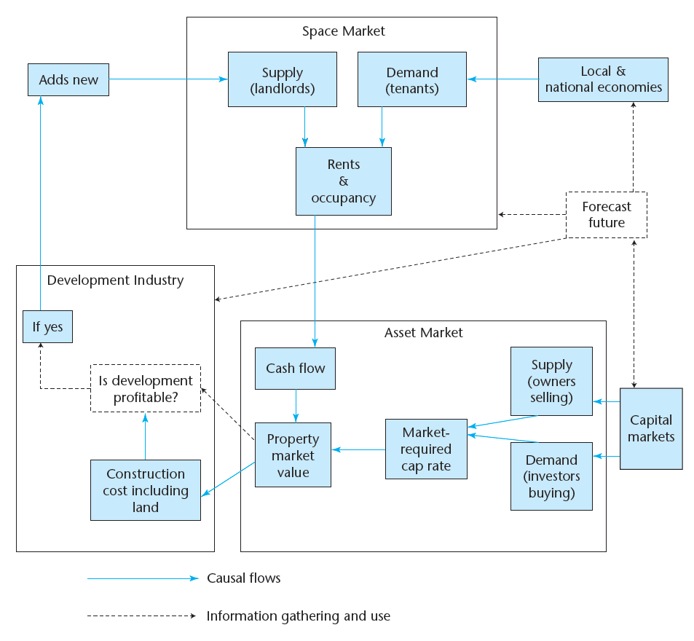
EXHIBIT 2-2 The Real Estate System: Interaction of the Space Market, Asset Market, and Development Industry

Slide 3
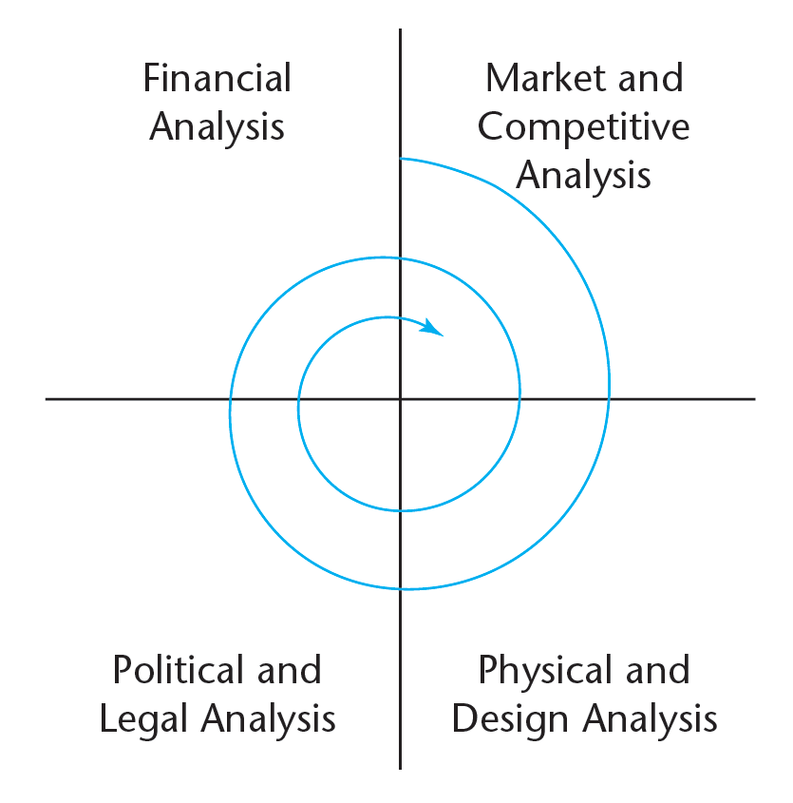
Development is important:
    From a finance & investment perspective, but also
    From an urban development (physical, social, environmental) perspective
Development is a multi-disciplinary, iterative process
EXHIBIT 28-1 Iterative, Multidisciplinary Process of Real Estate Development Decision Making (the Graaskamp Model)
Notes:
(Note the relationship to the basic MSRED core curriculum at MIT/CRE.)

Slide 4
Graaskamp also coined the concept that most development projects can be characterized as either:
        A use looking for a site, or
        A site looking for a use.
Use Looking for a Site:
      ➔ Developer has a particular specialization, or
      ➔ Developer is working for a specific user.
Site Looking for a Use:
      ➔ Developer tries to determine & build the “HBU”, or
      ➔ Public entity seeks developer to build a use determined through a political process (presumably also “HBU”).
Notes:
Either way (and as you iterate through the spiral), a basic task is… (next slide).

Slide 5
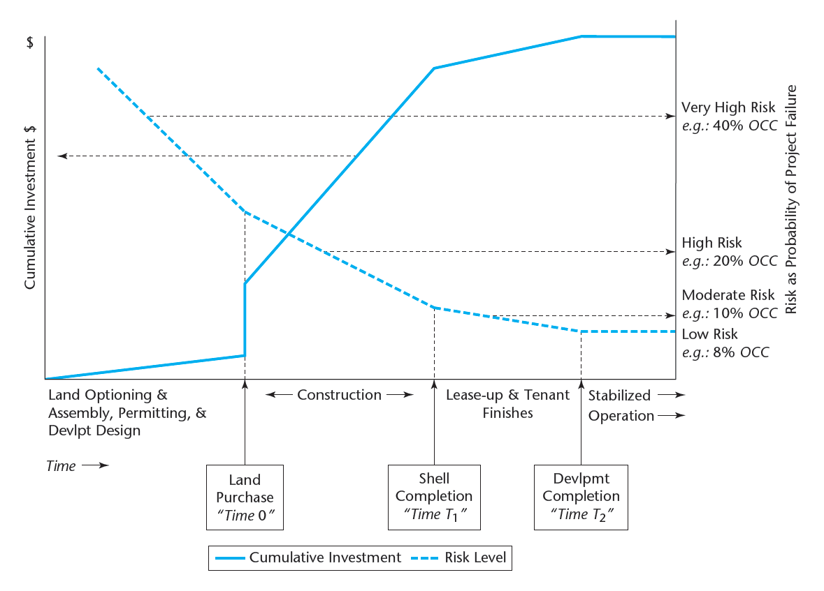
EXHIBIT 28-2 Development Project Phases: Typical Cumulative Capital Investment Profile and Investment Risk Regimes

Slide 6
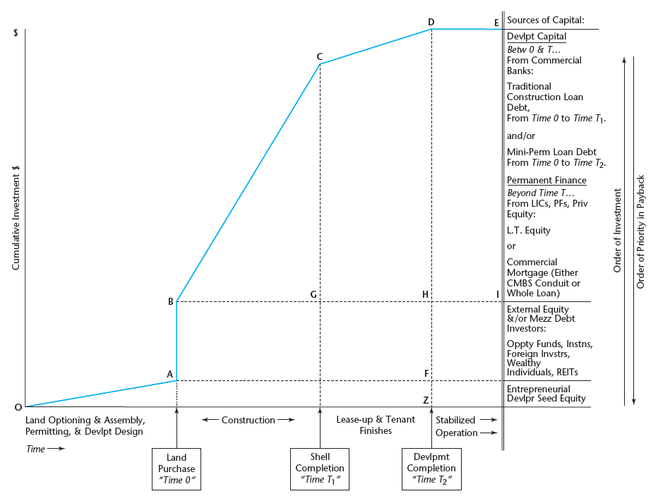
EXHIBIT 28-3 Development Project Typical Sources of Investment Capital

Slide 7
From Tod McGrath’s analysis of Massachusetts 40B projects

Slide 9
Their list of “primary risk factors”
  1. Entitlement Risk
    Risk of obtaining appropriate land entitlements, construction permits, and possibly zoning variances.
  2. Construction Risk
    Materials pricing – risk that the cost of materials may change significantly from the original construction budget.
    Scheduling – risk that planned construction completion could be prolonged due to weather delays, labor disputes, material delivery delays, etc.
  3. Leasing/Sales Risk
    Risk that forecasted absorption (leasing or unit sales) volume will not be realized.
    Risk that early termination clauses would be invoked or that the property becomes encumbered by a long-term lease with below-market rent escalation provisions (frequency and/or amount of increase).
    Risk of a market-driven restructure of leasing or sales commission rates.
  4. Operating Expense Risk
    Risk of a significant change in one or more fixed or variable expense categories such as insurance, electricity, real estate taxes, etc.
  5. Credit Risk
    Risk that pre-lease tenants and/or tenants’ industry segment is negatively impacted during development.

Slide 10
Continued . . .
  6. Partnership Risk (if applicable)
    Risk that accompanies any ownership less than 100% due to a myriad of factors regarding control, revenue distributions, etc.
  7. Capital Market Risk
    Interest Rates – risk of a significant change in interest rates during the development period. This could affect the cost of construction or, in the case of a condominium project, the buyer’s ability to obtain suitable purchase price financing.
    Alternative investment risk – risk that investor allocations or rates of return for alternative investments will change resulting in shifts in capitalization and discount rates.
  8. Pricing Risk
    Supply Risk – risk that unanticipated competitive supply will enter the market before lease-up or sellout is achieved resulting in short-, mid-, or long-term concessions, absorption, pricing, etc.
    Real Estate Cycle Issues – risk that rental rates may be negatively affected by changes in market supply/demand dynamics.
  9. Event Risk
    Risk of a material physical, economic, or other event occurring that significantly impacts asset operations and value. Weather, discovery of previously unknown environmental contamination, exodus of major employment providers, and terrorism comprise a sampling of such events.
  10. Valuation Risk
    Risk that a lack of applicable, current market data exists to accurately value the subject property.
    Risk that a lack of competency exists with the appraiser engaged to specifically address issues of property type, geography, valuation analytics, market research, etc.

Slide 11
28.2 Basic Information: Enumerating Project Costs & Benefits
Two types of project budgets are important to be developed:
    Construction & Absorption Budget:
        Covers construction (& lease-up, for “spec” projects);
        ⬅ Relates to the “COST” side of the NPV Equation.
    Operating Budget:
        Covers “stabilized” period of building operation after lease-up is complete;
        Typically developed for a single typical projected “stabilized year”;
        ⬅ Relates to the “BENEFIT” side of the NPV Equation.
NPV = Benefits – Costs = Value of Bldg – Cost of Devlpt.
Notes:
Thru here 1st class 15 minutes 2/11/03.

Slide 12
The Operating Budget (Recall the items from Chapter 11):
      Forecast Potential Gross Income (PGI, based on rent analysis)
      Less Vacancy Allowance
      = Effective Gross Income (EGI)
      Less forecast operating expenses (& capital reserve)
      = Net Operating Income (NOI)
The most important aspect is normally the rent analysis, which is based (more or less formally) on a market analysis of the space market which the building will serve. (See Chapter 6, or Wheaton’s 11.433 course.)
The bottom line:
NOI forecast, combined with cap rate analysis (of the asset market):
➔ NOI / cap rate = Projected Completed Building Value = “Benefit” of the development project.
Notes:
Note: Generally less need to perform a full-blown multi-year DCF analysis of the stabilized phase of a development project than for investment analysis of a pre-existing operational building (due to lack of “vintage leases” in development project).

Slide 13
The Construction & Absorption Budget:
Construction: “Hard Costs”
Land cost
Site preparation costs (e.g., excavation, utilities installation)
Shell costs of existing structure in rehab projects
Permits
Contractor fees
Construction management and overhead costs
Materials
Labor
Equipment rental
Tenant finish
Developer fees

Slide 14
The Construction & Absorption Budget (cont.):
Construction: “Soft Costs”
Loan fees
Construction loan interest
Legal fees
Soil testing
Environmental studies
Land planner fees
Architectural fees
Engineering fees
Marketing costs including advertisements
Leasing or sales commissions
Absorption Budget (if separate):
Marketing costs & advertising
Leasing expenses (commissions)
Tenant improvement expenditures (“build-outs”)
Working capital during lease-up (until break-even)
Notes:
Absorption budget phase may extend until projected stabilized occupancy level (beyond “break-even”), to point where building qualifies for a permanent mortgage that can be used to pay off the construction loan.

Slide 15
28.3 Construction Budget Mechanics
Construction takes time (typically several months to several years).
During this period, financial capital is being used to pay for the construction.
Time is money: The opportunity cost of this capital is part of the real cost of the construction.
This is true whether or not a construction loan is used to finance the construction process. But:
Construction loans are almost always used (even by equity investors who have plenty of cash).
Why?
Notes:
I don’t know the answer to this question. It might make a good thesis topic. Clearly, most investors want the added leverage. In some cases it would be difficult or complicated to obtain sufficient equity capital. But there seems to be more to it than that. The construction lender plays a useful role. Construction lenders (largely commercial banks) have specialized expertise and familiarity with local real estate markets, contractors and construction techniques. They provide a useful perspective and oversight role, a confirmation and assistance to the developer organization (especially useful if outside equity partners are also involved in the project). The use of a construction loan also tends to simplify the financial analysis of the project, by collapsing a series of temporally spread out construction cash outflows into a single number (the construction loan balance due) at a single point in time (the projected date of completion).

Slide 16
The “classical” construction finance structure:
Phase:
Construction
Lease-Up
Stabilized Operation…
C.O.
Financing:
Construction Loan
Bridge Loan
Permanent Mortgage
Source:
Commercial
Bank
Comm. Bank
Insur Co.
Via Mortg Brkr or Mortg Banker:
Life Insur. Co.
Pension Fund
Conduit ➔CMBS
Construction lender won’t approve construction loan until permanent lender has conditionally approved a “take-out” loan.
Notes:
Sometimes a “mini-perm” loan will cover both the construction and lease-up phase, usually provided by the construction lender.
It makes sense for commercial banks to supply construction loan capital, because: (i) They have local presence, enabling them to develop the type of local expertise needed to be successful (familiarity with real estate markets, developers, construction contractors); (ii) They have short-term liabilities (deposits), so they need to match these with short-term investments (which construction loans normally are). In contrast, Life insurance cos & pension funds have very long-term liabilities, which need to be matched by long-term assets that yield reliable cash flow streams.

Slide 17
The construction loan collapses a series of costs (cash outflows) incurred during the construction process into a single value as of a single (future) point in time (the projected completion date of the construction phase).
Actual construction expenditures (“draws” on the construction loan) are added to the accumulating balance due on the loan, and interest is charged and compounded (adding to the balance) on all funds drawn out from the loan commitment, from the time each draw is made.
Thus, interest compounds forward, and the borrower owes no payments until the loan is due at the end of construction, when all principle and interest is due.
Bottom line: Borrower (developer) faces no cash outflows for construction until the end of the process, when the entire cost is paid (including the “cost of capital”).
Notes:
This is the classical structure. Still widely used in many areas of the country. In recent years, however, some construction lenders have been requiring the interest on the loan to be paid concurrently, as the construction takes place. This requirement is more common on larger projects with longer construction times.

Slide 18
Example:
Commitment for $2,780,100 of “future advances” in a construction loan to cover $2,750,000 of actual construction costs over a three month period. 8% interest (nom.ann.), compounded monthly, beginning of month draws:
Construction schedule must estimate the amount and timing of the draws.
The accumulated interest (8333+8356+18411 = $30,100 in this case) is a very real part of the total cost of construction. AKA “Financing Cost”.
Typically a “commitment fee” is also required, up front (in cash).
Notes:
(.08/12)*500000 = 3333.33. Add that to draw to arrive at end-of-month balance of 503333.
(.08/12)*(750000 + 503333.33) = 8355.55. Add that to 750000 draw and to previous balance to arrive at bal at end of 2nd month of 1261688.88.
(.08/12)*(1500000 + 1261688.88) = 18411.26. Add that to 1500000 draw and to previous balance to arrive at bal at end of 3nd month of 2780100.14.
Obviously it is easy to set up a spreadsheet to do these calculations automatically.

Slide 19
28.4 Simple Financial Feasibility Analysis in Current Practice
A traditional widely employed method for the analysis of the financial feasibility of small development projects. Will be referred to here as: “Simple Financial Feasibility Analysis” (SFFA).
SFFA is based on the commercial mortgage market (for permanent loans).
It assumes the developer will take out the largest permanent loan possible upon completion of the building (ignores financing flexibility).
It assumes that the market value of the property on completion will just equal the development costs of the project (ignores NPV & wealth-maximization).
Obviously, SFFA leaves something to be desired from a normative perspective, but:
    It is simple and easy to understand.
    It requires no specialized knowledge of the capital markets other than familiarity with the commercial mortgage market (does not even require familiarity with the relevant property asset market).
NOT AN EVALUATION, ONLY A LIMITED TYPE OF “FEASIBILITY”, DOESN’T SAY WHETHER A GOOD INVESTMENT OR NOT.
SFFA comes in two modes: “Front Door”, & “Back Door” . . .

Slide 20
SFFA “Front Door” Procedure:
Start with costs & end with rent required for feasibility
Site Acquisition Costs
+ Construction Costs
= Total Expected Development Cost
× Loan to Value Ratio
= Permanent Mortgage
× Annualized Mortgage Constant
= Cash Required for Debt Service
× Lender Required Debt Service Coverage Ratio
= Required Net Operating Income or NOI
+ Estimated Operating Expenses (Not passed through to tenants)
= Required Effective Gross Income
÷ Expected Occupancy Rate
= Required Gross Revenue
÷ Leasable Square Feet
= Rent Required Per Square Foot
Question: Is this average required rent per square foot achievable?
Typical approach for “Site looking for a Use.”

Slide 21
Example:
Class B office building rehab project: 30,000 SF (of which 27,200 NRSF).
Acquisition cost = $660,000;
Rehab construction budget: $400,000 hard costs + $180,000 soft costs.
Estimated operating costs (to landlord) = $113,000/yr.
Projected stabilized occupancy = 95%.
Permanent loan available on completion @ 11.5% (20-yr amort) with 120% DSCR.
Estimated feasible rents on completion = $10/SF.
Site and shell costs: $ 660,000
+ Rehab costs: 580,000
= Total costs: $1,240,000
× Lender required LTV 80%
= Permanent mortgage amount: $ 992,000
× Annualized mortgage constant: 0.127972
= Cash required for debt svc: $ 126,948
× Lender required DCR: 1.20
= Required NOI: $ 152,338
+ Estd. Oper. Exp. (Landlord): 113,000
= Required EGI: $ 265,338
÷ Projected occupancy (1-vac): 0.95
= Required PGI: $ 279,303
÷ Rentable area: 27200 SF
= Required rent/SF: $10.27 /SF
What major issue is left out here?
Lender will base mortg on Mkt Val, not constr cost.
Use mkt cap rate info to est. bldg val.
Notes:
From Chapter 8 and 17 we have the monthly mortgage constant: (0.115/12)/[1 - 1/(1+0.115/12)^240]=0.010664. Times twelve is the annual constant: 0.010664*12=0.127972. On the business calculator: Set pmts/yr P/YR=12; 240➔N, 11.5➔i/yr, 1➔PV, 0➔FV; then compute (CPT) PMT=-0.010664.
To check whether the LTV requirement will allow support of this loan amount, divide required NOI (based on DCR as above) by projected mkt cap rate, to derive projected building value that would result from such NOI, and make sure that value is at least 1/0.8 times the loan amount shown here.

Slide 22
SFFA “Back Door” Procedure:
Start with rents & building, and end with supportable development costs
Total Leaseable Square Feet (based on the building efficiency ratio times the gross area)
× Expected Average Rent Per Square Foot
= Projected Potential Gross Income (PGI)
− Vacancy Allowance
= Expected Effective Gross Income
− Projected Operating Expenses
= Expected Net Operating Income
÷ Debt Service Coverage Ratio
÷ Annualized Mortgage Constant
÷ Maximum Loan to Value Ratio
= Maximum Supportable Total Project Costs
(Question: Can it be built for this including all costs?)
− Expected Construction Costs (Other than Site)
= Maximum Supportable Site Acquisition Cost
Question: Can the site be acquired for this or less?
Typical approach for “Use looking for a Site.”

Slide 23
Example:
Office building 35,000 SF (GLA), 29,750 SF (NRA) (85% “Efficiency Ratio”).
$12/SF (/yr) realistic rent (based on market analysis, pre-existing tenant wants space).
Assume 8% vacancy (typical in market, due to extra space not pre-leased).
Preliminary design construction cost budget (hard + soft) = $2,140,000.
Projected operating expenses (not passed through) = $63,000.
Permanent mortgage on completion available at 9% (20-yr amort), 120% DCR.
Site has been found for $500,000: Is it feasible?
Potential Gross Revenue = 29,750 × $12 = $ 357,000
− Vacancy at 8% = $ 28,560
= Effective Gross Income $ 328,440
− Operating Expenses $ 63,000
= Net Operating Income $ 265,000
÷ 1.20 = Required Debt Svc: $ 221,200
÷ 12 = Monthly debt svc: $ 18,433
➔ Supportable mortgage amount = $ 2,048,735
÷ 0.75 LTV = Min. Reqd. Value: $ 2,731,647
− Construction Cost $ 2,140,000
➔ Supportable site acquisition cost: $ 591,647
So, the project seems feasible.
But again, something seems left out… Project may be feasible, but…
Notes:
2048735 found on calculator using: 240=N, 9=I, 18433=PMT, 0=FV, ➔ CPT PV=2048735.
Will the property market indeed value the building at least at $2,731,647? What will be the market’s cap rate? To check whether the LTV requirement will allow support of this loan amount, divide required NOI (based on DCR as above) by projected mkt cap rate, to derive projected building value that would result from such NOI, and make sure that value is at least 1/0.75 times the loan amount shown here.

Slide 24
Problems with the SFFA:
Just because a project is financially feasible, does not necessarily mean that it is desirable.
Just because a project is not feasible using debt financing, does not necessarily mean that it is undesirable:
    A project may appear unfeasible with debt financing, yet it might be a desirable project from a total return to investment perspective (and might obtain equity financing).
Don’t confuse an SFFA feasibility analysis with a normatively correct assessment of the desirability of a development project from a financial economic investment perspective.
SFFA does not compute the value of the completed property.
Hence, does not compute the NPV of the development investment decision:
NPV = Value – Cost
SFFA merely computes whether it is possible to take out a permanent loan to finance (most of) the development costs.

Slide 25
The correct way to evaluate the financial economic desirability of a development project investment:
(Recall Chapter 10.)
“THE NPV INVESTMENT DECISION RULE”:
1) MAXIMIZE THE NPV ACROSS ALL MUTUALLY-EXCLUSIVE ALTERNATIVES; AND
2) NEVER CHOOSE AN ALTERNATIVE THAT HAS: NPV < 0.
For development investments:
NPV = Benefit – Cost = Value of Bldg – Cost of Devlpt.
Notes:
The NPV based approach is more consistent with fundamental economic theory, with what is taught at the MBA level in business schools, and with the mainstream practice in corporate finance and investments. It is not yet widespread in real estate practice, but becoming more so as real estate development investment becomes increasingly sophisticated and dominated by large publicly traded firms and institutional investors.

Slide 26
The Design Structure Matrix (DSM) Tool for Studying the Development Process…
EXHIBIT 28-2 Development Project Phases: Typical Cumulative Capital Investment Profile and Investment Risk Regimes

Slide 27
Using the Design Structure Matrix to Improve Real Estate Development Process and Organization
aka:
“Dependency Structure Method”
“Dependency Structure Matrix”
“DSM”
DSM is a method to model information flows and activity interactions in complex systems or processes.
Originated by Donald Steward (1981: “System Analysis & Management”).
Refined and popularized 1990s by Prof Steve Eppinger et al at MIT.
Commercial software applications (e.g., PlanWeaver by BIW).
DSM has been successfully applied in manufacturing product design & development, innovation (e.g., automotive, software, pharma, aerospace).
It has been applied to construction project management, but until Bulloch-Sullivan 2009 MSRED thesis never to real estate development as a whole.
After all: RED is the innovation & development of new products (buildings, infrastructure) through a complex process in which information flows and learning (iteration) are crucial.

Slide 28
What is the “DSM”…
An “N-square” matrix representing N units arrayed identically in rows & columns of a matrix…
Here 2 X 2:
 | A | B
A
B
A & B are tasks or activities or groups…
DSM as an information exchange model…
Applies to “architecture” (structure of interactions or information flows) within:
  Product or System:
    “parts” or “elements” are units of product structure;
  Process:
    “phases” or “tasks” or “activities” are units of process structure;
  Organization:
    “offices” (or “divisions” or “groups”, etc…) are units of organization structure.

Slide 29
What is the “DSM”…
You may be used to seeing this “architecture” (or “structure”) represented graphically in a diagram.
But it can be equally well represented in an N-square matrix, and this facilitates analysis & exposition…
Three Configurations that Characterize Info Flows in a Process or Organization: e.g.: Two tasks or sub-processes or organizational units: A and B…
Relationship | Parallel (Independent) | Sequential (Dependent) | Coupled (Interdependent)
Graph Representation (use position of blocks & arrows to indicate interactions)
DSM Representation (use “X”s in matrix to indicate interactions)
A
A
A
B
B
B
 | A | B
A
B
 | A | B
A
B | X
 | A | B
A |  | X
B | X

Slide 30
INDEPENDENT /
PARALLEL
DEPENDENT /
SEQUENTIAL
INTER-DEPENDENT /
COUPLED
FLOW CHART REPRESENTATION
A
A
A
B
B
B
MATRIX (I/O TABLE) REPRESENTATION
 | A | B
A
B
 | A | B
A
B | X
 | A | B
A |  | X
B | X

