Slide 1
Chapter 24
International Real Estate Investments: Markets, Strategies and Implementation

Slide 2
Structure of Chapter 24
24.1 There’s a Big World Out There
24.2 Going International: Rationales and Obstacles
24.3 Developing and Implementing International Real Estate Strategies
24.4 Chapter Summary

Slide 3
Learning Objectives
Rationales of international real estate investment
Obstacles and disadvantages associated with international real estate investment
Considerations driving international institutional real estate portfolios
Institutions enabling successful international real estate investment
International real estate portfolio management strategies

Slide 4
24.1 There’s a big world out there
24.1.1 The global RE capital market: size and flows
Estimates of international real estate capital market size and flows
Important global developments in securitization
24.1.2 The institutions of globalization
The international RE system
Institutions of International Transparency

Slide 5
24.1.1 The global real estate capital market: size and flows
Real estate investments have traditionally been very local, but the international real estate capital market is well-developed
Estimates of international real estate capital market
The estimated global institutional market in 2004 was US$ 7.7 trillion
European and Asia-Pacific markets are big and growing (see charts)
Especially Asian market is small compared to its potential
Markets very small relative to population and expected GDP growth

Slide 6
Size and composition of the European real estate market
The capital composition of Europe’s invested stock has been stable.
Public capital sources are far less important than in U.S.
Source: DTZ Research

Slide 7
Size and composition of the Asia-Pacific real estate market
Continuous growth in invested capital stock in real estate
Public capital sources even less developed than in Europe
Source: DTZ Research

Slide 8
24.1.2 The institutions of globalization: the global market is increasingly transparent
Relevant property market knowledge remains largely local in nature
Industry associations and for-profit firms (research consultants, data providers, property brokers) increasingly supply local data, of ever-improving quality
This development mainly holds for mature markets, with comparable returns
For many interesting emerging markets, transparency remains a problem
JLL transparency indicator reports generally increasing transparency, but the crisis has dented this upward trend.

Slide 9
International real estate system becomes more and more public: global property share market at pre-crisis level
Source: GPR

Slide 10
Structure of Chapter 24
24.1 There’s a Big World Out There
24.2 Going International: Rationales and Obstacles
24.3 Developing and Implementing International Real Estate Strategies
24.4 Chapter Summary

Slide 11
24.2 Section introduction: Is international property investment a good idea?
Yes, let’s go international
There may be good investment opportunities outside of the home country, especially if the home country has a well-developed property market: for opportunistic investors, the good times have passed.
It provides diversification benefits because markets move out of sync
Export your superior portfolio management and/or development expertise to other markets, and use your global client network
No, better stick to one country
International investment entails information costs: what do you really know about foreign markets; will you have access to the best deals?
How about transaction costs?
Additional risks:
Political risk
Economic risk
Currency risk

Slide 12
24.2.1 A first rationale for going international: return opportunities
Return opportunities abroad
Can be of a structural nature …
Economic development
Demographics
… or of a cyclical nature
Home country may be at or over top of cycle, so invest in countries where cycle phase is more favorable
However, …. is timing really possible, especially in far-away markets?
And how about transaction costs?

Slide 13
Structural return opportunities abroad: economic development
Economic growth is not evenly spread across the globe, and the differences are partly of a structural nature
As economic growth in mature markets (US, ‘old’ Europe, Japan) is weak, so is growth in property demand
Euro-area GDP growth since 1995: less than 0.5%
United States GDP growth since 1995: 2.4%
Emerging markets (in Asia, ‘new’ Europe, Americas) have much higher economic growth and comparable demand for real estate
China: 9% in last two decades
India: 8% in last decade
Central Europe: average of 3% since 1999
Brazil: 3% since 1999

Slide 14
Economic growth goes hand in hand with a growing need for property
Emerging economies need new and better housing, and they can afford it
(Urban) housing to accommodate rapid urbanization,
Ever higher-quality housing to accommodate wealthier demand
These economies need office and industrial properties to accommodate the workers
Employment is created in industry and (subsequently) in services
Workers migrate from agriculture to industry and (later) to services
These societies are getting the spending patterns of the West
Need shopping centers
Leisure projects

Slide 15
These property needs translate into large structural capital needs
Mature markets have mature capital markets, with lots of institutional investors and a structural oversupply of capital
Nothing new about that: in 18th century, the Dutch financed the American economy
But since the global crisis, capital seems to flow from emerging economies to mature markets (mirroring their current account surplus)
At some point, these capital flows will be again from mature markets to economically emerging markets

Slide 16
Structural return opportunities abroad: demographics
The demographic tide differs strongly across countries
Population is some countries keeps on growing, while it is already shrinking in others
It also differs greatly by property type
Demand for office space depends on working population
Demand for retail space depends on total population, population composition, and purchasing power
Demand for housing depends on household formation

Slide 17
Demographic changes and the office property markets
Demand for office space is driven by employment …
… but only if there are people to take the jobs
State-of-the-art predictive models of office markets assume all employment growth leads to occupied jobs, and occupied jobs need workspace
If employment growth is not matched by growth in labor population, labor force growth becomes driver of demand for office space
What will future office demand look like?
How will that affect the office markets?

Slide 18
Take a look at the literature regarding demographic effects on the property markets
Mankiw and Weil (1989)
House prices will fall when baby boom ends
Hendershott (1991), Dipasquale and Wheaton (1994), Engelhardt and Poterba (1991), Holland (1991), market since 1989
The Mankiw and Weil critique: supply may react adequately
But in United States demand growth is only slowing down, not getting negative
State-of-the-art predictive models of office markets assume all employment growth leads to occupied jobs, and occupied jobs need workspace
If employment growth is not matched by growth in labor population, labor force growth becomes driver of demand for office space
But this problem is too big to ignore
Can supply react adequately if demand growth is negative?

Slide 19
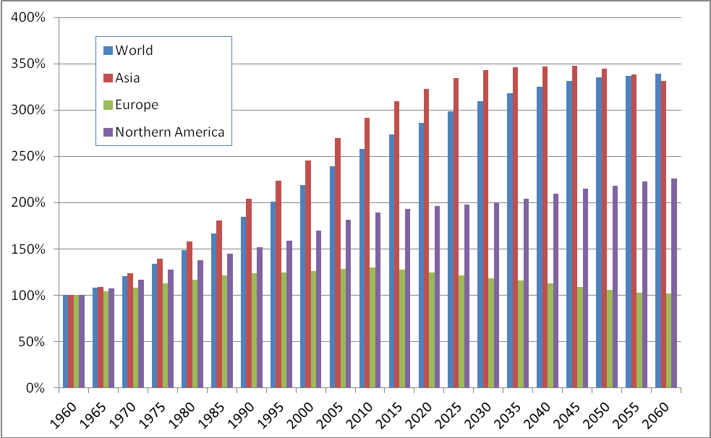
Population aged 18-65, 1960-2060 No more growth in Europe, but America and Far East zoom on
Source: United Nations

Slide 20
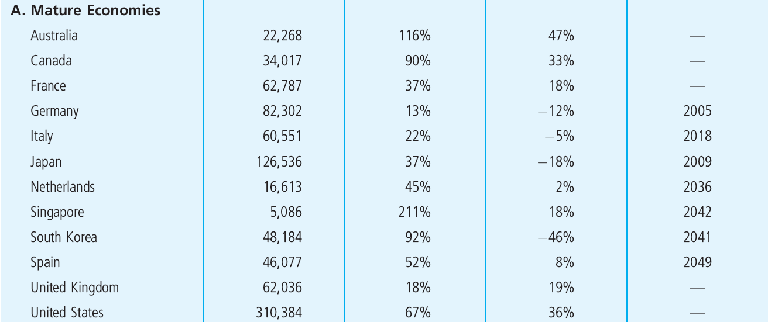
Population aged 18-65, 1960-2060 Is shrinking in some countries and grows less in others
Source: United Nations World Population Prospects Database.

Slide 21
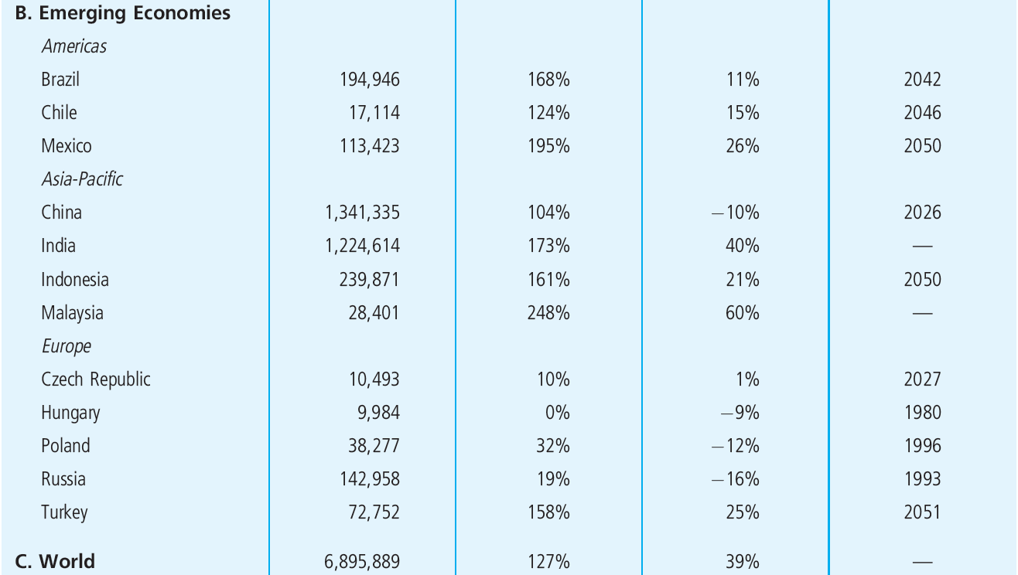
Population aged 18-65, 1960-2060 Emerging countries also show mixed demographic picture
Source: United Nations World Population Prospects Database.

Slide 22
Female economic participation level is near limit in mature economies and shows harmonization at 45%-46%

Slide 23
So will a gloomy future for the (European) office markets be inevitable?
The labor force in services may grow
EU enlargement will cause immigration
Later retirement and net inflow from disabled and unemployed
More women
Migration within countries makes picture more complicated
Attractive cities and regions will attract labor force; more competition between cities and locations
Even if all this will happen, office demand will grow less
Either new supply will have to slow down, or prices will fall
Change surely felt by developers; probably by investors

Slide 24
Demographic changes and the retail property market
Macro-demand for retail space is driven by number of people and their purchasing power
Number of people and age composition determines quantity
Purchasing power determines quantity and quality
Net new space only needed if these variables grow, otherwise only replacement
Type and location of needed retail space, and success of retail formats partly driven by composition of population

Slide 25
European population, 1950-2050 Population is already shrinking

Slide 26
Expected growth in wealth and population maintain attractiveness of retail in next decade How certain are these developments?
How about migration?
Population growth may be boosted by EU enlargement and migration flows Eastern Europe
Probably most relevant for the larger EU countries …
… but these people do not yet have a lot of purchasing power
Strong regional differences, so inter-country migration also very relevant for retail property
Other intrusions in the demographic picture
Fertility rate may pick up and mortality rate may go down
Will the economic climate be favorable?
Yes, projections of real growth based on extrapolation 1974 suggest lots of growth is possible

Slide 27
Demographic changes and the housing markets
Demand for housing units is driven by income development and interest rate, but ultimately by household formation
Household formation determines quantitative demand
Income and interest rate determine qualitative demand
End of baby boom has led US researchers to predict deep bust on housing market
Subsequent research and market developments have shown that housing supply has adequately adjusted for lower growth in demand …
… but research concerns United States, where number of households keeps growing stronger than in Europe and many other regions

Slide 28
Number of households in Europe, 1950-2050 Falling from 2015 onwards; less than 10 mln to go before that
millions
Source: Brounen and Eichholtz, 2004

Slide 29
European housing demand will grow for another decade, but regional differences are large Are these development inevitable?
Again, migration may change the picture
EU enlargement, Eastern Europe and Mediterranean migration flows could mean new structural demand for (cheap) housing
Inter country migration will still be very important
Exceptions
Turkey not only has growing population, but also shrinking family size
More demand for housing in urban areas, less in rural ones
If housing will be replacement market instead of growth market:
supply should adjust, or prices will go down
develop for more wealthy demand (incomes keep rising)
prepare for more competition; quality is key

Slide 30
Summing up the demographic developments
Property markets in many countries are turning into replacement markets
Good quality will drive out bad quality
Competition between regions will increase
Supply will have to adjust to avert prices falling
Fundamental uncertainty in these property markets is increasing
Market effects first felt in development and construction market

Slide 31
Consequences for international property investment
Different property types are exposed to different aspects of the demographic tide
Demographic changes will first affect office market, then retail and housing markets
Europe and Japan are ahead on the demographic curve
Emerging economies in Europe are very mature demographically
Immigration-based countries will follow (much) later
So investors from demographically mature markets make and should make strategic allocations abroad, especially to demographically immature markets

Slide 32
Cyclical return opportunities abroad
They really exist
Real estate markets move in non-synchronous ways
Look at DTZ, JLL, CBRE overview of property cycles
At any moment in time, for any property type, a global snapshot of local markets shows that there is a market in any phase of the cycle
International real estate investment enables timing approach without the need to go into cash
If all property market segments in home country are expected to do poorly, a local market timer has to go into cash
There will always be other countries in which expectations are more favorable, and they can be investment target

Slide 33
Cyclical return opportunities abroad: yes, but
To put these cyclical movements into practical investment policies, they need to be predictable
Are they? Key and Marcato (2005) suggest they are, but this is research for one country, without international dimension
Property is illiquid and trading is expensive
Markets move in cycles, but is international timing possible?
Success of opportunistic property funds would suggest it: they grow and are very popular
Can somebody from far away truly predict a market? Why would a local player who can really predict the market share that information with you?

Slide 34
24.2.2 A second rationale for going International: diversification
Intuition, logical reasoning and a short look at the fundamentals
Theoretical underpinnings
Global efficient frontier versus national frontier
Downward shift of market risk
The International CAPM
What does the empirical evidence say about this?
The case for international diversification reconsidered

Slide 35
Is international diversification a good idea for property investors?
International differences in market performance (economic, demographic, property) may be non-predictable, but you can still use them through diversification
Intuition and straight economic reasoning would suggest this is a good idea
Diversification is creating exposure to different aspects of the economy
Economies differ across countries
Timing of business cycles out of sync
Countries have different economic bases (concept of regional economic base on an international level)
Property markets driven by local factors en local economies
Demand is local employment, consumer spending and housing demand
Demand is local demographics ( we just saw how they differ)
Cash flows and their volatility are driven by local market institutions (rental contracts, zoning rules, etcetera)
Supply partly driven by local circumstances, like capital availability

Slide 36
Big international differences in rental contracts provide diversification benefits through different cash flow streams and risk exposures
Source: NAIdirect.com

Slide 37
Business cycles are non-synchronous
International correlations in GDP growth are low
Panel A: Correlation Matrix Real GDP % Change
 | Argentina | Australia | Brazil | India | Turkey | Indonesia | China | Eurozone | Japan
Australia | -0,28
Brazil | 0,33 | 0,23
India | 0,13 | 0,24 | 0,09
Turkey | 0,29 | -0,01 | 0,22 | 0,10
Indonesia | 0,05 | -0,34 | 0,18 | -0,06 | 0,19
China | 0,55 | 0,23 | 0,45 | 0,22 | 0,14 | 0,11
Eurozone | -0,09 | 0,20 | 0,07 | -0,11 | 0,27 | 0,01 | -0,10
Japan | -0,05 | 0,12 | 0,10 | -0,07 | 0,41 | 0,43 | -0,04 | 0,74
US | -0,02 | 0,62 | 0,17 | 0,02 | 0,32 | -0,20 | 0,10 | 0,70 | 0,53

Slide 38
Theoretical underpinning: Global efficient frontier dominates national frontier through greater investment universe

Slide 39
Theoretical underpinning: Downward shift of market risk through increased universe of assets

Slide 40
Theoretical underpinning: The International Asset Pricing Model (IAPM)
Theoretical difference between country and the world is in currency effects
Under certain assumptions …
PPP holds, international similarity in consumption baskets
… will IAPM derive similar portfolio advice to single-country CAPM
Investors should hold portfolio of risk-free bonds in own currency combined with world market portfolio
Global beta is single systematic risk measure
But IAPM does not explain international returns differences very well, so model should be extended to include more risk measures

Slide 41
The evidence regarding international diversification: Mostly supportive
Supporting
Not Supporting or Qualified Support
Eichholtz (1996)
Eicholtz (1997) & Eichholtz, Huisman, Koedijk, Schuin (1998)
Conover, Friday & Sirmans (2002)
Hoesli, Lekander, & Witkiewicz (2003)
De Wit (2010)
Kroencke & Shindler (2012)
Literature Review: Sirmans and Worzala (2003)
Liu and Mei (1998)
Goetzmann and Wachter (2002)
Ling and Naranjo (2002)
Stevenson (2000) found that international RE stocks did not enhance a portfolio’s return or risk attributes.
Yunus (2009) finds increasing integration

Slide 42
The case for international diversification reconsidered
Diversification effect depends on correlations between international RE markets
How stable are these correlations?
Not stable at all, move over even short horizons
Structural shifts in correlation patterns
Globalization, international capital market integration lead to upward shift in correlations
Continental factors increase correlations, but only within economic blocks
Is the low correlation there when you need it?
International correlations tend to shift upward in times of crisis
This holds also for real estate but less than for stocks and bonds

Slide 43
24.2.3 A third rationale for going international: managerial considerations
Exporting know-how
Decades of experience in institutional property portfolio management and development may be used profitably in markets where such expertise seems to be lacking
Central and Eastern Europe?
Emerging markets?
But how valuable is general know-how in property investment?
Listed property companies trade at discounts to Net Asset Value (NAV) for long periods, so consistent management premium is doubtful
Know-how is probably more valuable in development
Pure development companies are traded at value of current portfolio (small) plus present value of development profits (big). This suggests consistent management premium, but even that is doubtful. Recent research suggests that only land contracts have value in development

Slide 44
Other managerial considerations: servicing international clients
Corporate real estate users are becoming global …
Coca Cola, Nestle, BP, Unilever, etcetera
… and so are their servicers
Banks, law firms, accountancy firms, consultants
The providers of space are among those servicers.
Do they have to become global, too?
Only when corporations prefer centralized purchasing of space,
Only in sectors where corporations are indeed globalizing
Probably depends on property type
Logistics: yes on both counts
Retail: increasingly so, but truly global chains do not yet exist
Offices: global clients exist, but do not seem to centralize space decisions
Residential: no on both counts

Slide 45
24.2.4 Obstacles to international property investment
Costs
Transaction costs are often higher abroad
Information costs are high and a fundamental obstacle to far-away investors
Liquidity
Difficult to get into booming market at good prices
Difficult to get rid of property when markets turn bad
Risks
Currency risk
Economic risk
Political risk
Regulation
Foreign ownership constraints, especially for real estate
Barriers to repatriation of foreign-earned returns

Slide 46
Costs: Transaction costs vary strongly across countries, and are usually higher than in the United States, especially the property transfer tax
Source: NAI Global

Slide 47
Costs: Information costs are important in private markets
Two studies with international evidence: Eichholtz, Schweitzer, Koedijk (2001), Eichholtz, Gugler, Kok (2011)
Property market is not efficient
Possible to beat the market consistently
Possible to be beaten by the market consistently
Who beats whom?
The local property investors are the insiders
The international property investors are outsiders
This should be reflected in performance

Slide 48
Measuring pure information costs: Split allocation effect from information effect
Procedure in 5 steps
Look at country allocation for each international property company for every year
Construct mimicking portfolio of domestic property companies with same country allocation as international company
Calculate return index for each mimicking portfolio
Aggregate mimicking indices for each individual company into one overall index
Compare performance overall mimicking index with performance index internationals

Slide 49
Information costs are important …
Source: Eichholtz, Koedijk and Schweitzer (2001)

Slide 50
Political Risks
Bigger for real estate than for any other asset (maybe except art), and especially for foreign investors
Real estate and land is part of the national heritage
Government involvement (zoning, tenant protection) big and structural
Foreign investors are more vulnerable:
Weak political clout, especially without local coalition partners (if few jobs are at stake, for example)
Weaker connections at city hall
Unfair laws and corruption
Low liquidity of directly held RE assets makes expected political risk hard to escape

Slide 51
Regulation
There may be impediments to foreign asset ownership. If present, they usually are in place for real estate, and especially for housing and land
Switzerland is classical example
Former central/eastern Europe
China
There may be impediments to repatriation of profits. More important for foreign direct investments, including direct real estate
These issues are gradually getting less important, especially within trading blocks

Slide 52
Structure of Chapter 24
24.1 There’s a Big World Out There
24.2 Going International: Rationales and Obstacles
24.3 Developing and Implementing International Real Estate Strategies
24.4 Chapter Summary

Slide 53
How to do it?
Given obstacles to international investment, how can an investor get a satisfactory performance?
A successful international property strategy takes advantage of the benefits, while avoiding the (most important) obstacles
Look at obstacles: which are more cumbersome for international players than for domestic ones?
Information costs
Political risk
So how do you manage these issues?

Slide 54
Implementation of an international RE strategy
Towards a global REIT market
Determining country allocation
Peer group benchmarking: what have the top performers in international real estate investment done?
Currency hedging: do’s and don’ts

Slide 55
Towards a global REIT market
Listed property companies enable uninformed investors to make well-informed foreign property bets
Public markets are more or less fairly priced, so buying listed property shares in Hong Kong, Australia, France or the United States can be done by uninformed investors
Tax-exempt structures are now getting commonplace across the world. Slightly more than half of the property company universe is tax-transparent – 2004 (Op ‘t Veld 2005)
Most of these companies (a steady 90%) only invest in their own country, so are more or less local specialists

Slide 56
How can the global REIT market help the global property investor? A look at the obstacles to international RE investment
Costs
Transaction for property shares are low, and getting lower.
Property share market is more or less informationally efficient, so information costs are low or non-existent
Monitoring costs and impediments: monitoring a foreign property share portfolio is easy, and you can free-ride on the local co-shareholders
Liquidity
Is better than direct property holdings, comparable to comparable shares and generally going up.
No discrimination going in or out
Risks
Currency risk
Economic risk: as big as for direct investments, but more liquidity
Political risk: as big as for direct investments, but more liquidity
Regulation
Foreign ownership constraints usually smaller for stocks than for real estate
Barriers to repatriation of foreign-earned returns usually small for stocks

Slide 57
Determining country allocation
Modern portfolio theory
Lots of practical problems, period-specific outcomes and corner solutions (put everything in market that happens to do well in sample period)
Using international index weights
Stable allocation, but liable to ‘information coincidence’: Australia happens to have highly securitized property market and is therefore over-weighted in global portfolio
Index weights with GDP adjustments
Stable allocation, closer to ‘true’ global property market weights

Slide 58
The “home market” concept
If direct property markets are inefficient, an investor should concentrate on market(s) in which he has an information advantage: the home market(s)
Can be defined regionally or in terms of property type
Industrial properties in Northern Europe
Regional malls in North America
Offices in East Asia
Yes, but how about diversification?

Slide 59
Intermediate investors and end investors
Intermediate investors (property companies)
Shareholders can diversify, so diversification does not add value
Go for outperformance
Focus on the home martket
End investors (pension funds, family trusts, private persons)
Find optimum on trade-off between diversification and outperformance
Try to get critical mass in home markets, and use listed property shares in all other markets
Or concentrate property holdings only in home markets and invest in common stocks and bonds in all other markets

Slide 60
Structure of Chapter 24
24.1 There’s a Big World Out There
24.2 Going International: Rationales and Obstacles
24.3 Developing and Implementing International Real Estate Strategies
24.4 Chapter Summary

Slide 61
24.4 Chapter Summary
Return opportunities, diversification and managerial considerations provide strong arguments to invest internationally in real estate
But look out for political risks, illiquidity and especially information costs
Avoid these obstacles by concentrating private real estate holdings on home markets, while using global (property) share market anywhere else

