Slide 1
Chapter 22
Equilibrium Asset Pricing

Slide 2
22.1.1 Practical Uses for Asset Price Theory
Help investors understand what are reasonable ex ante returns on investments in different asset classes or types of investment products. (Quantify the OCC – Oppty Cost of Capital or “hurdle rate”.)
Help identify specific types of assets or investment products (or “sectors” of the asset market) that are currently mispriced relative to long-run equilibrium.
Control for risk when evaluating portfolio returns or investment performance.
Asset models do two things:
    Identify “risk” as it matters in the capital markets, and;
    Quantify the market’s metric for such risk (as it matters in asset pricing).

Slide 3
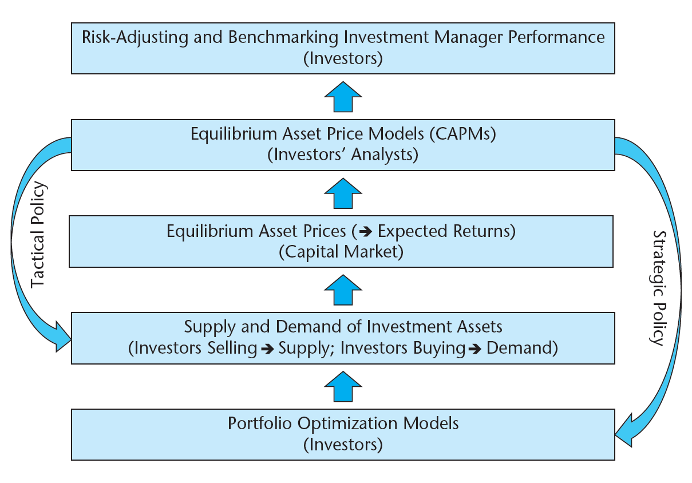
The relationship between equilibrium asset price models and investment policy…

Slide 4
The relationship between equilibrium asset price models and investment policy…
Tactical:
  Identify mis-priced assets (or classes or types of assets), by comparing model-predicted equilibrium expected returns with current realistic expected returns (at current prices).
Strategic:
  Identify “risk factors” (determinants of premia in long-run average returns) priced by the market (in equilibrium return expectations) that you don’t care about (➔ “bargain” for you, so over-weight in portf).
  Help form realistic long-run expectations for use in MPT or other portfolio allocation models).
Benchmarking:
  Adjust realized ex-post returns to account for risk the way the market prices risk (ex ante).
  ➔ More complete or fair assessment of ex post investment performance. (Don’t confuse taking on more risk for “beating the market.”)

Slide 5
Numerical example of tactical use of equilibrium asset price modeling…
Notes:
Obviously the $10 payments are risky.
(Through here 3rd day 3/04/03.)

Slide 6
22.1.2 A Threshold Point: What Underlies Asset Risk?
Source: Geltner and Mei (1995).
Most of the volatility in asset prices does not derive from rational changes in future cash flow expectations
Notes:
Heavy black line is very similar to actual history of real estate market values during this historical period.

Slide 7
22.2.1

Slide 8
Recall: The “2-Fund Theorem” (from Portfolio Theory) says that IF there exists a riskless asset, THEN the optimal (or “efficient”) portfolio of RISKY assets will be the SAME no matter what is the investor’s target return, and it will be the portfolio that maximizes its Sharpe Ratio.

Slide 9
Alternative perspective (equivalent result):
Asset prices in the capital market will be determined by the “representative investor”, defined as the value-weighted average investor, i.e., the aggregate of all investors, i.e., the investor who holds the capital market as a whole (the “Market Portfolio”, or more specifically the “National Wealth Portfolio” - NWP, or a pro rata share of it).

Slide 10
Recall that variance of the portfolio (P) is:
So, the component of that portf variance attributable to a unit-weight’s worth of any given one Asset Class i is:
≡ Covariance of i with P.
Notes:
Another way of looking at this is that the market represents the “average” investor (or the most “representative” investor, the one who stands for the market as a whole). The risk that matters to this average or representative investor in considering any specific asset is only that asset’s covariance with the rest of this investor’s portfolio, namely, the covariance with the market. This covariance equals that asset’s contribution to the risk of the investor’s overall wealth portfolio.
Let COV(i,M) = covariance betw asset i’s return and the market return; VAR(M) = the market return’s variance. Then, for the average or representative investor, VAR(M) is the risk in his/her wealth portfolio, and COV(i,M) is the effective risk in Asset i (as this asset would contribute to the risk in the average investor’s wealth portfolio). If (ErM-rf) is the market risk premium that effectively compensates the average (marginal) investor for the amount of risk in their wealth, then [COV(i,M)/VAR(M)](ErM-rf) should be the required risk premium for Asset i so that it provides the same risk premium per unit of effective risk as the rest of the investor’s wealth portfolio. (Otherwise, we are not in equilibrium: the investor would want to either purchase more of Asset i if it provided greater expected return per unit of risk (necessitating a sale of the rest of the market portfolio), or else he/she would want to sell Asset i short or get rid of it from their wealth portfolio, in contrast to the current equilibrium reality in which Asset i finds itself in the wealth portfolio of Mr/Mrs Average.) Note that [COV(i,M)/VAR(M)] is the definition of “beta”.

Slide 11
BETA = Asset i’s covariance with market (marginal unit contribution to mkt portf’s variance), divided by market’s variance (market portf’s risk)
= Asset i’s risk (that matters to investors) as a fraction of the market portfolio’s (all investors’ wealth’s) risk (that matters to investors).
Mulitply it times the mkt portf’s risk premium (market “price of risk” – what mkt requires in extra return expectation over riskless investment, per “unit” of risk defined as the amt of risk in the mkt portf), to get the risk premium (RP) that Asset i must provide ex ante.
Notes:
Let COV(i,M) = covariance betw asset i’s return and the market return; VAR(M) = the market return’s variance. Then, for the average or representative investor, VAR(M) is the risk in his/her wealth portfolio, and COV(i,M) is the effective risk in Asset i (as this asset would contribute to the risk in the average investor’s wealth portfolio). If (ErM-rf) is the market risk premium, that effectively compensates the average (marginal) investor for the amount of risk in their wealth, then [COV(i,M)/VAR(M)](ErM-rf) should be the required risk premium for Asset i so that it provides the same risk premium per unit of effective risk as the rest of the investor’s wealth portfolio. (Otherwise, we are not in equilibrium: the investor would want to either purchase more of Asset i if it provided greater expected return per unit of risk (necessitating a sale of the rest of the market portfolio), or else he/she would want to sell Asset i short or get rid of it from their wealth portfolio, in contrast to the current equilibrium reality in which Asset i finds itself in the wealth portfolio of Mr/Mrs Average.) Note that [COV(i,M)/VAR(M)] is the definition of “beta”.

Slide 12
THE MARGINAL CONTRIBUTION OF ASSET i to RISK OF PORTFOLIO P IS:
(weights sum to 1)
THE REPRESENTATIVE INVESTOR’S PORTFOLIO IS THE MARKET, SO THE CONTRIBUTION OF ASSET i TO THE REPRESENTATIVE INVESTOR’S PORTFOLIO IS COVARIANCE OF i WITH MKT:
AND REPRESENTATIVE INVESTOR DETERMINES THE PRICING OF ALL ASSETS IN THE MKT. SAME APPLIES TO THE MKT PORTFOLIO ITSELF:
THE RISK IN THE MKT AS A WHOLE IS ITS VARIANCE, VAR_{M} .
THUS, THE RISK IN ANY ASSET i AS A PROPORTION OF THE MARKET’S RISK IS:
THE PRICE OF THE MARKET’S RISK IS ITS RISK PREMIUM:
THE RISK PREMIUM OF ALL ASSETS (INCLUDING THE MKT) MUST BE PROPORTIONAL TO THEIR RISK (“LAW OF ONE PRICE”, “LINEAR PRICING”). THUS, THE RISK PREMIUM FOR ASSET i MUST BE:

Slide 13
22.2.2
Summary picture of the CAPM…
Exh.22-3: The “Security Market Line” (SML):
Graphical summary of the CAPM…
E[r]
Expected return of Portfolio i
r
f
β
Beta of Portfolio i
22.2.2 The Main Point in the Basic CAPM:
Risk in underlying assets that can be diversified away in large portfolios will not be priced in the capital market (no E[r] premium for it). Non-diversifiable risk in underlying assets will be priced, hence, will provide return premium in LR.

Slide 15
22.2.4 Strengths and Weaknesses in the Basic CAPM
Strengths:
  Useful as normative (what should be) prescription (it makes sense).
  As positive (what is) description the classical (original) single-factor CAPM has some value (especially at broad-brush level, as we’ll see later).
  Provides basic and elegant intuition that may at least partly explain why more complex models work better (e.g., maybe “Fama-French factors” proxy for types of systematic risk not quantified by traditional market beta).
Weaknesses:
  Without “enhancements” (e.g., Fama-French factors), the basic single-factor CAPM is a pretty incomplete model of the expected returns of specific portfolios within an asset class.

Slide 16
Section 22.3
Applying the CAPM at the Asset Class Level
The basic single-factor CAPM does a pretty decent job of explaining the expected return to the real estate asset class as a whole, provided you:
  Correct the real estate returns for appraisal smoothing and lagging, and;
  Define the “market portfolio” to include all investible wealth, including real estate.
For the former purpose, you can accumulate the contemporaneous plus lagged covariances between the real estate index and the market portfolio. Or you can use “unsmoothed” or transactions-based real estate indexes.
For the latter, you can define the market portfolio as a stylized “National Wealth Portfolio” (NWP) consisting of one-third shares each of stocks, bonds, and real estate.

Slide 17
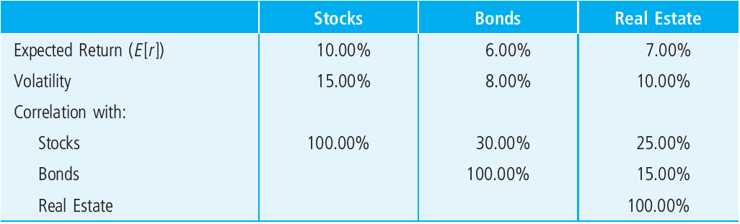
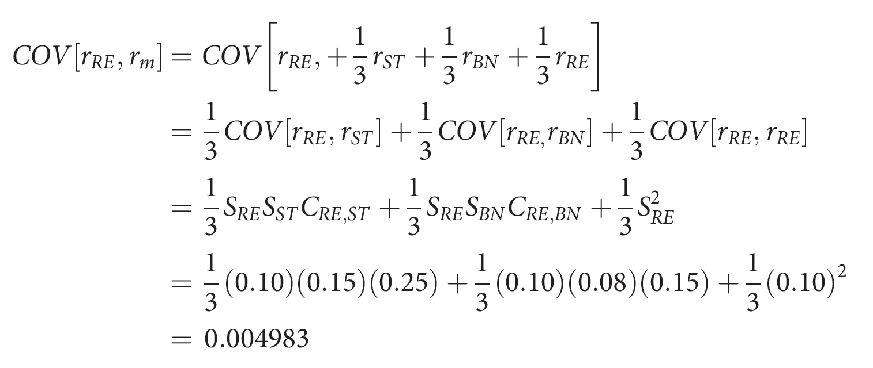
Example: Given following expectations (from Ch.21):
EXHIBIT 22-4A
Typical Risk and Return
Expectations
Assuming weights in a stylized “National Wealth Portfolio” (NWP) of: (1/3)Stocks, (1/3)Bonds, (1/3)RE,
We can compute the implied CAPM. E.g., the implied covariance betw RE and the “market” portf (NWP) is:
Similarly: COV[r_{ST},r_{m}] = .00995, COV[r_{BN},r_{m}] = .003733; And variance of NWP is: (1/9)[.0225+.0065+.01+2(.0036+.00375+.0012)]=.006222…

Slide 18
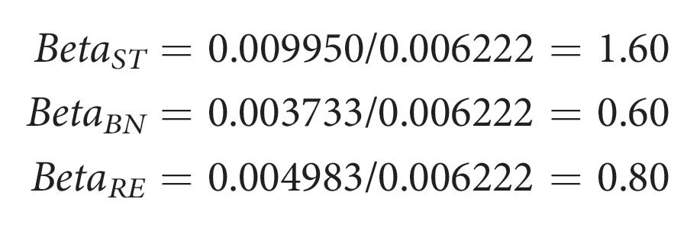
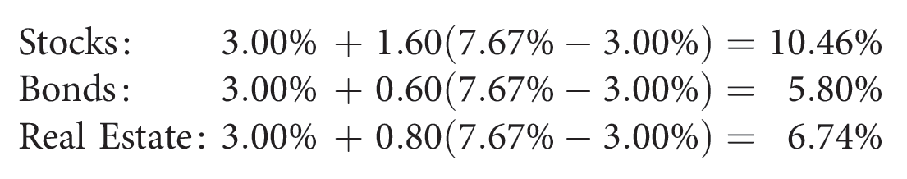
Example: Given following expectations (from Ch.21):
EXHIBIT 22-4A
Typical Risk and Return
Expectations
NWP = (1/3 each ST, BN, RE) ➔ VAR[NWP]=.006222, and:
COV[r_{ST},r_{m}]=.004983, COV[r_{ST},r_{m}]=.00995, COV[r_{BN},r_{m}]=.003733.
We can compute betas wrt NWP as follows:
NWP expected return is: E[r_{m}] = (1/3)(10%+6%+7%) = 7.67%
Which, with the above betas implies CAPM expected returns as follows (assuming riskfree rate = 3%):

Slide 19
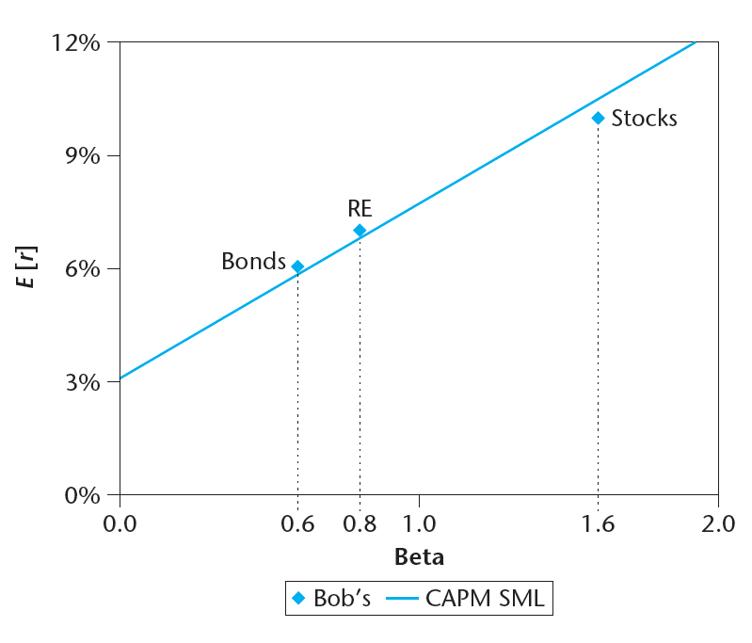
EXHIBIT 22-4B
Bob’s Expectations and the CAPM Prediction
CAPM prediction plots on diagonal line (SML), Exh.22-4A expectations shown as diamonds.

Slide 20
Expectations should be consistent with equilibrium model…
EXHIBIT 22-4A
Typical Risk and Return
Expectations
Equilibrium model should be consistent with expectations…
EXHIBIT 22-4B
Bob’s Expectations and the CAPM Prediction

Slide 21
22.3: Applying the Basic CAPM ACROSS asset classes
Correcting for smoothing, and defining beta wrt National Wealth…
CAPM-predicted NCREIF E[RP] ≈ 0.75%/qtr ≈ 3%/yr.
“CAPM works.”

Slide 22
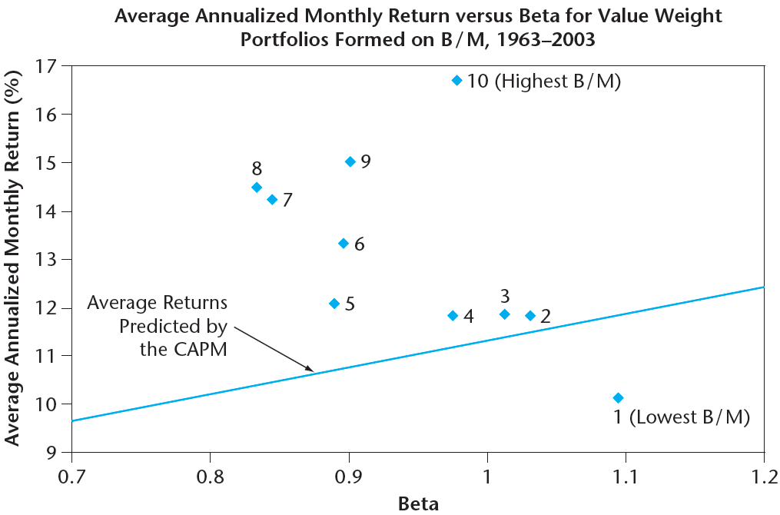
22.4
The simple 1-factor CAPM has trouble empirically within asset classes.
Fama-French: CAPM by itself doesn’t work very well within the stock market:
Exh.22-5
Source: Reproduced from Fama and French (2004), Figure 3.
Enhance the basic model with additional factors that are more “tangible” than beta: (i) Stock’s Size (mkt cap), & (ii) Stock’s Book/Market Value Ratio. The market apparently associates these with “risk”.

Slide 23
NCREIF portfolio avg returns and beta wrt NPI (1984-2003) by property size and type
The market pays more attention to tangible aspects of properties, most notably property size and quality (whether a property is “institutional” or not), and property usage type (e.g., office bldgs are “lower risk”?)
Source: Pai & Geltner, JPM (2007)
Notes:
Source: Arvind Pai MSRED thesis (2006).

Slide 24
Exh.22-6: During 2000-11 NCREIF properties show faint correspondence to single-factor CAPM, but

Slide 25
Recall from Ch.11…
11.2.6 Variation in Return Expectations Across Property Types
Greater E[r] spread between “Instl” vs “Non-Instl” than among differ prop mkt sectors.

Slide 26
Recall from Ch.11…
“Non-Instl” props have higher cap rates (income yields)…

Slide 27
“Institutional” (aka “Investment Grade”) properties (larger, in primary mkts) exhibit different price behavior than smaller (“mom & pop”) properties, as seen in CCRSI…
“Non-Instl” props also have higher same-property price appreciation…
Reflects different sources of financing (non-bank vs bank), different owner/investor clienteles (natl/intl instns vs local/users), different asset mkt segments.

Slide 28
1-Factor CAPM Across & Within Asset Classes…
Stocks
E[r]
Real Est
β
E[r]
Expected Return E[r]
β
Bonds
E[r]
β
Simple Classical CAPM “Beta” β

Slide 29
The Capital Market does perceive (and price) risk differences ACROSS asset classes . . .
Real estate based asset classes: Property, Mortgages, CMBS, REITs…
Pub.Eq
Pub.Db
Pri.Db
Pri.Eq
National Wealth BETA
Notes:
Apparently, the capital market does perceive and price risk differences ACROSS the quadrants.
Within real estate based asset classes:
PRIV EQ (direct property, unlevered) is the low-beta class.
PUBL EQ (REITs) is the high-beta quad.
DEBT lies in between.

Slide 30
A CAPM-based method to adjust investment performance for risk: The Treynor Ratio...
TR_{i} = (r_{i} - r_{f}) / βi
= slope of dashed line
Avg. Excess Return
r_{i} - r_{f}
SML
TR_{i}
r_{M} - r_{f}
0
1
Beta
Based on “Risk Benchmark”
Notes:
A manager’s or portfolio’s Treynor Ratio is its excess return over T-bills divided by its “beta”.
The “risk benchmark” underlies the estimation of the “beta” (e.g., National Wealth Portfolio, NWP).
Here, the manager’s excess return (r_{i}-r_{f}) is adjusted downward to reflect the effect of the manager taking on greater risk.
The manager’s custom benchmark could be similarly adjusted.
Then the manager and his custom benchmark could be compared on an equal-risk, “apples-to-apples” basis, using their Treynor Ratios.

Slide 31
The Treynor Ratio could be applied to managers (portfolios) spanning the major asset classes...
Avg. Excess Return
r_{i} - r_{f}
SML
TR_{i}
r_{M} - r_{f}
0
1
Beta
Notes:
Because the risk of asset classes differs, managers who have discretion to allocate portfolios across the asset classes could have their investment performance measured by the Treynor Ratio (or something like it), in order to adjust their performance for the risk they have taken on.

Slide 32
The Beta can be estimated based on the “National Wealth Portfolio” ( = (1/3)Stocks + (1/3)Bonds + (1/3)RE ) as the mixed-asset “Risk Benchmark”. . .
r_{i} - r_{f}
SML
TR_{i}
r_{M} - r_{f}
0
1
Beta
Based on “National Wealth Portfolio”
Notes:
The Beta can be estimated based on the “National Wealth Portfolio” ( = (1/3)Stocks + (1/3)Bonds + (1/3)RE ) .
In other words, we might consider using a simplified version of the National Wealth Portfolio could serve as a multi-quadrant “Risk Benchmark”.
In any case, when benchmarking for performance evaluation “across the quadrants”, we cannot ignore the need to adjust for risk in some logical manner.

Slide 33
Summarizing Chapter 22: Equilibrium Asset Price Modeling & Real Estate
  Like the MPT on which it is based, equilibrium asset price modeling (the CAPM in particular) has substantial relevance and applicability to real estate when applied at the broad-brush level ( across asset classes ).
  At the fundamental property level (unlevered), real estate in general tends to be a low-beta, low-return asset class in equilibrium, but certainly not riskless, requiring (and providing) some positive risk premium (ex ante).
  CAPM type models can provide some guidance regarding the relative pricing of real estate as compared to other asset classes (“Should it currently be over-weighted or under-weighted?”), and…
  CAPM-based risk-adjusted return measures (such as the Treynor Ratio) may provide a basis for helping to judge the performance of multi-asset-class investment managers (who can allocate across asset classes).*
  Within the private real estate asset class, the CAPM is less effective at distinguishing between the relative levels of risk among real estate market segments, implying (within the state of current knowledge) a generally flat security market line across prop asset mkt segments. (not across derivatives w different leverage)
  This holds implications for tactical portfolio investment research & policy within the private real estate asset class: ➔ Search for market segments with a combination of high asset yields and high rental growth opportunities: Such apparent “bargains” present favorable risk-adjusted ex ante returns.
* Treynor Ratio requires a single-risk-factor asset pricing model.
Notes:
* Treynor Ratio requires a single-risk-factor asset pricing model.

