Slide 1
Chapter 18
Commercial Mortgage Analysis
and Underwriting

Slide 2
Section 18.1:
Expected Returns vs Stated Yields
Measuring the Impact of Default Risk
Notes:
This section is normally covered in the spring course 11.432/15.427.

Slide 3
Mortgage expected returns (≠ “interest rate” aka “coupon”…)
Terminology: “Int rate”, “Coupon”, “Yield”, “Expected return”…
Example: 6%, $100, 3-yr, interest-only mortgage.
Originated “at par”: YTM (=IRR to maturity) = 6% = Coupon:
1 day later the “market interest rate” (actually, “mkt yld”, which is YTM) drops to 5%. Par = OLB still $100, coupon still 6%, but now PV (mkt val price) of mortg is:
But the expected return E[r] (probabilistic expectn) is neither 6% nor 5%, not at origination nor later…
See Ch.17 (sect. 17.2 pp.419-425) re terminology.

Slide 4
Mortgage expected returns (≠ “interest rate” aka “coupon”…)
Terminology: “Int rate”, “Coupon”, “Yield”, “Expected return”…
Suppose ex ante 90% chance contract will be fulfilled (no default), then ex post yield (IRR) will indeed be 6%.
But ex ante 10% chance loan will default in last year & lender recovers only 70% in foreclosure. Then these will be cash flows and ex post yield (IRR) will be -5.17%:
Expected return E[r] (probabilistic expectn) is:
.9*(6.00%) + .1*(-5.17%) = 4.88%.
➔ 112 bps expected “credit losses” in yield (ex ante).

Slide 5
Mortgage expected returns (≠ “interest rate” aka “coupon”…)
“Expected Returns” versus “Stated Yields” . . .
In a bond or mortgage (capital asset with contractual cash flows):
Stated Yield (aka “Contractual Yield”) = YTM based on contractual obligation. (in mortg & bond world, “yield” usually refers to an IRR over maturity.)
Expected Return (aka “Expected Yield” or “Ex Ante Yield”) = E[r] = Mean of probability distrn of future total return on the bond or mortg investmt. (also usually IRR, not nec over maturity: over expctd hold)
Quoted yields are always stated yields.
Contract yields are used in mortgage design and evaluation (price quotes).
Expected return is more fundamental measure for mortgage investors,
For making investment decisions.
Difference:
Stated Yield – Expected Return
is impact of Default Risk (possibility of “Credit Losses” ) in ex ante return investor cares about.
Notes:
The difference betw contractual YTM and statistical E[r] can also result from likelihood of prepayment in mortgages with points or prepayment penalties. However, this is not a major issue with commercial mortgages.

Slide 6
18.1.1 Yield Degradation & Conditional Cash Flows…
“Credit Losses” = Shortfalls to the lender (mortgage investor) as a result of default and foreclosure.
“Realized Yield” = What the lender (investor) actually receives (as an IRR).
“Yield Degradation” = Impact of credit losses on the lender’s realized yield as compared to the contractual yield (expressed in IRR units).
Contractual Yield
- Yield Degradation ⬅ Due to Credit Losses
--------------------------
= Realized Yield
Yield Degradation (“YDEGR”) = Lender’s losses measured as a multi-period lifetime return on the original investment (IRR impact).

Slide 7
Numerical example of Yield Degradation:
$100 loan.
3 years, annual payments in arrears.
10% interest rate.
Interest-only loan.
Here are the contractual terms of the loan as an NPV equation:
Contractual YTM = 10.00%.
Suppose:
  Loan defaults in 3rd year.
  Bank takes property & sells in foreclosure, but
  Bank only gets 70% of OLB: $77.
$33 = “Credit Losses”.
70% = “Recovery Rate”.
30% = “Loss Severity”.
Here are the realized cash flows of the loan as an NPV equation:
Realized IRR = -1.12%
Yield Degradation = 11.12%:
Contract.YTM – Yld Degrad = Realized Yld:
10.00%. – 11.12% = -1.12%.

Slide 8
From an ex ante perspective, this 11.12% yield degradation is a “conditional” yield degradation.
It is the yield degradation that will occur if the loan defaults in the third year, and if the lender gets 70% of the OLB at that time.
(Also, 70% is a conditional recovery rate.)
Suppose the default occurred in the 2nd year instead of the 3rd:
Yield Degradation = -17.11%.
Other things being equal (in particular, the conditional recovery rate), the conditional yield degradation is greater, the earlier the default occurs in the loan life.
From a loan lifetime performance perspective, lenders are hit worse when default occurs early in the life of a mortgage.
Implications for construction loans?...

Slide 9
Note: “YDEGR” as defined in the previous example was:
  The reduction in the IRR (yield to maturity) below the contract rate,
  Conditional on default occurring (in the 3rd year), and
  Based on a specified conditional recovery rate (or loss severity) in the event that default occurs.
For example, if the loss severity were 20% instead of 30%, then the conditional yield degradation would be 7.13% instead of 11.12%:
YDEGR₃ = 10% - 2.87% = 7.13%.

Slide 10
Relation between Contract Yield, Conditional Yield Degradation, & the Expected Return on the mortgage…
Expected return is an ex ante measure.
To compute it we must specify:
Ex ante probability of default, &
Conditional recovery rate (or the conditional loss severity) that will occur in the event of default.
Suppose that at the time the mortgage is issued, there is:
  10% chance of default in 3rd year.
  70% conditional recovery rate for such default.
  No chance of any other default event.
Then at the time of mortgage issuance, the expected return is:
E[r] = 8.89% = (0.9)10.00% + (0.1)(-1.12%)
= (0.9)10.00% + (0.1)(10.00%-11.12%)
= 10.00% - (0.1)(11.12%) = 8.89%.
In general: Expected Return = Contract Yield – Prob. of Default * Yield Degradation.
E[r] = YTM – (PrDEF)(YDEGR)
Notes:
Recall that we are defining yield degrataion (YDEGR) here as a conditional value, conditional on the posited default event occurring.

Slide 11
What would be the expected return if the ex ante default probability and conditional credit loss expectations were:
  80% chance of no default;
  10% chance of default in 2nd year with 70% conditional recovery;
  10% chance of default in 3rd year with 70% conditional recovery.
  ?
Answer:
E[r] = YTM – Σ(PrDEF)(YDEGR)
E[r] = 10% – (.1)(11.12%) – (.1)(17.11%) = 10% - 2.82% = 7.18%.

Slide 12
Note: The probabilities we were working with in the previous example:
        80% chance of no default;
        10% chance of default in 2nd year;
        10% chance of default in 3rd year.
Were “unconditional probabilities” as of the time of mortgage issuance:
    They did not depend on any pre-conditioning event;
    They describe an exhaustive and mutually-exclusive set of possible outcomes for the mortgage, i.e.,:
    The probabilities sum to 100% across all the eventualities.

Slide 13
18.1.2 Hazard Functions and the Timing of Default…
More realistic and detailed analysis of mortgage (or bond) default probability (and the resulting impact of credit losses on expected returns) usually works with conditional probabilities of default, what is known as a:
Hazard Function
The hazard function tells the conditional probability of default at each point in time given that default has not already occurred before then.
Example: Suppose this is the hazard function for the previous 3-yr loan:
Year: Hazard:
1 1%
2 2%
3 3%
i.e., There is:
1% chance loan will default in the 1st year (i.e., at the time of the first payment);
2% chance loan will default in 2nd year if it has not already defaulted in the 1st year; &
3% chance loan will default in 3rd year given that it has not already defaulted by then.

Slide 14
Given the hazard function for a mortgage, we can compute the cumulative and unconditional default and survival probabilities.
Example: Suppose this is the hazard function for the previous 3-yr loan:
Year: Hazard:
1 1%
2 2%
3 3%
Then the table below computes the unconditional and cumulative default probabilities for this loan:
“Conditional Survival Probability” (for year t) = 1 – Hazard for year t.
“Cumulative Survival Prob.” (for year t) = Probability loan survives through that yr.
“Unconditional Default Prob.” (for year t) = Prob.(as of time of loan origination) that loan will default in the given year (t) = Hazard * Cumulative Survival (t-1) = Cumulative Survival (t) – Cumulative Survival (t-1).
“Cumulative Default Prob.” (yr.t) = Prob.(as of time of loan origination) that loan will default any time up through year t.
In this case: 5.89% unconditional probability (as of time of origination) that this loan will default (at some point in its life). 5.89% = 1.00% + 1.98% + 2.91% = 1 – 0.9411.

Slide 15
For each year in the life of the loan, a conditional yield degradation can be computed, conditional on default occurring in that year, and given an assumption about the conditional recovery rate in that year.
For example, we saw that with previous 3-yr loan the conditional yield degradation was 11.12% if default occurs in year 3, and 17.11% if default occurred in year 2, in both cases assuming a 70% recovery rate.
Similar calculations reveal that the conditional yield degradation would be 22.00% if default occurs in year 1 with an 80% recovery rate.*
Defaults in each year of a loan’s life and no default at all in the life of the loan represent mutually-exclusive events that together exhaust all of the possible default timing occurrences for any loan.
For example, with the three-year loan, Borrower will either default in year 1, year 2, year 3, or never.
Thus, the expected return on the loan can be computed as the contractual yield minus the sum across all the years of the products of the unconditional default probabilities times the conditional yield degradations.
Notes:
* This is computed as: (80%)*($110)/(1+(-.12)) = $100, so –12% is the conditional return, and –12% is 22% less than the contractual yield of 10%. Note that in computing the conditional yield, the conditional recovery rate is applied to the OLB at the time of the default, in this case $110. This reflects the fact that the lender would accelerate the loan in the event of default so that the entire outstanding balance would be due at that time. It is likely that a greater proportion of the loan balance could be recovered from a foreclosure in the first year, as there is less time for the property to have lost value subsequent to loan issuance. So it is plausible to assume a recovery rate of 80% in the first year if the subsequent rate is 70%.

Slide 16
Example:
Given previous hazard function (1%, 2%, and 3% for the successive years);
Given conditional recovery rates (80%, 70%, and 70% for the successive years);
Expected return on the 3-yr 10% mortgage at the time it is issued would be:
E[r] =10.00%-((.0100)(22.00%)+(.0198)(17.11%)+(.0291)(11.12%))
=10.00% - 0.88%
= 9.12%.
The 88 basis-point shortfall of the expected return below the contractual yield is the “ex ante yield degradation” (aka: “unconditional yield degradation”).
It reflects the ex ante credit loss expectation in the mortgage as of the time of its issuance.

Slide 17
Two alternative ways to compute the expected return . . .
“Method 1” “Return-based” (as previously described) E[IRR(CF)] :
Take the expectation over the conditional returns…
Most commonly used.
Makes sense if investor preferences are based on the return achieved.
“Method 2” “Expected CF-based”, or “Pooled CF-based”, IRR(E[CF]) :
Take the expectation over the conditional cash flows and then compute the return on the expected cash flow stream:
Makes sense if investor preferences are based on the cash flows achieved.
Notes:
To clarify, in this case there are N = T+1 possible mutually-exclusive and exhaustive default “scanarios”, namely, a is possible in any one of the T years of the loan maturity, and also it is possible that no default will occur ever in any of those years. Each of these scenarios is associated with a given future cash flow pattern, and a given probability that this cash flow pattern will describe the future life of the loan (the investment). Each of these cash flow scenarios is also associated with the realization of a given lifetime IRR for the investment.
Method 2 is probably slightly preferable in principle from an economic theory perspective, based on the notion that utility is defined on consumption, which in turn is purchased with cash (not with returns per se). However, bond yield analysis occurs at an aggregate level, removed from individual investor utility preferences, and the investment industry is oriented toward thinking in terms of returns or yields as the fundamental objective of the investor clients in the business.
Note: The return computation issue raised here is illustrated concretely in the “MortgHazardsTools” Excel workbook downloadable from the course web site. It should also be noted that this issue is in fact relevant in computing any ex ante expected return, not just for mortgage yields. It thus applies in principle also to the OCC estimate in DCF-based capital budgeting investment analysis (equity investment). In capital budgeting, Method 2 is usually implicitly assumed, because the numerators in the DCF equation are expected cash flows (i.e., expectations take over the possible cash flow scenarios). With commercial mortgages it is not uncommon for the difference between the two methods to be as much as 50 to 100 basis points in the expected return.

Slide 18
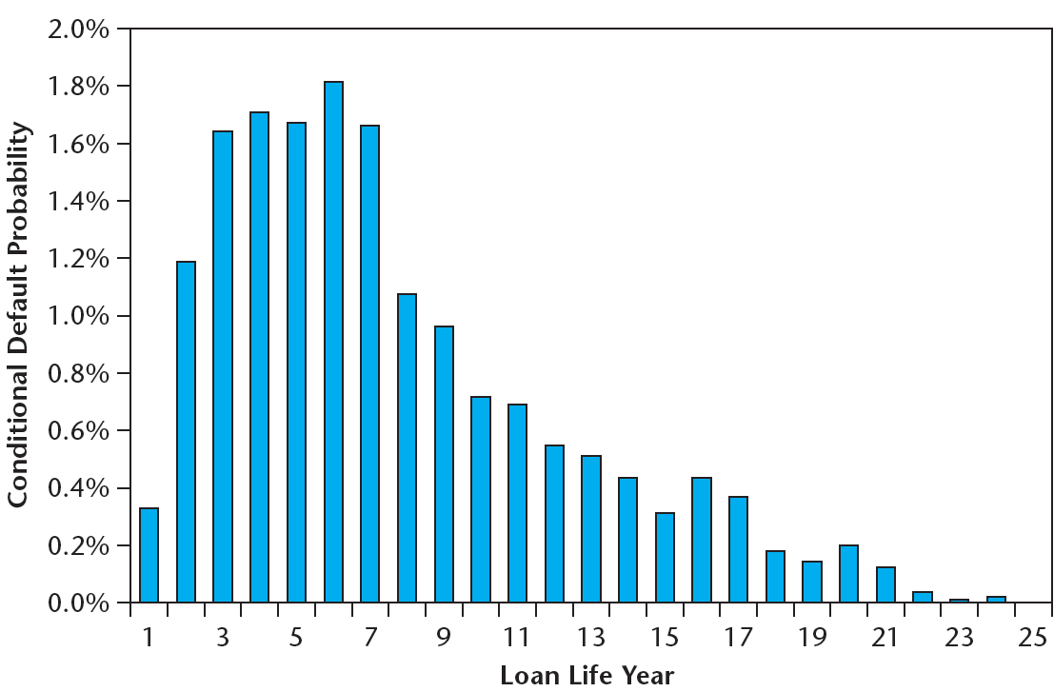
18.1.3 Yield Degradation in Typical Commercial Mortgages…
The most widely used empirical evidence on commercial mortgage hazard rates in the U.S. is that of Snyderman and subsequent studies at Morgan-Stanley.*
EXHIBIT 18-1 Typical Commercial Mortgage Hazard Rates
Source: Based on data from Esaki et al. 2002.
Notes:
* The most recent of these studies published (Esaki, 2002) is in the 11.432 course supplemental reader that can be purchased from the MIT Copy Center.

Slide 19
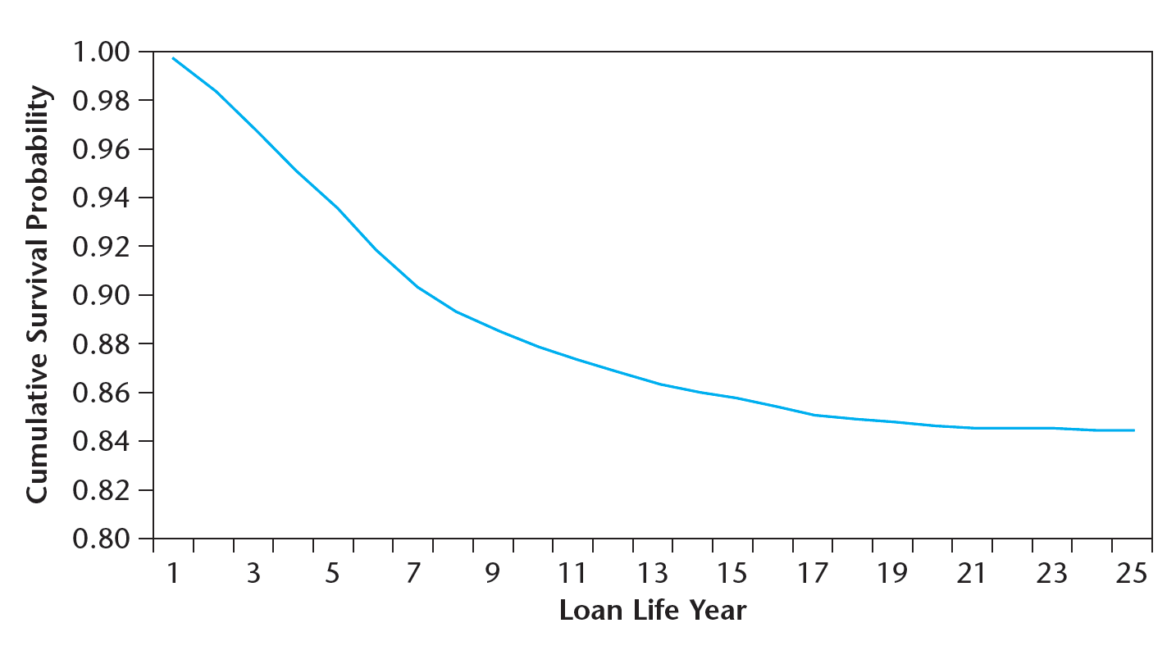
The implied survival function and cumulative default probability is shown here:
EXHIBIT 18-2 Typical Commercial Mortgage Survival Rates
Source: Based on data from Esaki et al. 2002.
Overall Average Default Probability = 16%.
1 out of 6 commercial mortgages in the U.S. default at some point in their lives.

Slide 20
Exhibit 18-4: Default Rate in Outstanding Loans, by Lender Type, 1990-2010.

Slide 21
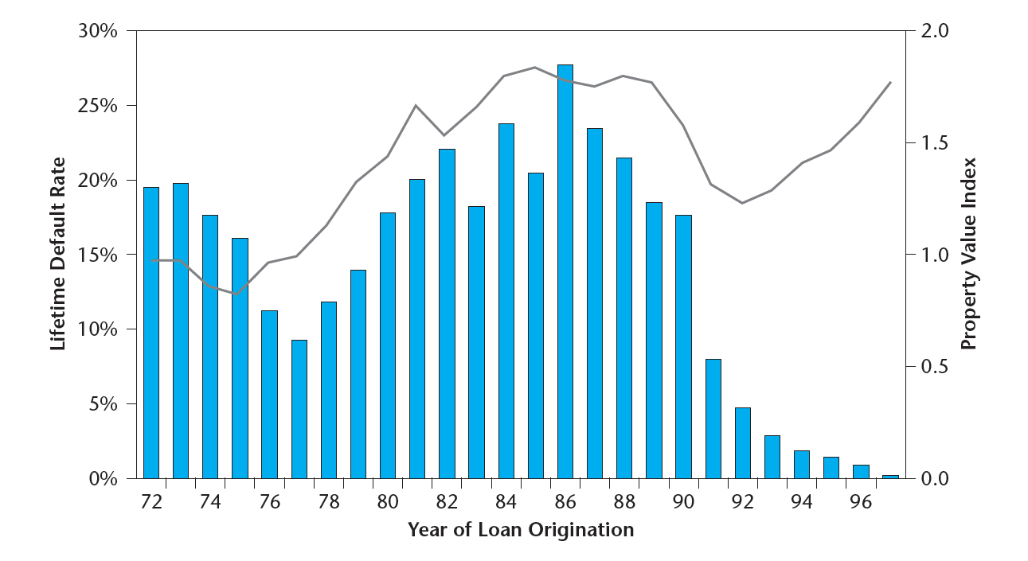
Loan lifetime default probabilities are strongly influenced by the time (phase of the real estate market cycle) at which the loan was originated:
EXHIBIT 18-3 Lifetime Default Rates and Property Values
Sources: Based on data from Esaki, et al. 2002 and NCREIF Index.
Why do you suppose this is so?
And what do you think about it?

Slide 22
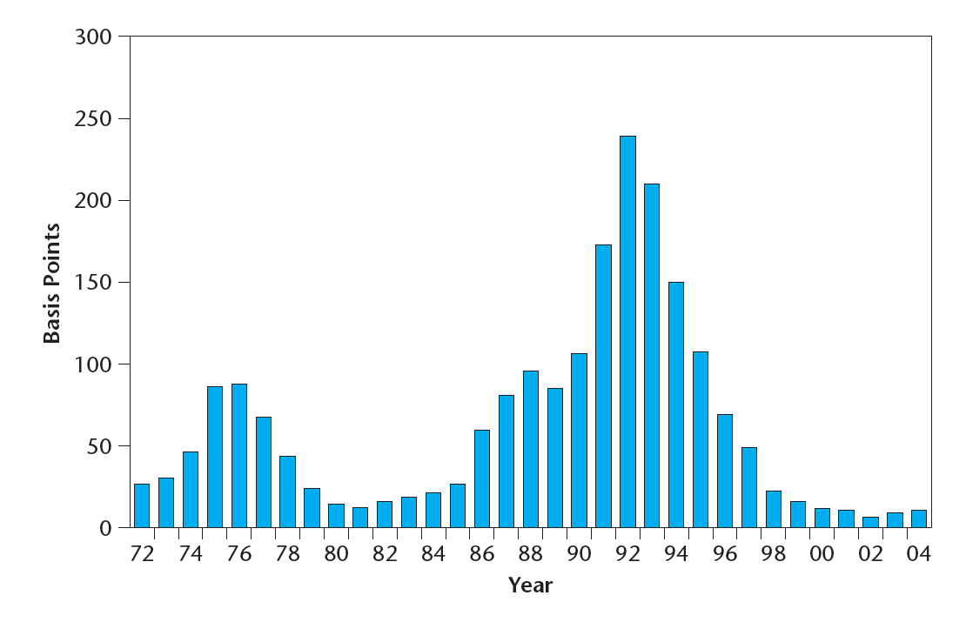
Combining empirical data on conditional recovery rates (typically assumed to be between 60% and 70%), we can estimate the typical ex ante yield degradation in U.S. commercial mortgages…
Typical Yield Degradation:
60 to 120 basis points.
Similar results are observed in the Giliberto-Levy Commercial Mortgage Index (GLCMI), the major index of commercial mortgage (“whole loan”) periodic ex post returns (HPRs).
1972-2004 Avg =
62 basis points*
Source: Based on data from GLCMPI—John B. Levy & Co.
Notes:
*The GLCMPI also estimates periodic total returns on commercial mortgages both with and without adjustment for credit loss. The average per annum adjusted return over the 1972-2004 period was 88 basis points lower than the average unadjusted return. This number is greater than the 62 basis-point average credit loss because the denominator in the holding-period returns (HPRs) adjusts over time to reflect changes in the current market value of the mortgage. This denominator value declines prior to loan default, as the current loan-to-value ratio typically rises and debt service coverage ratio typically falls, increasing the loan’s default risk and thereby lowering its market value. In contrast, the denominator in the credit loss calculation remains at the par value of the loan (its contractual OLB). For this reason, in principle, the average credit loss over time probably provides a better indication of the magnitude of ex ante yield degradation.
Web site is: http://www.jblevyco.com/.

Slide 23
Much focus on current “delinquency rates” (% of loans currently non-paying). Not the same as lifetime default rate or yield degradation, but strongly related & very common current indicator. Most loans currently delinquent will default, others also will.
U.S. bank loan delinquency (currently in default) rates, 2006-10 (FRB):
Note: Bank CRE loans tend to be dominated by construction loans and smaller (“mom & pop” or local user-occupied property & related business) loans. This experience may differ from that of larger “institutional” CRE loans including life insurance and pension sourced loans and CMBS conduit loans.

Slide 24
Section 18.2:
Commercial Mortgage Underwriting
Notes:
This section is normally covered in the fall (11.431/15.426) course.

Slide 25
“Underwriting”
= Process lenders go through to decide to issue a commercial mortgage, and the terms of the loan:
Loan Origination (“primary” market).
Often a negotiation type process (esp. for large loans): Commercial Mortgage business is a “custom” shop.
Standard criteria may sometimes be “bent” (esp. for large borrowers, or when the market is “hot”), but provide the basic guidelines.

Slide 26
Basic Purpose of Underwriting:
➔ To make default a rare event.
But no one can operate “outside the market”…
Supply & Demand:
Most borrowers cannot (or do not want to) conform to underwriting standards so tight as to eliminate default risk (even if that would get them T-Bond interest rates).
Lenders must conform to the market in order to “play the game”: Modify loan terms so that E[r] is sufficient to compensate for default risk.

Slide 27
Two Foci of Underwriting:
Borrower & Property
1) Borrower:
  On the downside:
    i) Can “bleed” healthy property as “cash cow”.
    ii) Can use Ch.11 if they get in trouble (“cramdown”).
    iii) Financial health of borrower is important.
    iv) Check “parent” company.
  On the upside:
    i) Potential “repeat customer”.
    ii) Consider size, track record, future potential.

Slide 28
Two Foci of Underwriting:
Borrower & Property
2) Property:
  Generally more important than borrower:
  i) Main source of CF to service loan.
    ii) Comm.Mtgs effectively “non-recourse”.
    iii) Careful lender w well-crafted loan: strong property counts more than strong borrower.
  Standard Property-level Underwriting Criteria:
    i) Asset value criteria...
    ii) Property income criteria...

Slide 29
Asset Value Criterion:
Initial Loan-to-Value Ratio (LTV)
LTV = L/V
Exh. 18-5: Typical relationship between initial LTV ratio and the ex ante lifetime default probability on a commercial property mortgage:
Default Prob.
LTV Ratio

Slide 30
Is 16% avg lifetime default probability surprisingly high? . . .
Consider relation between:
LTV,
Property Risk (volatility),
Loan Default Probability.
A simplified example…
(Text box p. 447)
Suppose…
Initial Prop. Val = $100, E[g] = 2%/yr.
75% LTV (No amort ➔ OLB = $75 constant).
Average loan default occurs in year 7 of loan life (Esaki).
Individ. Prop. Ann. Volatility (Std.Dev[g]) = 15%.
Prop. Val follows random walk (effic. mkt.).
➔
Notes:
Note: Indices of large portfolios of properties have annual volatility more like 10%. But much idiosyncratic individual property volatility is diversified out of such indices. In the same manner that individual stocks are more volatile than the stock indices composed of those stocks, individual property volatility must be greater than aggregate property volatility. Evidence suggests typical annual individual property volatility around 15%.
Note, If property markets have inertia due to slow incorporation of news, then long-term volatility is more than proportional to the square root of the return measurement interval. However, inertia may have little impact over a 7-yr horizon (positive autocorrelation in the 1-3 year horizon may be offset by negative autocorrelation or due to error-correction or cyclicality over the 5-10 year horizon).

Slide 31
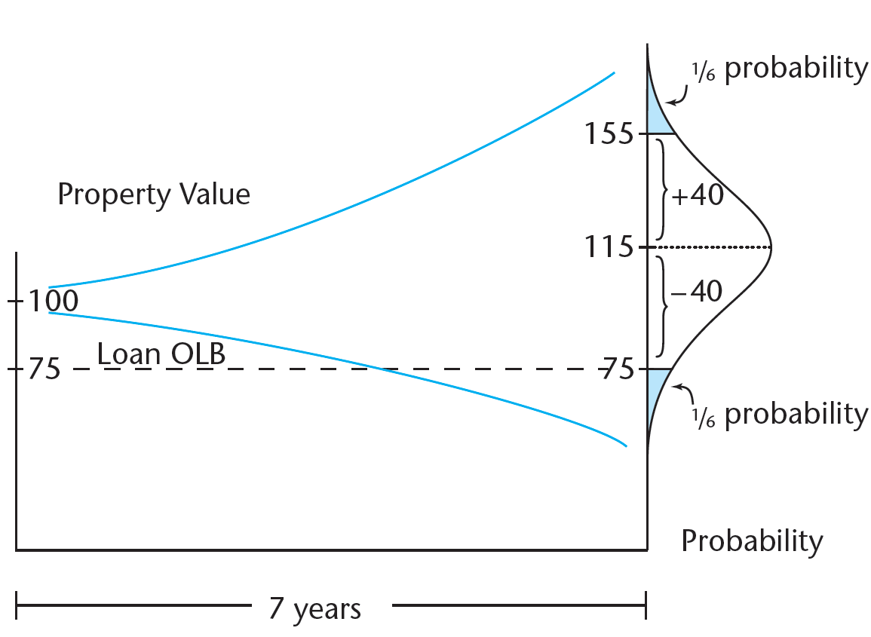
LTV tradl underwriting limit 75%:
A simplified example (Ch18 p447)…
Relation between:
LTV,
Property Volatility, &
Loan Default Probability.
Avg default in Yr 7 of mortg life
Avg property ann volatility 15%
Thus, After 7 years:
E[Val] = 1.02⁷(100) = 115
Std.Dev[Val] =
1 Std.Dev below E[Val] = $115 - $40 = $75.
If Prob[Val] ~ Normal, ➔ 1/6 chance Val < OLB, ➔ Loan “under water” (large chance of default in that case). In fact about 1/6 US comm mortgs default.

Slide 33
The point is . . .
Greater Property Volatility (Risk)
Lower LTV corresponds to a given lifetime default probability.
Lower Max LTV Limit in underwriting criteria.
Typical LTV limit in commercial mortgages on good quality stabilized properties is 75%.
Based on lower of appraisal or purchase price.
Based on lower of DCF or Direct Cap.
Sometimes “bent”, or fudged in appraisal, due to market pressure.

Slide 34
Property Income Criteria…
1) Debt Service Coverage Ratio (DCR):
DCR = NOI / DS
Typical: DCR >= 120%

Slide 35
2) Break-even Ratio (BER):
BER = (DS+OE) / PGI
➔ Occupancy ratio required for EBTCF > 0 (exclu CI)
➔ Lender usually requires BER < (100% - Mkt Vac)
Typical: BER <= 85%, or less than mkt avg occupance minus some buffer (typically 5%).

Slide 36
3) Equity Before-Tax Cash Flow (EBTCF):
EBTCF = NOI – DS – CI
Similar to DCR, only includes effect of CI.
Projection of EBTCF < 0 any year of loan
➔ “Red Flag”.

Slide 37
4) Multi-year Pro-Forma Projection:
In principle, lenders project income ratios for all years of loan life.

Slide 38
Variables and loan terms to negotiate:
• Loan Amount
• Loan Term (maturity)
• Contract Interest Rate
• Amortization rate
• Up-front fees and points
• Prepayment option and back-end penalties
• Recourse vs. Non-recourse debt
• Collateral (e.g., cross-collateralization)
• Lender participation in property equity
• Cramdown insurance
• Etc. . . .

Slide 39
Underwriting Example
The Problem:
• Buyer (borrower) & seller claim property worth $12,222,000;
• Buyer wants to borrow 75% ($9.167 Million, or $91.67/SF) from you (mortgage lender), for purchase-money 1st mortgage;
• Wants non-recourse, 10-yr interest-only loan, monthly pmts;
• Willing to accept “lock-out”.
• Should you do the deal?

Slide 40
Underwriting Example (cont.)
Current Capital Market Information:
In Bond Mkt: 10-yr US Govt Bonds yielding 6.00%.
In Mortg Mkt: 10-yr balloon lock-out commercial mortgages require risk premium in contract total yield typically 200bp (CEY) spread over TBonds for good properties, non-recourse.
➔ Loan YTM = 6% + 2% = 8% CEY,
➔ What EAY & MAY?
➔ EAY = 8.16%, ➔ 7.87% MEY required YTM.

Slide 41
Underwriting Example (cont.)
Underwriting Criteria (from capital provider):
Max Initial LTV = 75%.
Max projected terminal LTV = 65%.
In computing LTV, normally: (i) Apply direct capitalization with going-in cap rate ≥ 9%, terminal cap rate ≥ 10%; (ii) Apply multi-yr DCF with Disc. Rate ≥ 10%; (iii) Use lower of (i) & (ii) to compute Initial LTV.
Min DCR = 120%.
Max BER = 85%, or 5% less than mkt vac (whichever is less).
Consider need for CI, and avoid EBTCF < 0.
Loan must conform to these criteria, given capital market (yield requirement) and property markets (space & asset mkts ➔ value & income criteria).

Slide 42
Underwriting Example (cont.)
Property & R.E. Market Information (from broker):
100,000SF, fully occupied, single-tenant, off.bldg.
10-yr lease signed 3 yrs ago.
$11/SF net (suppose EOY ann. pmts).
"Step-ups" of $0.50 in lease yr.5 & 8 (yrs 2 & 5).
Current mkt rents on new 10-yr leases are $12/SF net.
Expect mkt rents to grow @ 3%/yr. (same age).

Slide 43
Solution, General Procedure . . .

Slide 44
Underwriting Example (cont.)
So, you need to deal with the usual . . .
You make following modified assumptions:
1% Market rental growth for existing bldg (3%-2%depr).
Yr.8 Leasing expenses: $2/SF if renew, $5/SF not renew.
Yr.8 TI: $10/SF if renew, $20/SF if not renew.
Yr.10 cap rate = 10%.

Slide 45
Underwriting Example (cont.)

Slide 46
Underwriting Example (cont.)
DCR (Yr.1) = NOI / DS = $1,100,000 / $721,443 = 1.52
BER (Yr.1) = (OE + DS) / PGI = ($0 + $7.214) / $12.12 = 0.60
(Note use of current mkt rent in BER: Consistent with intent of that ratio.)
DS from: $9,167,000 X 7.87% = $721,443, in Interest-Only Loan.
Although standard income ratios look good, this loan does have some problems.

Slide 47
One problem is in the income criteria. Can you spot it in the proforma?...
Negative EBTCF in Yr. 8
Another problem is in the initial LTV:
  Based on direct capitalization, loan passes OK:
    $1,100,000 / 9% = $12.22 M, ➔ LTV = 9.167 / 12.22 = 75%.
  But the DCF @ 10% gives PV(PBTCF) = $11,557,000.
    ➔ 9.167 / 11.557 = 79%.
A similar problem is in the Terminal LTV:
        $9,167,000 / $12,994,280 = 71%, which is > the 65% limit.

Slide 48
Underwriting Example (cont.)
How good a future potential “customer” is this borrower?
How much pressure is there in the loan market?
Try to negotiate a similar loan? . . .

Slide 49
Underwriting Example (cont.)
Consider a $8,700,000 loan with 40-yr Amort. 10-yr balloon (instead of $9,167,000, Interest-Only):

