Slide 1
CHAPTER 16
MORTGAGE BASICS
(CH.16, sects 16.1, 16.2 only)

Slide 2
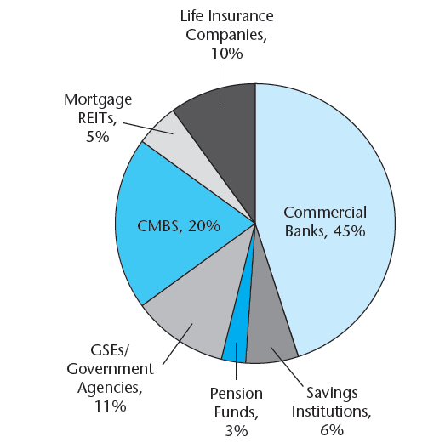
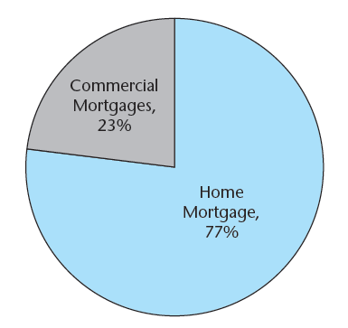
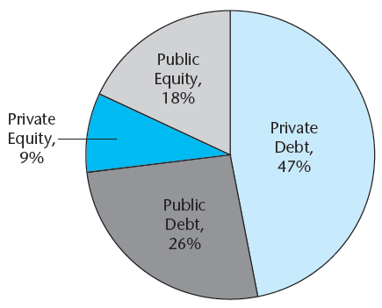
Exhibit 16-1: Overview of U.S. Mortgage Debt Outstanding as of 2011.
Panel A U.S. Mortgages Outstanding, 2011 $13.5 trillion
Panel B U.S. Institutional Commercial Real Estate Capital Structure, 2011 $4.1 trillion
Panel C U.S. Commercial Mortgages Sources, 2011 $3 trillion outstanding
Sources: FRB, CoStar Group Inc.

Slide 3
Exhibit 16-2: U.S. Commercial & Multi-family Mortgages Share of Outstanding Balance Held by Various Capital Sources: 1978-2011.

Slide 4
Exhibit 16-3: U.S. Commercial & Multi-family Quarterly Mortgage Flows: 1978-2011 (Change in Balance Outstanding)
Note periods of capital outflow: 1990-94, 2008-10.

Slide 5
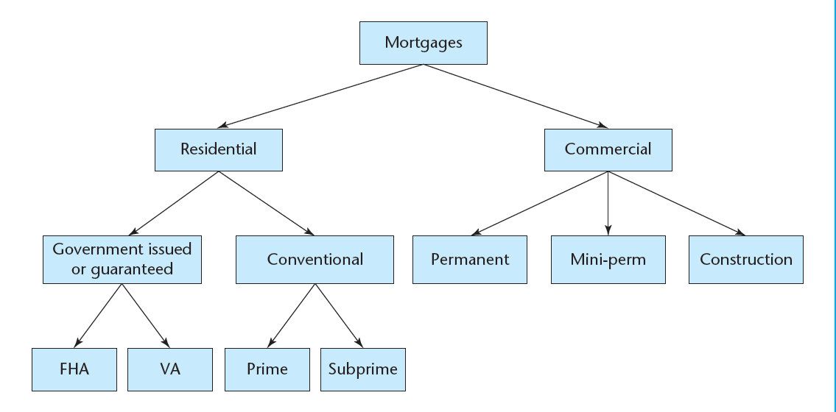
16.1 Basic Typology of Mortgages and Overview of the U.S. Mortgage Industry
EXHIBIT 16-4 Typology of U.S. Mortgages

Slide 6
Types of Mortgages
Type of Collateral:
  Residential
  Commercial
    Permanent vs. Construction
Government Involvement:
  Government-Insured (FHA, VA)
  Conventional

Slide 7
16.2. Basic legal concepts and terminology
Terminology . . .
Owner begins with “O.” So “...or” ===> owner
Lessor is owner (landlord), lessee is renter.
Mortgagor is owner (borrower), mortgagee is lender.

Slide 8
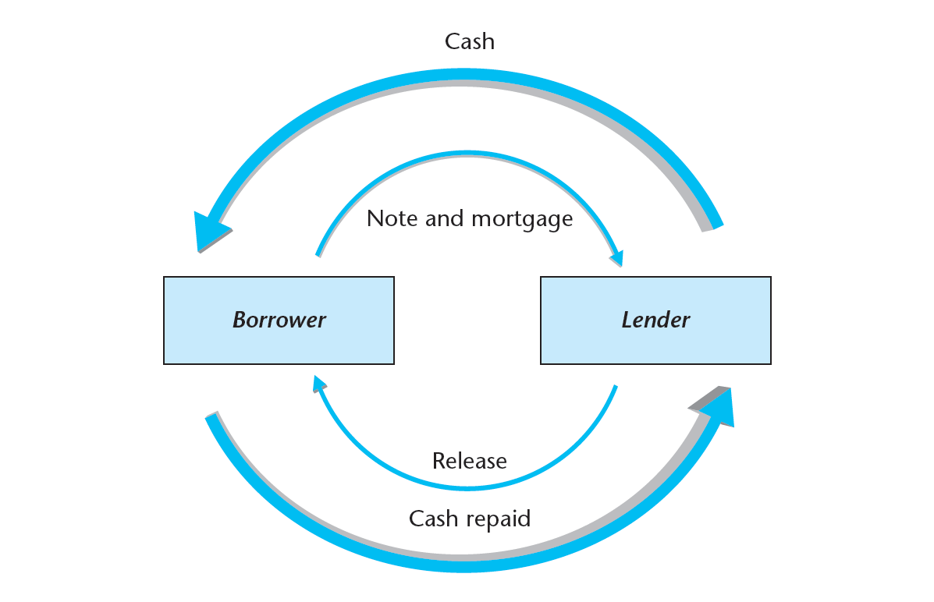
16.2.1 Legal Structure of Mortgages...
Exhibit 16-2: Mortgage deed relationships:

Slide 9
Mortgages have 2 parts (documents):
Promissory Note: Contract establishing debt.
Mortgage Deed: Secures debt with real property collateral (potentially conveys title).

Slide 10
Two legal bases of mortgages:
“Lien Theory” (most states): borrower holds title, lender gets lien.
“Title Theory” (a few states): Lender holds title.

Slide 11
16.2.2 Priority of Claims in Foreclosure
Lien Priority established by Date of Recording, except:
Property Tax Lien comes first
Sometimes Mechanics Liens
Explicit Subordination Claus
Bankruptcy Proceedings may modify debtholder rights
“First Mortgage” (earlier recording) = “Senior Debt”
“2nd (etc) Mortgage” = “Junior Debt”

Slide 12
Example:
1st Mortg = $90,000
2nd Mortg= $20,000
3rd Mortg = $10,000
Property sells in foreclosure for $100,000:
1st Mortgagee gets $90,000
2nd Mortgagee gets $10,000
3rd Mortgagee gets 0.

Slide 13
“Redeem up, Foreclose down”
Senior Lien Holders obtain their claim (to the extent foreclosure sale proceeds and their priority allows), even if they did not bring the suit.
Junior Lien Holders lose claims after foreclosure, provided they are included in the foreclosure suit.
Lien Holder bringing foreclosure suit normally buys the property in the foreclosure sale, for amount sufficient to cover its claim.

Slide 14
TYPICAL COVENANTS & CLAUSES
Promise to Pay
  Specifies principal, interest, penalties, etc., along with date, names, etc.
Covenant to Avoid Liens w Priority over the Mortgage
  For example, if borrower fails to pay property tax, she is in default of mortgage too, because property tax lien has priority over mortgage lien.
Hazard Insurance
Borrower must insure value of the property (at least up to mortgage amount) against fire, storm, etc.

Slide 15
TYPICAL COVENANTS & CLAUSES
(continued)
Mortgage Insurance
Borrower must hold mortgage insurance (usually only if loan is not Govt insured and Loan/Value ratio > 80%.
Escrow
Borrower required to pay insurance and property tax installments to lender in advance, who holds funds in escrow until due to insurer and property tax authority, when lender pays these bills for the borrower.
Order of Application of Payments
First to penalties and expenses, then to interest, then to principal balance. (This implements the 4 Rules.)
Good Repair Clause
Borrower must maintain property in good repair.

Slide 16
TYPICAL COVENANTS & CLAUSES
(continued)
Lender's Right to Inspect
Lender has right to enter property, with prior notice and at the owner’s convenience, to verify that borrower is keeping property in good repair.
Joint & Several Liability
Each party signing the mortgage is individually completely liable for the entire mortgage debt.
Acceleration Clauses
Allow lender to make the entire outstanding loan balance due immediately under certain conditions. Normally applied to default (to enable lender to sue for entire loan balance in foreclosure) and to implement a “due-on-sale” clause.

Slide 17
TYPICAL COVENANTS & CLAUSES
(continued)
“Due-on-Sale” Clause
Lender may accelerate loan when/if borrower transfers a substantial beneficial interest in the property to another party. This normally prevents mortgage from being “assumed” by a buyer of the property. Government insured loans (FHA, VA) usually do not have this clause, but most conventional residential mortgages do. Results in “demographic prepayment” (as distinguished from “financial prepayment”) of residential mortgages.

Slide 18
TYPICAL COVENANTS & CLAUSES
(continued)
Borrower's Right to Reinstate
Allows borrower to stop the “acceleration” of the loan under default, up to time of court decree, upon curing of the default (payment of all back payments and penalties and expenses required under the loan terms).
Lender in Possession
Provision giving lender automatic right of possession of the property in the event of default on the loan. Enables lender to control leasing and care & maintenance of the building prior to completion of the foreclosure process.

Slide 19
TYPICAL COVENANTS & CLAUSES
(continued)
Release Clauses
States the conditions for freeing the real property collateral from the loan security (e.g., when debt is paid off the lender must release the property by returning the mortgage deed and extinguishing the lien or returning the title to the borrower). More complicated release provisions are involved in loans in which the collateral will be sold of gradually in parts or parcels.

Slide 20
TYPICAL COVENANTS & CLAUSES
(continued)
Estoppel Clause
Requires borrower to provide lender with a statement of the remaining outstanding balance on the loan. This provision is necessary to enable loan to be sold in the secondary market, as the identity of the “lender” (that is, the current owner or holder of the mortgage asset) will change as the mortgage is sold in the secondary market.

Slide 21
TYPICAL COVENANTS & CLAUSES
(continued)
Prepayment Clause
Provision giving the borrower the right (without obligation) to pay the loan off prior to maturity, like “callable” bonds. This effectively gives the borrower a call option on a bond, where the bond has cash flows equivalent to the remaining cash flows on the mortgage, and the exercise price of the option is the outstanding loan balance (plus prepayment penalties) on the mortgage (i.e., what one would have to pay to retire the debt).

Slide 22
TYPICAL COVENANTS & CLAUSES
(continued)
Lender's Right to Notice (Jr Loans)
A provision in junior loans requiring the borrower to notify the lender if a foreclosure action is being brought against the borrower by any other lien-holder. Junior lien-holders may wish to help to cure the default or help work out a solution short of foreclosure, because junior lien-holders will stand to lose much more in the foreclosure process than the senior lien-holder.

Slide 23
TYPICAL COVENANTS & CLAUSES
(continued)
Subordination Clause
A provision making the loan subordinate to (that is, lower in claim priority in the event of foreclosure than) other loans which the borrower obtains subsequent to the loan in question. Often used in seller loans and subsidized financing, to enable the recipient of such financing to still obtain a regular first mortgage from normal commercial sources.

Slide 24
TYPICAL COVENANTS & CLAUSES
(continued)
Future Advances
  Provision for some or all of the contracted principal of the loan to be disbursed to the borrower at future points in time subsequent to the establishment (and recording) of the loan. This is common in construction loans, where the cash is disbursed as the project is built.
Covenant against Removal
  Borrower (property owner) is not permitted to remove from the property any part of the collateral, such as fixtures attached to the building.

Slide 25
TYPICAL COVENANTS & CLAUSES
(continued)
Personal Property Clauses
  Provisions including in the collateral specified items of personal property (as opposed to the real property that is automatically included in the mortgage deed). “Real property” includes land and any structures and fixtures attached to the land. “Personal property” includes movable, non-fixed items such as furniture, most appliances, cars, boats, etc.
Owner Occupancy Clause
  Requires borrower to live in the house.

Slide 26
TYPICAL COVENANTS & CLAUSES
(continued)
Sale in One Parcel Clause
  Prevents the collateral property from being broken up into parcels sold separately.
Exculpatory Clause
  Removes the borrower from responsibility for the debt, giving the lender “no recourse” beyond taking possession of the collateral which secures the loan. Without an exculpatory clause, the lender can obtain a “deficiency judgment” and sue the borrower for any remaining debt owed after the foreclosure sale.
etc., etc. . . .Anything the borrower and lender mutually agree on to include in the contract.

