Slide 1
Chapter 15
REAL ESTATE INVESTMENT
CAPITAL STRUCTURE

Slide 2
CHAPTER OUTLINE
15.1 Debt When There Is an Equity Capital Constraint
  15.1.1 Debt to Obtain Positive Equity NPV
  15.1.2 Debt and Diversification
  15.1.3 Limitations on the Equity Constraint Argument for the Use of Debt
15.2 Other Considerations Regarding the Role of Debt in Real Estate Investments
  15.2.1 Debt as an Incentive and Disciplinary Tool for Management
  15.2.2 Debt and Liquidity
  15.2.3 Cost of Financial Distress
  15.2.4 Debt and Inflation
15.3 Project-Level Capital Structure in Real Estate
  15.3.1 Enriching the Traditional Capital Structure Plate
  15.3.2 Numerical Example of Multi-Tiered Project Capital Structure
  15.3.3 Analyzing Project-Level Capital Structure: An Example Application of Sensitivity Analysis
15.4 Chapter Summary

Slide 3
LEARNING OBJECTIVES
After reading this chapter, you should understand:
➲ What is meant by capital structure and the major pros and cons for the use of debt financing of real estate equity investments for different types of investors.
➲ What is meant by an equity capital constraint and how this can affect the value of debt financing.
➲ The relationship between the use of debt financing and such considerations as management incentives, investor liquidity, and inflation.
➲ The costs of financial distress and how these are affected by the use of debt.
➲ Typical capital structures used in micro-level real estate investment (project-level financing).

Slide 4
“Capital Structure”
= How investment (asset ownership) is financed . . .
= Use of debt vs equity (how much of each) as sources of financial capital.
Traditionally this question has focused on publicly-traded corporations, but…
Much real estate investment is made more directly, not through publicly-traded companies.
Much real estate investment is financed at the project level (individual assets are financed directly).
Real estate assets trade directly, and are relatively simple, transparent cash generators.

Slide 5
15.1 Debt When There is an Equity Capital Constraint
In theory, publicly-traded corporations never face an equity capital constraint (if the stock market is efficient). Whenever they face a positive-NPV investment opportunity, they can simply issue new stock to obtain equity financing.
This is not the case for private companies or individuals.
Nor for tax-exempt institutions such as pension funds.
In real estate investment, debt finance can be useful simply as a NECESSARY source of capital if you face an equity constraint, and:
You face a positive (or at least non-negative) NPV opportunity (at least from IV perspective), or
You seek more diversification across properties than your equity alone can allow, given the size of properties and the amount of your equity.

Slide 6
A particular point for small-scale individual entrepreneurs:
Use debt financing to leverage your “human capital” (as well as your financial capital:
  Your skill and talent and knowledge enable you to successfully manage income property.
  This enables you to earn “wages” or “profits” effectively as a “property manager” or “asset manager”.
  The more properties you own, the more you can guarantee yourself a job managing, hence, the more earnings you can make on your managerial human capital.
  Use of debt allows you to own more properties, to extend your human capital earnings.
(How else could you possibly cash in on such human capital without taking on the financial investment role as well?...)

Slide 7
How would the leveraging of human capital show up in the quantitative DCF and NPV mechanics we described in previous chapters? . . .
  Define multiple “profit centers” for the firm, some of which derive from operations as distinct from passive investment.
  “Operating expenses” that are pure cash outflows from the investment perspective, may contain an element of profit from the operational perspective.
Thus, a deal contains more than one source of value:
  NPV from the pure investment perspective (return on financial capital).
  NPV from operational profit centers (return on human capital).
  Together the two (or more) NPVs above equal the total NPV of the deal from the firm’s (or individual’s) particular IV (“investment value”) perspective (see Ch.12).
15.1.3: Beware: constraints on equity capital availability may not be as great or as binding as you first might think. There are lots of ways to “joint venture” in real estate deals.

Slide 8
15.2.1
Debt as an Incentive and Disciplinary Tool for Management

Slide 9
15.2.2
Debt and Liquidity

Slide 10
15.2.3
Cost of Financial Distress

Slide 11
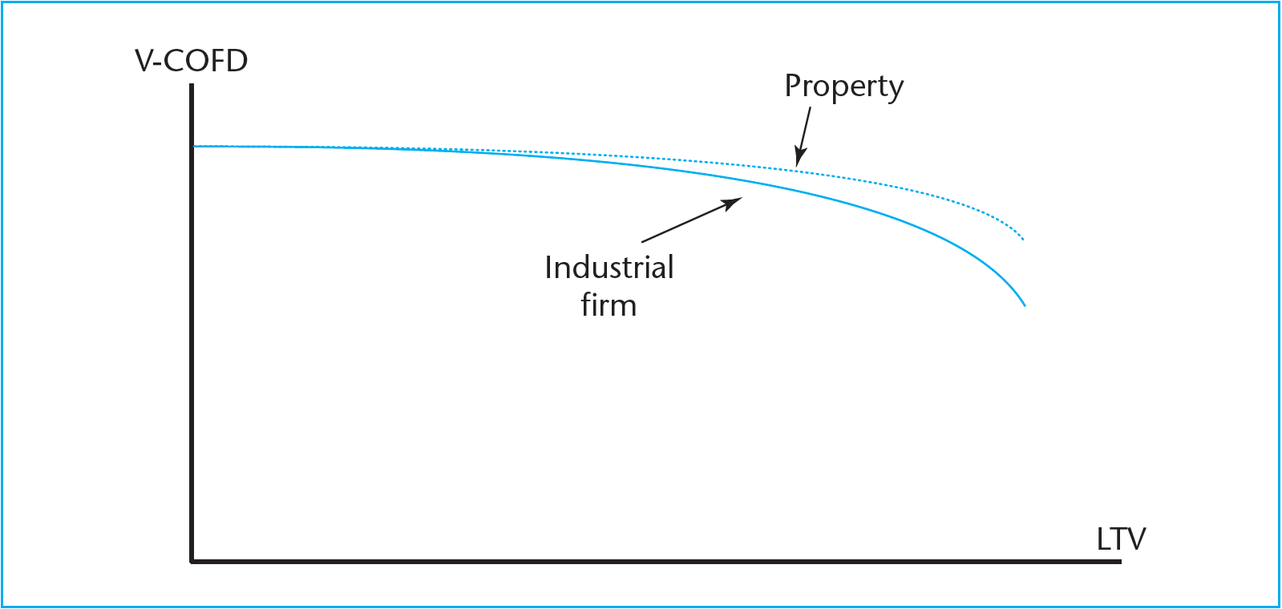
Exhibit 15-1:
Cost of Financial Distress

Slide 12
15.2.4
Debt and Inflation
Notes:
Debt can actually make the levered equity a positive speculation on inflation.

Slide 13
Exhibit 15-2: Example of effect of inflation on ex-post levered equity appreciation returns with 1-year loan...
Notes:
Note that the real return to the levered equity actually increases with ex post realizations of inflation (above the ex ante expectation), and vice versa.

Slide 14
15.3
Project Level Capital Structure in Real Estate
Much real estate finance occurs at the micro-level of individual investments in properties, projects, or “deals ."
Hence, much “capital structure” in real estate occurs at this micro-level.
Why?...
  Much real estate investment is still done directly by individuals or small entrepreneurial firms.
  Also real estate assets are relatively simple, tangible and “transparent”: Makes them ideal candidates for secured debt and other types of project-level financing
  (External investors need to feel confident that they know what is going on in the investment even if they don’t have direct management control or highly specialized expertise.)
  Also, the law governing real property rights facilitates this type of finance.

Slide 15
General points:
Just because finance is at the project (asset) level does not alter the basic principles and considerations presented in Chs 13-15.
Classical micro-level real estate finance consists of equity and debt (mortgage):
      Chs 13 & 14, & Sects 15.1 & 15.2 apply.
In recent years, capital markets have become more sophisticated.
More types of investment vehicles tailored to a more diverse range of investors. Result is growth in more complex capital structures at the micro-level. (Ways & means to get more leverage! Hence: Watch out!)
Consider some of the new, additional types of financing and capital structures being used for real estate investments in the U.S. today . . .
Two major purposes of these “fancier” structures (same as traditional):
  Match risk & return (& CF timing & liquidity) preferences to heterogeneous investors
  Provide appropriate performance incentives to parties controlling the underlying physical capital (the real estate).
Esp for multi-layer project finance.
Esp for JV splits.

Slide 16
Multi-layer project finance…
Multiple-Note 1st-lien Mortgage
1st-lien mortgage (senior debt investment) is split into two or more separate notes. Allows separate investors or owners of the same mortgage.
Splitting may be done either “horizontally” or “vertically” (or both). With horizontal splitting the two notes are identical in terms of seniority and interest (“pari passu”). Sometimes one note will be securitized and the other held privately, or the two notes will both be securitized but into different CMBS pools (as the entire loan might be too large for any one pool).
With vertical splitting there may be an “A” note and a “B” note, with “A” having senior claim to cash flow or collateral. In effect, the B-note becomes much like a “second mortgage” or subordinate debt, though it is structured as a note on a single underlying mortgage. Sometimes the A-note will be securitized and the B-note held privately.
From equity investors’ perspective, the whole thing is just like one senior debt obligation.

Slide 17
Multi-layer project finance…
Mezzanine Debt
So-called “mez debt” is an investment vehicle structured as a loan, may include a “lien” on the underlying property, but often unsecured to operating entity, in any case subordinated to other specified senior investment vehicles (such as 1st-lien mortg), but mez is senior to equity.
Mez debt investors typically don’t receive return on or of their investment until after senior debt holders are fully compensated for what is owed them.
Mez debt capital is typically “drawn” or placed into the investment before the senior debt capital.
Mez debt thus provides a buffer of capital exposure helping to protect the senior debt investors.
Mez debt typically carries interest rates considerably above those of first mortgages. Similar to CMBS “B piece” only not based on diversified pool of mortgages but rather on single property asset collateral.

Slide 18
Multi-layer project finance…
Preferred Equity
Similar to mez debt (provides a contractually-stated dividend or yield payment in the form of a “guaranteed” return).
But normally subordinated to any secured debt on the property and any mez debt to the operating entity. May be a 3rd layer (out of 4).
Generally does not include formal collateral or lien on the underlying real estate.
Preferred equity senior to common equity in priority of claims.
Preferred equity obtains its returns usually purely in the form of a preferred dividend (no appreciation of principle or capital paid in).
Sometimes the preferred return not paid out currently accumulates with (or without) compounding.
In capital structures where there is both mez debt and preferred equity, usually the preferred equity goes in before, and comes out after, the mez debt capital, and the preferred equity return may be higher than the mez debt return.

Slide 19
Multi-layer project finance…
Common (or Residual) Equity
This is normally the property ownership entity that has the operational management responsibility and primary governing control of the project. This may itself be a multiple-party JV entity.
Common equity has no guaranteed or contractual return and receives only the residual cash flow after the other senior investment vehicles have been paid their preferred returns.
(However, common equity is sometimes entitled to return of its paid-in capital with zero return prior to preferred equity being paid its preferred return.)

Slide 20
JV profits splits…
Differentiated Equity Partners (Classes)
Differentiate investors according to what they bring into the deal and what they want to get out of it. Typical joint venture (JV) profit & capital contribution agreement.
Entrepreneurial (mgt) investor may essentially bring operational management ability and the deal itself (e.g., in a development, the land with entitlements and permits, as well as the project design).
Money partner brings most of the required equity cash but lacks the ability or desire to manage the operation of the project or property at the more detailed level.
Define different “classes” of partners or stockholders in the ownership equity entity, e.g.:
Entrepreneurial partner has operational control.
Money partner has control over major capital decisions (financing and asset buy/sell decisions, maybe major leasing decisions, maybe ultimately over project mgt).
Entrepreneurial partner may or may not subordinate some of its equity claim to that of the money partner (though the entrepreneurial partner may also take a fee for service, and a “promoted interest” – greater than pro rata).

Slide 21
JV profits splits…
Differentiated Equity Partners (Classes), cont.:
“Splits” . . .
Common arrangement splits the equity entity’s overall cash flow among the partners on a “pro rata pari passu” basis (proportionately relative to their capital contributions, equal seniority)…
Until the equity entity achieves a certain “hurdle” return (specified either on a cumulative current or a look-back IRR basis, or both);
Beyond that hurdle return the cash flow split is differentiated to provide entrepreneurial partner with a proportion greater than its capital contribution (either on a current or back-end basis).
This is called a “promote," and surpassing the return hurdle is referred to as “earning the promote."
Provides partner charged with operational management more incentive to make the project a success. (Such success benefits all investors in the project.)
(The promote structure may also provide some degree of “reward” for putting the deal together in the first place.)

Slide 22
Types of Cash Flow “Waterfall” Splits: Vertical, Horizontal, Differ Oper/Reversion…
Operating Cash Flows: “Return On”
Reversion Cash Flows: “Return Of & On”
Money Ptnr:
“pari passu” but not “pro rata”
Mgr Ptnr:
“pari passu” but not “pro rata”:
“Promote”
Money Ptnr:
“pari passu” but not “pro rata”
Mgr Ptnr:
“pari passu” but not “pro rata”
“Promote”
Less than proportionate share
More than proportionate share
Less than proportionate share
More than proportionate share
2nd Hurdle
2nd Hurdle
Money Ptnr:
“pro rata pari passu”
Mgr Ptnr:
“pro rata pari passu”
Money Ptnr:
“pro rata pari passu”
Mgr Ptnr:
“pro rata pari passu”
Cash flow order
Cash flow order
share in proportion to contribn
share in proportion to contribn
share in proportion to contribn
share in proportion to contribn
1st Hurdle
1st Hurdle
Senior Claim
(e.g., debt, or money ptnr)
“seniority”
Senior Claim
(e.g., debt, or money ptnr)
“seniority”
First claim until coupon or 1st hurdle return obtained
First claim of , then 1st claim on (or possibly 1st on both)

Slide 23
JV profits splits…
Differentiated Equity Partners (Classes), cont.:
“Splits” . . .
Focus here (in Part V) is on micro-level, hence, on single-deal JVs. However…
Similar procedures and practices and terminology also typically apply to:
On-going joint ventures (multiple deals, sourced over time, often open-ended relationship between money partner & managing/entrepreneurial partner.
Private equity funds: Co-mingled investment funds (especially for closed-end, finite-lived, typically for “value-added” or “opportunistic” investment “styles”: See Chapter 26 for more about macro-level investment management). For example, the “promote” structure described here provides fund managers with what is termed their “carried interest” source of compensation (which under 2003 law was taxed as capital gains, at 15%).

Slide 24
15.3.2: Numerical Example of Multi-tiered Project Capital Structure
Consider the $1,000,000 apartment property investment example of Ch.14.
Only now let’s assume it is a development project:
  Time-to-build: 1 year (projected value on completion = $1,000,000).
  Up-front land cost: $200,000.
  Construction cost: $750,000 payable on completion (including interest), financed by 1st-lien construction loan.
  Hence: $950,000 total devlpt cost ($50,000 projected “entrepreneurial profit”).
  Take out construction loan on completion with $750,000 permanent mortgage (1st -lien).
  Equity ownership entity is a “joint venture” with 2 partners: “entrepreneurial” (residual) and “money” (senior), as follows:
⬅ Amort $2000/yr.

Slide 25
Recall the apartment investment example of Chapter 14 . . .

Slide 26
The deal structure . . .
Money partner contributes 90% of the equity cash requirement (that is, $180,000 of the $200,000 land price at Year 0).
Entrepreneurial partner contribute the rest of the cash, has operational management control.
Money partner receives annual preferred return of 6% (any unpaid current return accumulates forward with annual compounding).
Any positive net operating cash flow from the property (after the debt service has been paid) will go:
  1st) To provide money partner with preferred 6% return (as current as possible), then
  2nd) Split 50/50 between the two partners (even though the money partner contributes 90% of the equity capital).
Reversion cash flow from net resale proceeds (after debt repayment) will go first to provide the money partner with her preferred 6% return (look-back).
Any remaining cash available upon termination will go:
  1st) To pay back the entrepreneurial partner for his capital contribution (with zero return) and next
  2nd) Split 50/50 between the two partners.
Notes:
The arrangement described here does not provide for a pro rata pari passu split of residual cash flow prior to the earning of the 6% return for the money partner. Thus, this is more of a senior/subordinate preferred return arrangement than a classical return hurdle-with-promote arrangement, with consequences for the entrepreneurial partner that we shall see shortly. While the structure described here could well exist in particular circumstances in the real world, we are using it here more for pedagogical purposes, in order to make a point about fairness of splits arrangements, and in order to demonstrate capital accounting for senior portions of the capital structure.

Slide 27
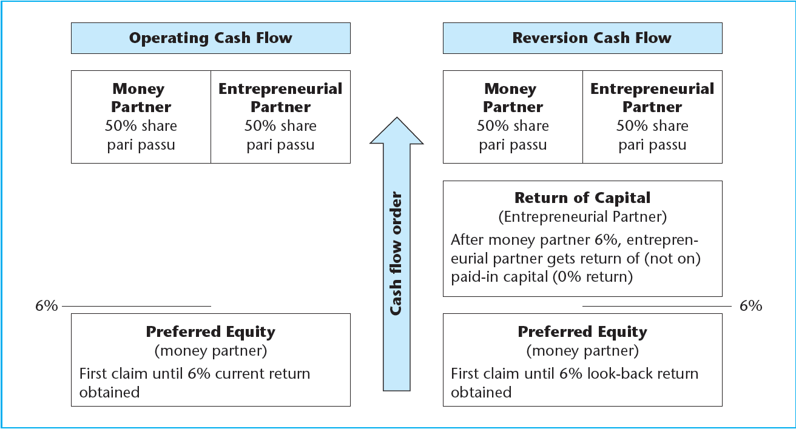
Exhibit 15-3: Apartment Example Waterfall Illustration

Slide 28
Exhibit 15-4

Slide 29
Preferred equity capital account: First two years…
⬅ Return “on”
⬅ As current as possible*
But not yet
return “of”
(current only)
*5302 = MIN(MAX((16750-11448),0),(190800-180000)) = Whatever is available from current Oper EBTCF to pay back-owed earned but not yet paid pref return on (not of) cumulative pref equity capital paid in.

Slide 30
Entity level oper.CF yr.11.
Terminal
year
(yr.11)
Cash
Flows
and
Splits
Entity level reversion.
Reflects cumulated unpaid current preferred returns, plus additional capital paid in to finance capital improvement expenditures
Entrepreneurial partner investment (0 return)
⬅ Asset level
Net sale proceeds of property
OLB on permanent mortgage
Remainder
Includes from yr.11 operations: 21195 = 6% of 238685 + 4707backOwedCurrent + 0.5*(23361-19028) = 14321 + 4707 + 2167.
From reversion: 291301 = 233978 + 0.5*(374622-233978-25998).
Total: 21195 + 291301 = 312496.

Slide 31
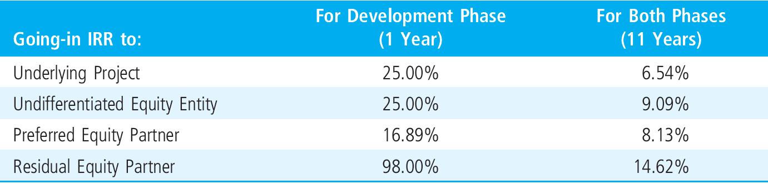
Resulting expected returns (ex ante):
Are these “ fair ” ? . . .

Slide 32
One way to approach this is to conduct sensitivity analysis . . .
e.g., Construct “Optimistic” and “Pessimistic” outcome scenarios, as follows:
Initial rents such that Year 2 NOI is either $63,000 or $57,000 instead of the proforma (expected) assumption of $60,000. (This results in Year 1 completed building values either $1,050,000 or $950,000, instead of the $1,000,000 base case assumption.)
Annual NOI growth rate beyond Year 2 either up to 2% or down to 0% instead of the base-case assumption of 1%.
Year-11 terminal yield (going-out resale cap rate) either down to 4.5% or up to 7.5% from the base case assumption of 6.0%.
Then see if ex ante (going-in expected) return risk premia are proportional to risk as defined by the spread in the IRR outcomes…

Slide 33
Risk & Return Analysis: Partner Breakout…
Subordinated (entrepreneurial) partner in this deal is getting less expected return risk-premium per unit of risk than the Senior (money) partner…

Slide 34
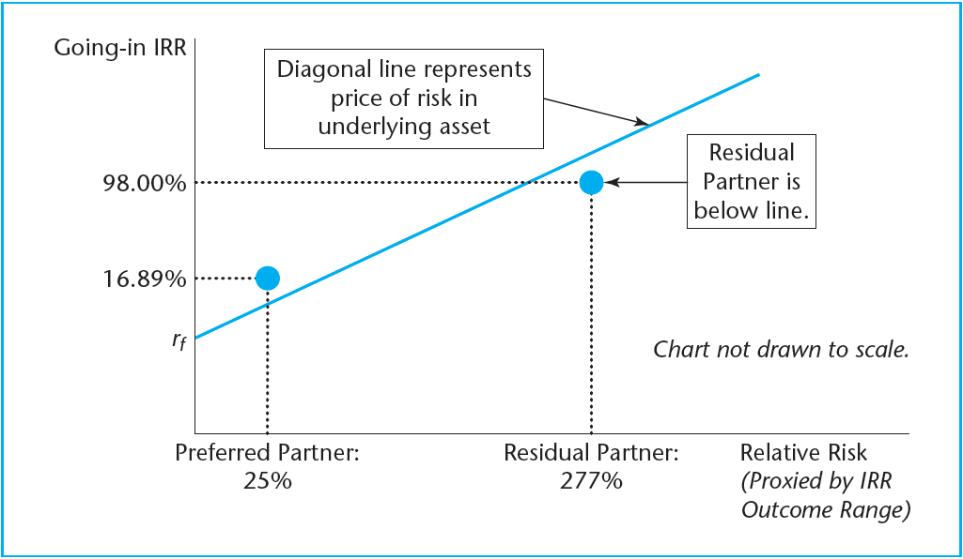
This suggests perhaps a modification of the deal structure is in order…
EXHIBIT 15-6 Framework for Evaluating Fairness of Capital Structure Terms
Note: If diagonal line based on underlying property & debt, then it is only SML if investment is @ MV. (NPV=0 based on MV).
(e.g., this deal structure did not include a pro rata pari passu component.)

