Slide 1
Chapter 13
LEVERAGE
(The use of debt)

Slide 2
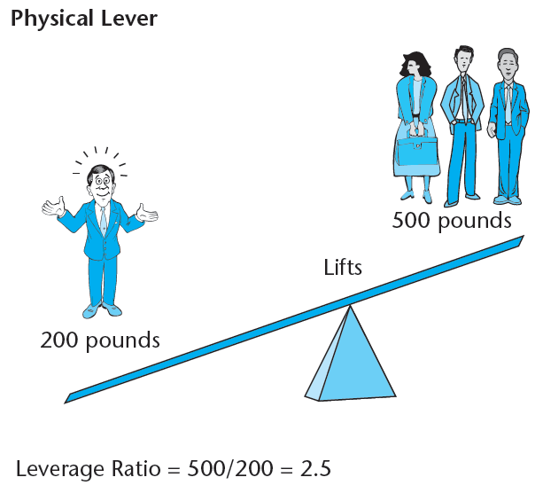
The analogy of physical leverage & financial leverage...
“Give me a place to stand, and I will move the earth.”
- Archimedes (287-212 BC)

Slide 3
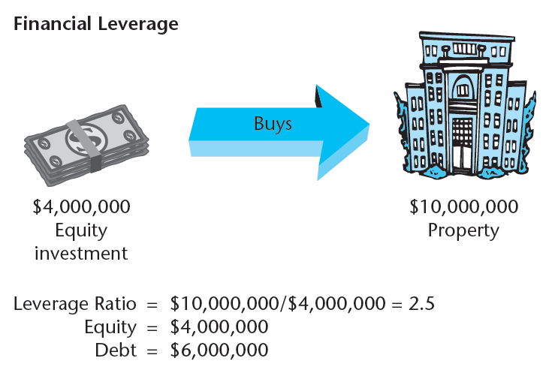

Slide 4
Terminology...
“Leverage”
“Debt Value”, “Loan Value” (L) (or “D”).
“Equity Value” (E)
“Underlying Asset Value” (V = E+L):
"Leverage Ratio“ = LR = V / E = V / (V-L) = 1/(1-L/V)
(Not the same as the “Loan/Value Ratio”: L / V,or “LTV” .)
“Risk”
The RISK that matters to investors is the risk in their total return, related to the standard deviation (or range or spread) in that return.

Slide 7
Effect of Leverage on Risk & Return
(Numerical Example)…
Example Property & Scenario Characteristics:
Current (t=0) values (known for certain):
E₀[CF₁] = $800,000
V₀ = $10,000,000
Possible Future Outcomes are risky (next year, t=1):
"Pessimistic" scenario (1/2 chance):
CF₁ = $700,000; V₁ = $9,200,000.
"Optimistic" scenario (1/2 chance):
CF₁ = $900,000; V₁ = $11,200,000.
$11.2M
+ 0.9M
Property:
50%
$10.0M
50%
$9.2M
+0.7M
Loan:
$6.0M
100%
$6.0M
+0.48M

Slide 8
Case I: All-Equity (No Debt: Leverage Ratio=1, L/V=0)...
Item Pessimistic Optimistic
Inc. Ret. (y):
Ex Ante:
RISK:
App. Ret. (g):
Ex Ante:
RISK:
Case II: Borrow $6 M @ 8%, with DS=$480,000/yr
(Leverage Ratio=2.5, L/V=60%)...
Item Pessimistic Optimistic
Inc. Ret.:
Ex Ante:
RISK:
App. Ret.:
Ex Ante:
RISK:
700/10000= 7%
900/10000= 9%
(1/2)7% + (1/2)9% = 8%
±1%
(9.2-10)/10 = -8%
(11.2-10)/10=+12%
(1/2)(-8) + (1/2)(12) = +2%
±10%
(0.7-0.48)/4.0= 5.5%
(0.9-0.48)/4.0= 10.5%
(1/2)5.5 + (1/2)10.5 = 8%
±2.5%
(3.2-4.0)/4.0 = -20%
(5.2-4.0)/4.0 = +30%
(1/2)(-20) + (1/2)(30) = +5%
±25%

Slide 9
➔ Return risk (y,g,r) directly proportional to Levg Ratio (not L/V).
➔ E[g] directly proportional to Leverage Ratio.
➔ E[r] increases with Leverage, but not proportionately.
➔ E[y] does not increase with leverage (here).
➔ E[RP] = E[r]-rf is directly proportional to Leverage Ratio (here)…

Slide 10
Exhibit 13-4: Effect of Leverage on Investment Risk and Return:
The Case of Riskless Debt...

Slide 11
Exhibit 13-5: Effect of Leverage on Investment Risk and Return:
The Case of Risky Debt...

Slide 12
A really useful formula. . .
Section 13.3
The "Weighted Average Cost of Capital" (WACC) Formula . . .
r_{P} = (L/V)r_{D} + [1-(L/V)]r_{E}
Derivation of the WACC Formula:
V = E+D
Where: r_{E} = Levered Equity Return,
r_{P} = Property Return,
r_{D} = Debt Return,
LTV=Loan-to-Value Ratio (D/V).
Invert for equity formula:

Slide 13
Or, equivalently, if you prefer . . .
E = V-D
Where: r_{E} = Levered Equity Return,
r_{P} = Property Return,
r_{D} = Debt Return,
LR=Leverage Ratio (V/E).

Slide 14
Using the WACC formula in real estate:
The "Weighted Average Cost of Capital" (WACC) Formula . . .
r_{P} = (L/V)r_{D} + [1-(L/V)]r_{E}
(L/V) = Loan/value ratio
r_{D} = Lender's return (return to the debt)
r_{E} = Equity investor's return.
Apply to r, y, or g. . .
E.g., in previous numerical example:
E[r] = (.60)(.08) + (.40)(.13) = 10%
E[y] = (.60)(.08) + (.40)(.08) = 8%
E[g] = (.60)(0) + (.40)(.05) = 2%
(Can also apply to RP.)
In real estate,
Difficult to directly and reliably observe levered return,
But can observe return on loans,
and can observe return on property (underlying asset).
So, "invert" WACC Formula:
Solve for unobservable parameter as a function of the observable parameters:
r_{E} = {r_{P} - (L/V)r_{D}} / [1 - (L/V)]
(Or in y or in g.)
(In y it’s “cash-on-cash” or “equity cash yield”)

Slide 15
Note:
WACC based on accounting identities:
Assets = Liabilities + Owners Equity,
Property Cash Flow = Debt Cash Flow + Equity Cash Flow
WACC is approximation,
Less accurate over longer time interval return horizons.

Slide 16
Using WACC to avoid a common mistake. . .
Suppose REIT A can borrow @ 6%, and REIT B @ no less than 8%. Then doesn’t REIT A have a lower cost of capital than REIT B?
Answer: Not necessarily. Suppose (for example):
REIT A: D/E = 3/7. ➔ D/V = L/V = 30%.
REIT B: D/E = 1. ➔ D/V = L/V = 50%.
& suppose both A & B have cost of equity = E[r_{E}] = 15%.
Then:
WACC(A) =(0.3)6% + (0.7)15% = 1.8% + 10.5% = 12.3%
WACC(B) =(0.5)8% + (0.5)15% = 4% + 7.5% = 11.5%
So in this example REIT A has a higher cost of capital than B, even though A can borrow at a lower rate. (Note, this same argument applies whether or not either or both investors are REITs.) You have to consider the cost of your equity as well as the cost of your debt to determine your cost of capital.

Slide 17
“POSITIVE” & “NEGATIVE” LEVERAGE
13.4
“Positive leverage” = When more debt will increase the equity investor’s (borrower’s) return.
“Negative leverage” = When more debt will decrease the equity investor’s (borrower’s) return.

Slide 18
“POSITIVE” & “NEGATIVE” LEVERAGE
Whenever the Return Component is higher in the underlying property than it is in the mortgage loan, there will be "Positive Leverage" in that Return Component...
See this via The “leverage ratio” version of the WACC. . .
r_{E} = r_{D} + LR*(r_{P}-r_{D})

Slide 19
Derivation of the Leverage Ratio Version of the WACC:
E = V-D
Where: r_{E} = Levered Equity Return,
r_{P} = Property Return,
r_{D} = Debt Return,
LR=Leverage Ratio (V/E).

Slide 20
Section 13.5
e.g.:
Total: 10% =
(67%)*6%+(33%)*18%
Yield: 8% =
(67%)*7% + (33%)*10%
Growth: 2% =
(67%)*(-1%)+(33%)*8%
Leverage skews total return relatively toward growth component, away from current income yield.
Notes:
Loan “g” = Loan (r-y) = 6%-7%, or 8%-9% = -1%.

Slide 21
SUMMARY OF LEVERAGE EFFECTS...
(1) Under the typical assumption that the loan is less risky than the underlying property, leverage will increase the ex ante total return on the equity investment, by increasing the risk premium in that return.
(2) Under the same relative risk assumption, leverage will increase the risk of the equity investment, normally proportionately with the increase in the risk premium noted in (1).
(3) Under the typical situation of non-negative price appreciation in the property and non-negative amortization in the loan, leverage will usually shift the expected return for the equity investor relatively away from the current income component and towards the growth or capital appreciation component.

Slide 22
Note: The preceding simple rule about what determines “pos” vs “neg” leverage (relationship betw prop vs dbt return) does not always hold with IRR attributes, because the WACC does not apply exactly for multi-period returns or components…
For example, across the four properties in the HBS “Angus Cartwright” Case, the rule works in 11 out of 12 cases. (All except Fowler YC…)
Note that in the simple return, r = y + g, while in the IRR the correspondent to “g” breaks out into two components, CFC + YC. That is:
IRR ≈ IY + (CFC + YC) ≈ y + g.
The pos/neg levg rule will always hold for IY, and therefore will always hold for the combination (CFC+YC), but it may not always hold separately for both CFC and YC (as we see in Cartwright).

