Slide 1
CHAPTER 7 LECTURE
BACKGROUND . . .

Slide 2
Lecture Outline
Orientation
Evolution
Asset Mkt Basics (Investors)
Four Asset Classes
Two RE Investmt Mkts

Slide 3
From Part II to Parts III-VII we’re moving from Space Mkt & Dvlpt Industr to focus on Asset Mkt…
Exhibit 2-2
SPACE MARKET
LOCAL
SUPPLY
DEMAND
&
ADDS
(Landlords)
(Tenants)
NATIONAL
NEW
ECONOMY
RENTS
&
OCCUPANCY
FORECAST
FUTURE
DEVELOPMENT
INDUSTRY
ASSET MARKET
IF
IS
SUPPLY
YES
DEVELPT
CASH
(Owners
PROFITABLE
FLOW
Selling)
?
CAPI
TAL
PROPERTY
MKT
MKTS
CONSTR
MARKET
REQ’D
D
EMAND
COST
VALUE
CAP
(Investors
INCLU
RATE
Buying)
LAND
= Causal flows.
= Information gathering & use.

Slide 4
Exhibit 1-6: Major Types of Capital Asset Markets and Investment Products
 | Public Markets: | Private Markets:
Equity Assets: | Stocks REITs Mutual funds ETFs | Real Property Private firms Oil & Gas Partnerships Hedge Funds
Debt Assets: | Bonds MBS Money instruments | Bank loans Whole Mortgages Venture Debt

Slide 5
Lecture Outline
Orientation
Evolution
Asset Mkt Basics (Investors)
Four Asset Classes
Two RE Investmt Mkts

Slide 6
Evolution of U.S. Institutional Real Estate Market*
Source: PPR
*Somewhat narrow definition of “institutional real estate”.

Slide 7
Exhibit 7-11: The “Roller Coaster Ride” in US Institutional Commercial Property Prices over Recent Decades
Gray shade indicates GDP recession
2003-7
Boom
& Bubble
Reckless
Debt
1998-99
Fin Crisis,
REIT Bust
Tax reform
Boom,
Tax incentives
Overbuilding
2007-09
Crash,
2010
bottom?
S&L Dereg
Disinflation
2001-02
Recession but asset demand
End of
60s
Boom
Securitzn:
- REIT boom & bubble
- CMBS
ERISA: MPT
=>P.F.demand
S&L crisis:
FIRREA
REIT bust,
Recession
Inflation Fear

Slide 8
Even within the “institutional” properties, there is some asset mkt segmentation…
“Major” = Bos, NYC, DC, Chi, SF, LA.
“Non-Major” = All else.
This is all larger properties ($2.5M+), corresponds roughly to CoStar “Investment” properties.

Slide 9
Lecture Outline
Orientation
Evolution
Asset Mkt Basics (Investors)
Four Asset Classes
Two RE Investmt Mkts

Slide 10
WHY DO PEOPLE INVEST?..
3. Asset Mkt Basics
Individuals:
  THE 25-YR-OLD "YUPPY" ?
  THE 25-YR-OLD "DINC" COUPLE ?
  THE 35-YR-OLD "YOUNG FAMILY" ?
  THE 45-YR-OLD "MID-LIFE CRISIS" ?
  THE 65-YR-OLD "RETIREE" ?
  ➔ DIFFERENT LIFE STYLES, LIFE CYCLES, PERSONAL GOALS, LEVELS OF WEALTH

Slide 11
WHY DO PEOPLE INVEST?
3. Asset Mkt Basics
Institutions:
  LIFE INSURANCE COMPANIES
  PENSION FUNDS
  MUTUAL FUNDS
  BANKS
  FOUNDATIONS
  ➔DIFFERENT CONSTITUENCIES, EXPERTISE, LIABILITIES, REGULATIONS, SIZES

Slide 12
WHY DO PEOPLE INVEST?
3. Asset Mkt Basics
===> DIFFERENT TIME HORIZONS, RISK TOLERANCES, NEEDS FOR INCOME vs GROWTH
Therefore, . . . (opportunities for new product development in the investment industry)

Slide 13
TWO MAJOR INVESTMENT OBJECTIVES:
3. Asset Mkt Basics
GROWTH (SAVINGS) - RELATIVELY LONG-TERM HORIZON (NO IMMEDIATE NEED);
INCOME (CURRENT CASH FLOW) -- SHORT-TERM & ON-GOING NEED FOR CASH.

Slide 14
MAJOR CONSTRAINTS & CONCERNS:
3. Asset Mkt Basics
RISK
LIQUIDITY
TIME HORIZON
MANAGEMENT BURDEN, EXPERTISE
AMOUNT OF FUNDS AVAILABLE FOR INVESTMENT (SIZE)
CAPITAL CONSTRAINT
Therefore (again), . . . What?
Need for variety of investment products & vehicles: ➔ “Investment Industry”…

Slide 15
Lecture Outline
Orientation
Evolution
Asset Mkt Basics (Investors)
Four Asset Classes
Two RE Investmt Mkts

Slide 16
RE Equity Includes:
Housing equity: $10,900 Billion
CommRE equity: 4,700 (excluding corpRE)
Ag & Timber: 1,200
REIT equity: 300
Notes:
This pie includes private homes, but excludes private debt (unlike Exh.1-8). Here, only real estate “pure play” equity is included in the real estate segment. Mortgages and corporate real estate value are included in the “bonds” and “stocks” segments.

Slide 17
Four major investment asset classes: Stocks, Bonds, Real Estate, Cash:
7-6:

Slide 18
Exhibit 7-7: HISTORICAL TOTAL RETURN PERFORMANCE OF MAJOR INVESTMENT ASSET CLASSES, COMPARED TO INFLATION (CPI), 1969-2010
Capital value growth + Income reinvested
Notes:
Based on annual total returns (income plus capital value change).

Slide 19
4. Four Asset Classes

Slide 20
4. Four Asset Classes
First half of the period
Capital value growth + Income reinvested
Calendar year annual end-of-year values

Slide 21
4. Four Asset Classes
Second half of the period
Capital value growth + Income reinvested
Calendar year annual end-of-year values

Slide 22
4. Four Asset Classes

Slide 23
4. Four Asset Classes

Slide 24
Lecture Outline
Orientation
Evolution
Asset Mkt Basics (Investors)
Four Asset Classes
Two RE Investmt Mkts

Slide 25
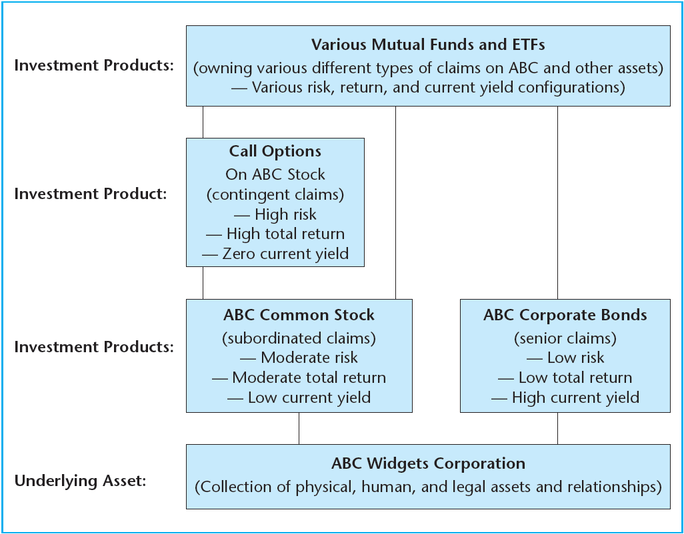
EXHIBIT 7-2
Real Estate Example of the Investment System

Slide 26
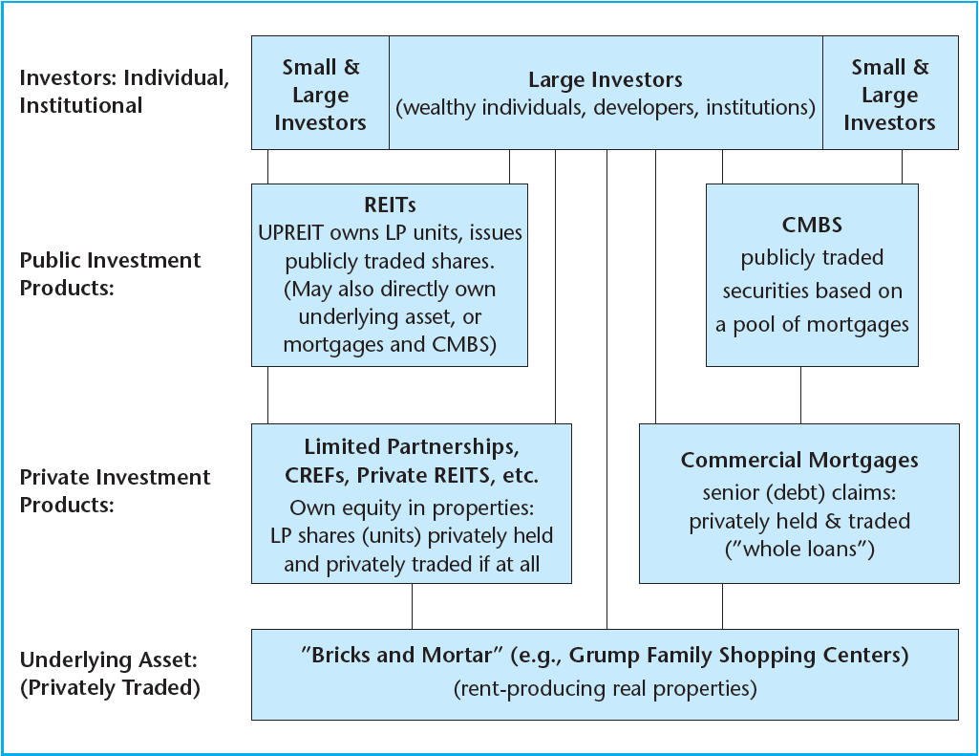
EXHIBIT 7-2
Real Estate Example of the Investment System

Slide 29
Exhibit 25-8 (from Chapter 25), showing relation betw REIT-based vs Direct Private Mkt based CRE asset price evolution…

Slide 30
7.3.2. Sources of Debt & Equity Capital
Institutional Real Estate Capital Structure: 2011
Source: PPR, 2011

Slide 31
Exh.7-12: How is institutional real estate financed?... Buyers’ equity:
Properties $5M+
Source: Real Capital Analytics Inc.

Slide 32
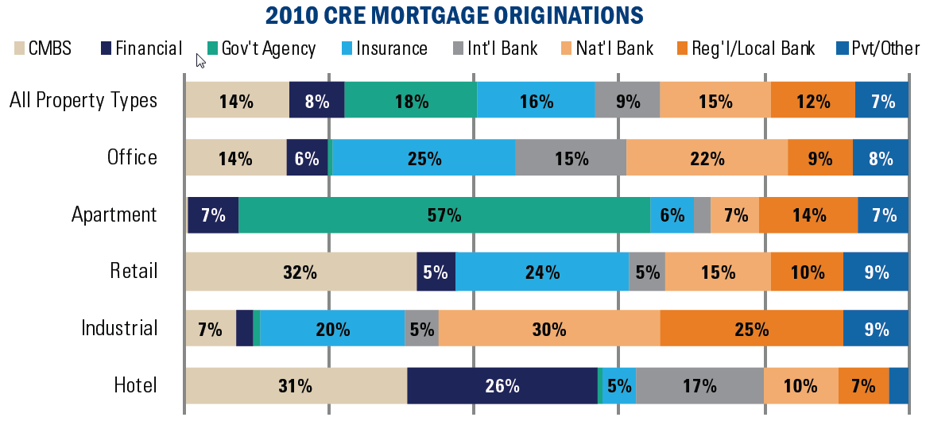
Exh.7-13: How is institutional real estate financed?... Buyers’ debt:
Source: Real Capital Analytics Inc.

Slide 33
7.3.2. Sources of Debt & Equity Capital
Institutional Real Estate Debt Sources:
Outstanding Balance as of 2011
Source: PPR, 2011

