Slide 1
Chapter 5:
Inside the City II:
A Closer Look

Slide 2
Introduction
Chapter 4 and the Monocentric City Model presented the basics, but we need to broaden our study of urban form and land value to include some key aspects of the real world that are important for real estate practitioners and investors…

Slide 3
Chapter 5
Learning Objectives:
The difference between land value and land rent, and the key determinants of land values in and around a city.
Why uncertainty can result in higher land values but less land development in a city.
Why different land uses and densities occur at different locations within a city.

Slide 4
Chapter 5
Learning Objectives (cont’d):
How neighborhoods grow and mature and sometimes decline and rise again.
The concept of property life cycle, and its implications for real estate investors.
The nature and cause of the major characteristics of the urban form of the typical American city, and how this form has been changing.

Slide 5
Effect of Urban Growth & Uncertainty on Land Rents & Land Values Just Beyond the Urban Boundary
Exhibit 5-1: Components of Land Rent Outside & Inside the Urban Boundary, Under Uncertainty . . .
When you develop today, you give up the option to develop tomorrow instead. Devlpr needs to be compensated for loss of this option.
Location Rent
Irreversibility Rent
Construction Rent
Agricultural Rent
B
Distance from CBD
B = Urban Boundary
Exhibit 5-2: Components of Land Value Outside & Inside the Urban Boundary, Under Uncertainty . . .
PV of property asset includes PV of expected future growth in rents developed property can earn after its development.
Location Value
Construction Cost
Irreversibility Premium
Growth Premium
Agricultural Value
Building today vs next yr does not forego oppty to obtain this growth.
B
Distance from CBD
B = Urban Boundary

Slide 6
Effect of Urban Growth & Uncertainty on Land Rents & Land Values Just Beyond the Urban Boundary
Exhibit 5-1: Components of Land Rent Outside & Inside the Urban Boundary, Under Uncertainty . . .
As boundary expands, land value just beyond boundary can grow rapidly, due to increase in growth premium & irreversibility (option) premium values, depending on how fast the boundary is expanding, and the magnitude of the location value rent gradient inside the boundary.
Location Rent
Irreversibility Rent
Construction Rent
Agricultural Rent
B
Distance from CBD
B = Urban Boundary
Exhibit 5-2: Components of Land Value Outside & Inside the Urban Boundary, Under Uncertainty . . .
Location Value
Construction Cost
Irreversibility Premium
Growth Premium
Agricultural Value
B
Distance from CBD
B = Urban Boundary
Direction of bdy expansion
Direction of time flow

Slide 7
Effect of Urban Growth & Uncertainty on Land Rents & Land Values Just Beyond the Urban Boundary
Exhibit 5-1: Components of Land Rent Outside & Inside the Urban Boundary, Under Uncertainty . . .
As boundary expands, land value just beyond boundary can grow rapidly, due to increase in growth premium & irreversibility (option) premium values, depending on how fast the boundary is expanding, and the magnitude of the location value rent gradient inside the boundary.
Location Rent
Irreversibility Rent
Construction Rent
Agricultural Rent
B
Distance from CBD
B = Urban Boundary
Exhibit 5-2: Components of Land Value Outside & Inside the Urban Boundary, Under Uncertainty . . .
Key place & time of value creation!
Location Value
Construction Cost
Irreversibility Premium
Growth Premium
Agricultural Value
B
Distance from CBD
B = Urban Boundary
Direction of bdy expansion
Direction of time flow

Slide 8
These considerations give us a fifth principle of urban form:
Principle 5:
“Faster urban growth and greater uncertainty in that growth will tend to increase urban land values, with the uncertainty also suggesting that a smaller, denser city is optimal, as rational development is postponed longer than it otherwise would be.”

Slide 9
Varied Land Use and Density…
In Circlopolis we had only one land use (housing) of only one density (2 houses/acre).
Real world cities have multiple land uses:
  Commercial
  Industrial
  Residential
And multiple densities:
  High-rise
  Mid-rise
  Low-rise
  Spread-out

Slide 10
Varied Land Use and Density…
In cities in countries with market-based economies and more or less freely-functioning land markets, we tend to see higher-intensity land uses (e.g., commercial uses and higher-density uses, taller buildings closer together), in the more central locations (CBD & other transport nodes).

Slide 11
What determines how different uses & densities are located and distributed within the city?

Slide 12
Recall the bid-rent function and the land rent gradient concepts from Chapter 4
Exhibit 5-3: Bid-Rent Functions of Three Land Uses With Differing Productivity & Sensitivity to Transport Cost . . .
Use can pay land the residual left over after other factors get necessary profit.
At any given location, this residual value is greater for some uses than for others.
Highest bidder wins.
Land Rent
A
B
C
Zone of Use B
Center
Distance from Center

Slide 13
Spatial depiction of previous slide’s transept
C
B
A
B
C

Slide 14
What indicates the productivity of a land use?
Height of bid-rent (residual) at central point.

Slide 15
What indicates the sensitivity of a land use to accessibility (transport costs)?
Steepness of bid-rent function (land rent gradient for that use).

Slide 16
Why is density (or intensity) of land use positively correlated with both land use productivity and sensitivity to accessibility?
Greater density ➔ More labor & capital applied per acre (➔ Greater Productivity)
Greater density ➔ More value of inputs & outputs per acre, most needing to be transported ➔ Greater Sensitivity (rent gradient). e.g., $250/Mi/Yr/Person transport cost ➔ $500/Mi rent gradient @ 2 hab/acre density, but $750/Mi gradient @ 3 hab/acre density.

Slide 17
In the land market, which type of use will prevail nearest the center?

Slide 18
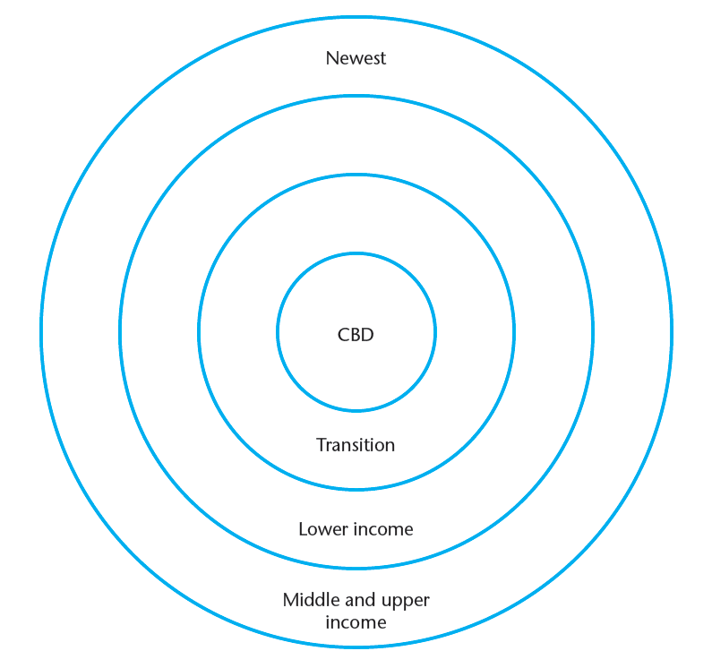
This result in part explains the classical Burgess Concentric Ring Model of Urban Form
This is a good model of the typical American city in the mid-20th century, and not a bad model even now.

Slide 19
Why is density (or intensity) of land use positively correlated with both land use productivity and sensitivity to accessibility?…
Greater density ➔ More labor & capital applied per acre (➔ Greater Productivity)
Greater density ➔ More value of inputs & outputs per acre, most needing to be transported ➔ Greater Sensitivity (rent gradient). e.g., $250/Mi/Yr/Person transport cost ➔ $500/Mi rent gradient @ 2 hab/acre density, but $750/Mi gradient @ 3 hab/acre density.

Slide 20
Recall the bid-rent function and the land rent gradient concepts from Chapter 4…
Exhibit 5-3: Bid-Rent Functions of Three Land Uses With Differing Productivity & Sensitivity to Transport Cost . . .
Land Rent
A
B
C
Zone of Use B
Center
Distance from Center

Slide 21
How does it happen that higher-income residences are farther from the central point, given that higher-income people have higher value of their time, causing them to have higher transport costs and therefore greater value of accessibility?…
In the Burgess Model . . .
[Hint 1: Consider cultural preferences for density, and the relation between density and land rent gradient.]
[Hint 2: Consider historical development patterns, from the center outward, and cultural/income preferences for “newness” of construction (latest building design styles, latest building technology).]

Slide 22
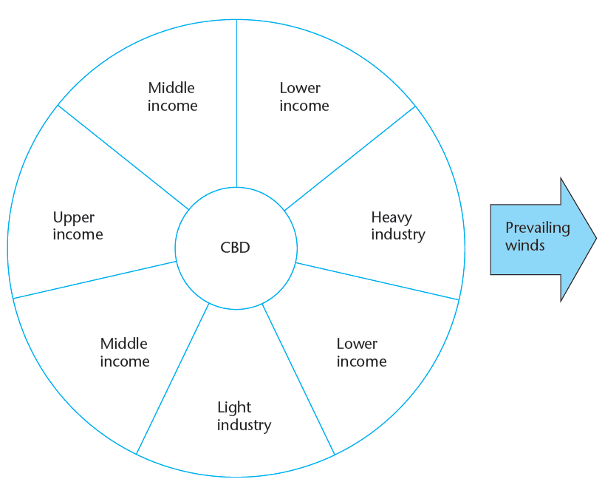
Here’s a famous alternative model: The Hoyt Sector Model of Urban Form…

Slide 23
Which model do you think is a more accurate depiction of urban land use structure?…
How would you draw the rings and sectors in the Boston metro area?…

Slide 24
Effect of Land Use Boundaries…
Similar land uses tend to clump together in districts or zones.
Some adjacent uses are more compatible than others.

Slide 25
What are some examples of compatible land uses (with favorable location externalities)?…
What are some examples of incompatible land uses (with negative location externalities)?…

Slide 26
Zones ➔ Boundaries between zones.
The boundary may have a depressing effect on adjacent location rent (even for compatible land uses)…
Exhibit 5-6: Effect of negative externalities near a land use boundary
Bid-rent
Comm.
Ctr.
Distance

Slide 27
Real cities are “polycentric” (not monocentric)…
CBD (Central Business District -- “Downtown”)
NBD (Neighborhodd Business District -- “Community Ctr”)
MAC (Major Activity Ctr, e.g., Airport, Harvard Sq, Fenway, Foxboro)
“Edge Cities” (as big or bigger than the CBD, e.g., Galleria in Atlanta, Tysons Corner in Washington/N.Va, Burlington/Hanscom in Boston…)
Polynuclear cities (Minneapolis-StPaul, Los Angeles, Ruhr)

Slide 28
All cities must be polycentric because different land uses have different and multiple “central points”.
Rent gradients and land values reflect this…
Exhibit 5-7: Rent Gradients in a Polycentric City . . .
MAC
NBC
CBD
MAC

Slide 29
All cities must be polycentric because different land uses have different and multiple “central points”.
Tysons Corner, VA: “Edge City”…

Slide 30
Neighborhood Succession Theory…
Exhibit 5-8: The Neighborhood Succession Model . . .
Land Value
More
Intensive
Devlpt?
Maturity
Rejuvination?
Growth
Decline
I
II
III
IV
Time

Slide 31
Example: Property prices on the Herengracht (canal) in central Amsterdam, 1628-1972 (adjusted for inflation, based on a repeat-sale regression). Note, in this location, buildings remained largely the same, usage almost entirely residential until 20th century, when substantial commercial conversion occurred.
Source: P. Eichholtz & D. Geltner, “Four Centuries of Location Value: Implications for Real Estate Capital Gain in Central Places” Working Paper, 1997.

Slide 32
When will major growth in land value occur?…
What are the implications for how common will be (and for the conditions underlying) large capital gains for real estate investors?…

Slide 33
5.4 Property Life Cycle & the Effect of Structural Depreciation
In addition to possible evolution of neighborhood HBU over time, each individual property will experience a life cycle related to the deterioration and rehabilitation (or redevelopment) of the structure on the site.

Slide 34
Exh.5-10: Property Value = Land Value + Structure Value
Property
$ Value
Components
U
P
U
K
P
U
K
U
P
L
P
S
L
C
R
R
R
R
Time
R = Construction / reconstruction points in time (typically 30-100 yrs between)
U = Usage value at highest and best use at time of reconstruction
P = Property value
S = Structure value
L = Land appraisal value (legal value)
C = Land redevelopment call option value (economic value)
K = Construction (redevelopment) cost exclu acquisition cost

Slide 35
The Depreciation Principle:
Real estate investment appreciation return (capital gain) is reflected by the change in “P” between reconstruction points in time (“R”), not by the change in land value or usage value of the site (the change in “U” or “L” values). Investment returns reflect the effect of real depreciation of the structure (the “S” value).

Slide 36
Example:
What is the rate of real depreciation (per year) relative to the usage value (value of HBU as if vacant) of a property that gets redeveloped on average every 50 years, and in which the site cost typically equals 20% of the total dvlpt/redvlpt cost (land + construction) at the time of construction?
i.e., At point “R” in time:
        P_{OLD} = L_{OLD} = C_{OLD} = 0.2U = 0.2P_{NEW ..}
Notes:
What was Walden Woods land cost pct of total devlpt cost?

Slide 37
Answer:
3.17%/Year real depreciation:
(1 - x)⁵⁰ = 0.2 ➔ x = 1 - 0.2^{1/50} ➔ x = 0.0317
That is: (1 - 0.0316)⁵⁰ = 0.2.

Slide 38
Suppose location value increases 2%/Yr in real terms. (In monocentric city model what could cause this?)
Then with the above property life-cycle (structural depreciation), what would be the expected long-run average annual rate of appreciation in property value (“capital gain”) experienced by investors?
(in real terms)

Slide 39
Answer:
Approximately 2% - 3.16% ≈ -1.2%.
More exact answer:
(1 + 0.02)(1 - 0.0316) - 1 = (1.02)(0.9684)-1 = 0.9878 - 1 = -0.0122 = -1.22%/Yr.
i.e., negative appreciation (positive depreciation), of 1.2% per year.
That’s in “real” (infla-adjstd) terms. If infla = 3%/yr, ➔ nominal apprec = 3% - 1.2% =1.8%/yr.

Slide 40
Three causes (sources) of structure (building) depreciation
(1) Physical depreciation:
  The structure physically “wears out”, costs more and more to operate and keep up, and/or gradually falls apart. Example: Roof leaks, foundation cracks, HVAC chokes, etc…
(2) Functional depreciation:
  The structure becomes more and more “out of date” in terms of the current needs and preferences of the space market (potential users of the building). Example: Class A office buildings now need atriums, heliports & natural light, fiber-optic cables, and satellite access; instead of lobbies, copper wiring, and phone lines.
(3) Economic depreciation:
  The structure no longer serves the HBU of the site. Example: HBU (as if vacant) is now high-density apartment or condo, or commercial usage, instead of the single-family home that is on the site (which was the HBU when the home was built).

Slide 41
Of the three forms of depreciation . . .
Physical depreciation normally requires relatively frequent, routine capital improvement expenditures (small injections of capital at frequent “R” points).
Functional depreciation can often (but not always) be mitigated by less frequent, more major reconstruction or rehabilitation of the existing structure (larger injections of capital at occasional“R” points).
Economic depreciation usually (but not always) requires demolition and complete redevelopment of the site with a new structure (major injections of capital) at very infrequent points in time (infrequent“R” points), if ever.

Slide 42
“Extra” slides…
Example realistic numbers for property depreciation rates, life-cycle analysis…

Slide 43
Recall: Herengracht (“Gentlemen’s Canal”), Amsterdam

Slide 44
Even in Downtown Manhattan, Market Rents (for a given use) Don’t Trend Up in Real Terms (net of inflation)… (Note: this is not “same-property”, hence does not reflect building depreciation.)
Source: CBRE-EA
But note: Density (of built leasable SF/acre) has been increasing, such that same real rent/SF ➔ Greater real land value/acre. (May, or may not, more than offset real decline in rent.)

Slide 45
Same in Boston (no real increase)…
Source: CBRE-EA

Slide 46
Example: Boston Class A Office Properties…
Start from historical Class A office rent data for Boston sub-mkts. Suppose:
  Avg age of Class A rental stock remains constant (due to renewal).
  Class B rents 2/3 of Class A rents.
  30-year cycle A to B.
  Inflation (CPI) = 3%/yr in the future.
  Constant cap rates over time, & betw Class A & B (simplification).
  Suppose Bos CBD, Bos Suburb, Cambridge Class A off mkts max HBU (no further “jump”, no increase in HBU density or intensity).
1. What is trend of same-property (investment) price growth rate:
  In real (inflation-adjusted) terms?
  In nominal terms?
2. What if constant HBU real value?
3. What if constant real HBU and property appreciation/depreciation governed by 100-year reconstruction cycle in which redevelopment acquisition cost (site/land value) is 20% of the value of the new HBU?

Slide 47
Nominal (current-dollar) Rents:

Slide 48
Real (constant-dollar) Rents:

Slide 49
Real (constant-dollar) Rents:
For long-run analyses, always:
  Work with real (net of inflation) values (then add current or future infl back)
  Be aware of cycle in historical data (LR trend is pk-to-pk or trgh-to-trgh)

Slide 50
Trend in Boston Metro Office Market Rents, Nominal & Real:
Are these trends in property values?...
Or location (usage) values?... Recall section 5.4 (the “U” line in Exh.5-10…)
Property
$ Value
Components
U
P
U
K
U
K
P
U
P
L
P
L
S
R
R
R
R
Time

Slide 51
What does the 30-yr A-to-B cycle imply relative to HBU?
“x” is depreciation rate between “R” points…
If it takes 30 yrs to depreciate to 2/3 orig value…
OrigVal*(1 – x)³⁰ = NewVal = 0.67*OrigVal, ➔
x = 1 – 0.67^{1/30} = 0.9867 = 1.3%/yr.
But this is relative to the top-of-mkt HBU value…
If avg mkt rent reflects constant avg-age bldgs, then
Avg mkt rent rate of change = HBU val rate of change
e.g., 1.6%/yr depreciation (real), Boston A-Off mkt
➔ Class A same-property avg deprec rate =
1.6%/yr + 1.3%/yr = 2.9%/yr.
If inflation is 3%/yr, then nominal (current $) rate of same-property price appreciation is:
3%/yr – 2.9%/yr = +0.1%/yr (i.e., virtually flat).

Slide 52
Evolution of location or usage value in real terms…
If the recent Boston office market experience is typical (-1.6%/yr)…
dU/U = -1.6%
dP/P = -2.9%
Class A property depreciates @ 1.3%/yr RELATIVE TO HBU value
dL/L = -1.6%
Here “Land Value” is actually “Class B Building Value”
HBU real value evolution @ -1.6%/yr
30 year cycle (betw “R”s) evolution from “Class A” to “Class B” property
Class B rent = 2/3 Class A rent (& assume same cap rate for simplicity)…
      ➔ 2.9%/yr Real Depreciation of Built Property.

Slide 53
Evolution of location or usage value in nominal terms @ 3% infl…
If the recent Boston office market experience is typical (-1.6%real)…
dL/L = +1.4%
dP/P = +0.1%
Class A property depreciates @ 1.3%/yr RELATIVE TO HBU value
dU/U = +1.4%
Here “Land Value” is actually “Class B Building Value”
HBU real value evolution @ -1.6%/yr ➔ nominal 3%-1.6%=+1.4%/yr apprec
30 year cycle (betw “R”s) evolution from “Class A” to “Class B” property
Class B rent = 2/3 Class A rent (& assume same cap rate for simplicity)…
➔ 2.9%/yr real depr ➔ +0.1%/yr nominal apprec of Built Prop.

Slide 54
Real values reflect better the economic fundamentals.
But nominal values can be more important for debt & leverage considerations.

Slide 55
What if same 30-yr cycle but constant real HBU?
“x” is depreciation rate between “R” points…
If it takes 30 yrs to depreciate to 2/3 orig value…
OrigVal*(1 – x)³⁰ = NewVal = 0.67*OrigVal, ➔
x = 1 – 0.67^{1/30} = 1 – 0.9867 = 1.3%/yr.
But this is relative to the top-of-mkt HBU value…
If avg mkt rent reflects constant avg-age bldgs, then
Avg mkt rent rate of change = HBU val rate of change
e.g., 0%/yr depreciation (constant real HBU val)
➔ Same-property avg deprec rate =
0%/yr + 1.3%/yr = 1.3%/yr.
© 2014 OnCourse Learning. All Rights Reserved.
If inflation is 3%/yr, then nominal (current $) rate of same-property price appreciation is:
3%/yr – 1.3%/yr = +1.7%/yr.

Slide 56
Evolution of location or usage value in real terms…
If HBU value holds constant in real terms…
© 2014 OnCourse Learning. All Rights Reserved.
Here “Land Value” is actually “Class B Building Value”
HBU real value evolution @ 0%/yr
30 year cycle (betw “R”s) evolution from “Class A” to “Class B” property
Class B rent = 2/3 Class A rent (& assume same cap rate for simplicity)…
      ➔ 1.3%/yr Real Depreciation of Built Property.

Slide 57
Evolution of location or usage value in nominal terms @ 3% infl…
If HBU real values remain constant…
dL/L = +3%
dP/P = +1.7%
Class A property depreciates @ 1.3%/yr RELATIVE TO HBU value
dU/U = +3%
© 2014 OnCourse Learning. All Rights Reserved.
Here “Land Value” is actually “Class B Building Value”
HBU real value evolution @ 0%/yr ➔ nominal @ +3%/yr apprec
30 year cycle (betw “R”s) evolution from “Class A” to “Class B” property
Class B rent = 2/3 Class A rent (& assume same cap rate for simplicity)…
➔ 1.3%/yr real depr ➔ +1.7%/yr nominal apprec of Built Prop.

Slide 58
What if constant real HBU & 100-yr/20% cycle?
“x” is depreciation rate between “R” points…
If it takes 100 yrs to depreciate to 20% orig value…
OrigVal*(1 – x)¹⁰⁰ = NewVal = 0.20*OrigVal, ➔
x = 1 – 0.20^{1/100} = 1 – 0.9840 = 1.6%/yr.
But this is relative to the top-of-mkt HBU value…
If avg mkt rent reflects constant avg-age bldgs, then
Avg mkt rent rate of change = HBU val rate of change
e.g., 0%/yr depreciation (constant real HBU val)
➔ Same-property avg deprec rate =
0%/yr + 1.6%/yr = 1.6%/yr.
© 2014 OnCourse Learning. All Rights Reserved.
If inflation is 3%/yr, then nominal (current $) rate of same-property price appreciation is:
3%/yr – 1.6%/yr = +1.4%/yr.

Slide 59
Evolution of location or usage value in real terms…
If HBU holds constant with 100-yr reconstruction cycle @ 20% site acquisition cost…
➔ 1.6%/yr Real Depreciation of Built Property.

Slide 60
Evolution of location or usage value in real terms…
If HBU holds constant in real terms with 100-yr reconstruction cycle @ 20% site acquisition cost & 3%/yr inflation…
dU/U = +3%
dP/P = +1.7%
© 2014 OnCourse Learning. All Rights Reserved.
dL/L = +3%
Redvlpt Opt Val (C) could be growing @ 20% to 30% per year. (But note that it is not significant in magnitude until near the end of the cycle (last 10 yrs)
1.6%/yr Real Depreciation of Built Property.
+1.4%/yr Nominal Appreciation of Built Property.

Slide 61
Evolution of location or usage value in real terms…
How “intensive” a land use is “office”, relatively speaking?...
How supply-constrained is the Boston metro, relatively speaking?...
What do the typical “U” and “P” lines look like?...
Exh.5-10
Property
$ Value
Components
U
P
U
K
© 2014 OnCourse Learning. All Rights Reserved.
P
U
K
U
P
L
P
S
L
C
R
R
R
R
Time
R = Construction / reconstruction points in time
U = Usage value at highest and best use at time of reconstruction
P = Property value
S = Structure value
L = Land appraisal value (legal value)
C = Land redevelopment call option value (economic value)
K = Construction (redevelopment) cost exclu acquisition cost

