Slide 1
Part II
Urban Economics & Real Estate Market Analysis

Slide 2
Urban Economics and
Real Estate Market Analysis
Financial Economics ➔ Knowledge about the R.E. Asset Market.
Urban Economics ➔ Knowledge about the R.E. Space Market (Fundamental source of value).
5% of U.S. land is in urban areas, but 90% of real estate value is in urban areas.
Real estate is an urban phenomenon
To understand real estate, you need to understand cities.

Slide 3
Urban Economics & Geography:
Why/how do some cities grow faster than others?…
What determines locations of different types of activities?…
What determines location value (& land value)?…
How does location value change over time in different parts of a city?…
How can we analyze the market for different types of space usage in different types of locations?…

Slide 4
Chapter 3
Central Place Theory & the System of Cities

Slide 5
Central Place Theory and the System of Cities
The “Big Picture” of cities…
Why cities form, grow, & decline
What are the centralizing & decentralizing forces that explain the number and sizes of cities
What is a "system" of cities, and the essential characteristics of the US system of cities
The key practical insights and principles of central place theory and urban hierarchy theory, and how real estate decision makers can use these
What is meant by the economic base and export base of a city
Employment & population multipliers

Slide 6
Central Place Theory and the System of Cities
  “Central Place Theory”
  “Urban Hierarchy”
  “Economic Base”

Slide 7
3.1 The Pattern of City Size
Cities are not isolated phenomena.
Each city is part of a “system” of cities.
Each city has a place and role as an element in this system.
Example:
A high-rise, upscale apartment building can make lots of money in New York City.
The same building would probably lose lots of money in Des Moines, IA.

Slide 8
Two Fundamental
Characteristics of Cities:
Size
Location
Consider the pattern in the sizes of cities…

Slide 9
The “Rank/Size Rule”
(aka “Zipf’s Law”)

Slide 10
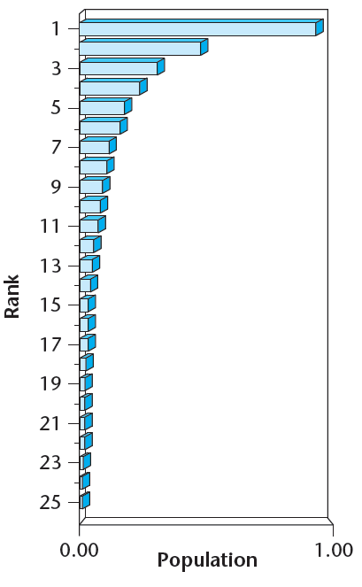
Theoretical picture:
EXHIBIT 3-1A Theoretical Rank/Size Rule

Slide 11
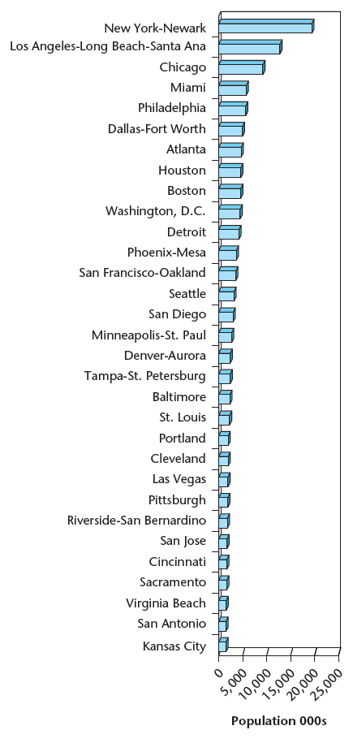
Actual Sizes and Ranks of U.S. Cities➔
Theoretical picture:
EXHIBIT 3-1A Theoretical Rank/Size Rule
Portion of EXHIBIT 3-1B

Slide 12
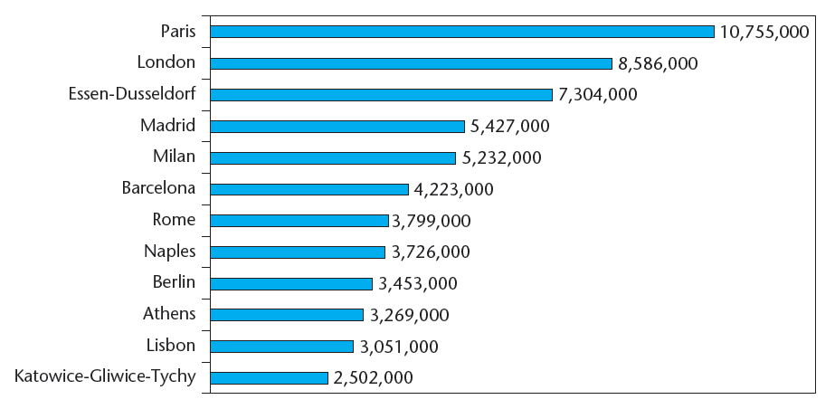
Actual sizes & ranks of European cities…
EXHIBIT 3-5 Population of Largest Urban Areas of the European Union
Source: “Demographia World Urban Areas.” Demographia. July 2012. http://www.demographia.com/db-worldua.pdf

Slide 13
What causes the rank/size rule?…
In part, it’s pure Mathematics…
• Suppose all cities grow at random rates over time.
• Suppose all cities tend to grow at the same average rate.
• Suppose all cities have the same “volatility” in their growth rates.
➔ Then the “Zipf’s Law” rank/size pattern will result.

Slide 14
But why would all cities tend to grow at the same average rate?…
The number of new jobs is proportional to the number of existing jobs.

Slide 15
Why would all cities have the same volatility of growth?
Once a certain size, cities tend to have diversified economic bases.
Smaller towns do not have diversified economies, so they experience more volatility, causing many to “die out”.
So there are fewer small towns than Zipf’s Law would predict.

Slide 16
What this math cannot explain:
Why do cities change rank so rarely?…
Rank changes tend to be systematic, not random (e.g., southern & western cities tend to move up in rank, eastern cities move down.
To understand the size pattern of cities, we must also consider location . . .

Slide 17
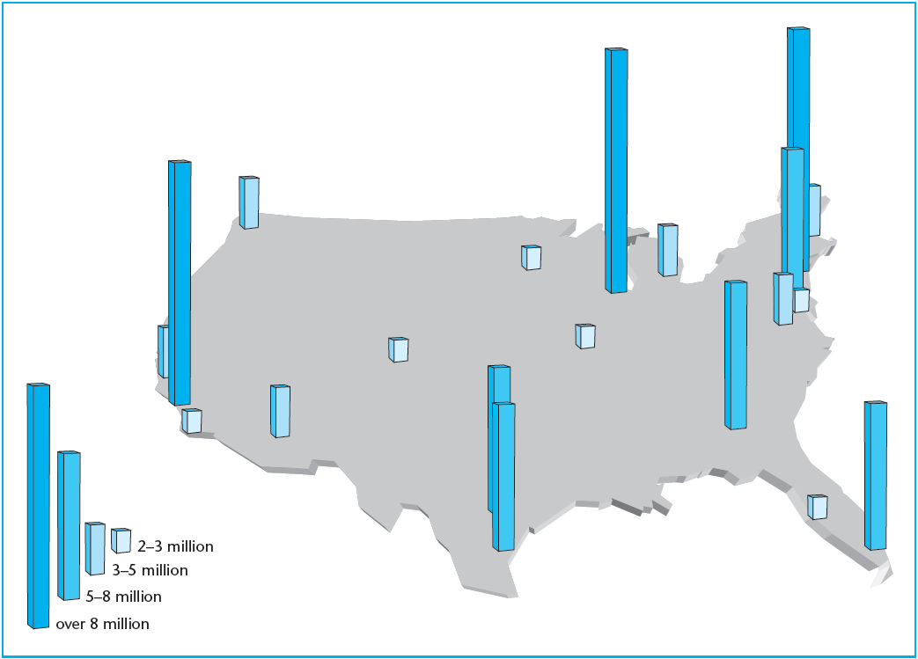
3.2 The Pattern of City Location
Look at a map of city size & location in the U.S.
Geographical “Zones of Influence”
EXHIBIT 3-2 The 20 Largest U.S. Metropolitan Areas
Source: U.N. Urban Agglomeration Population, 2009.

Slide 18
Some history behind the pattern:
Evolution of the top 10 ranking cities in the US: 1850 & 1990.*
1850 Top 10 Cities:
1850
Rank
1900 Rank
1950 Rank
1990 Rank
1990 Top 10 Cities:
New York
*
*
*
*
New York
Baltimore
*
*
*
*
Los Angeles
Boston
*
*
*
*
Chicago
Philadelphia
*
*
*
*
San Francisco
New Orleans
*
*
*
*
Philadelphia
Cincinnati
*
*
*
*
Boston
St.Louis
*
*
*
Detroit
Pittsburgh
*
*
*
*
Washington
Louisville
*
*
*
*
Dallas
Buffalo
*
*
*
Houston
Below Top 10
*
*
*
*
Below Top 10:
*Based on cntral city municipal populations in 1850 and 1900, on Urbanized Areas in 1950, and on CMSA/MSAs in 1990 (except Washington-Baltimore split).
The fall of the East; The rise of the West; The rise & fall of the Midwest; The recent rise of the South.

Slide 19
3.3 Factors underlying the pattern:
The “Rank/Size Rule”, & the Geographical “Zones of Influence” ➔
i Centralizing city-causation ("centripital") forces are counter-balanced by opposing "decentralizing" ("centrifugal") forces.
ii The relative strength of the centralizing and decentralizing forces differs for different functions and activities.

Slide 20
3.3.1 Centripetal Forces:
Would lead to fewer, larger cities…

Slide 21
1) Economies of Scale
  Cheaper per unit to produce more stuff at one place.
  i.e., Declining average costs with larger production capacity.
  Due to “fixed” costs.
  Example: Auto factory with 200,000 cars/yr production capacity is more efficient than auto factory with 50,000 cars/yr capacity.

Slide 22
2) Economies of Agglomeration
  Productivity advantage of physical clustering.
  Vertical & horizontal production linkages (synergy, critical mass).
  Example: Silicon Valley.

Slide 23
3) Positive Locational Externalities
  One firm benefits another firm nearby.
  Example: Trucking firm & Airfreight firm hub.
“Growth Spirals”, “Cumulative Causation”…

Slide 24
3.3.2 Centrifugal Forces
Decentralizing forces that put a break on urban agglomeration, result in a larger number of smaller cities.
Congestion
Pollution
Crime
High intra-urban transportation costs
High rents & urban land costs
High inter-urban transportation costs (with greater distance between fewer larger cities)

Slide 25
3.3.3 The Balance of Centripetal & Centrifugal Forces…
Centralizing forces are relatively stronger in comparison with decentralizing forces for some types of activities than for others…
National Government functions?…
International financial services?…
Corporate headquarters?…
Corporate research facilities?…
Light manufacturing?…
Distribution?…
Corporate branch offices, sales offices?…

Slide 26
3.3.4 Central Place Theory & Urban Hierarchy
Central Place Theory (CPT)…
Suppose “everyone” (13 people) lived on a 12-inch ruler…
In order to reduce 'spatial friction', places of similar size, rank, or function will tend to be EVENLY SPACED across geographical space and/or population.

Slide 27
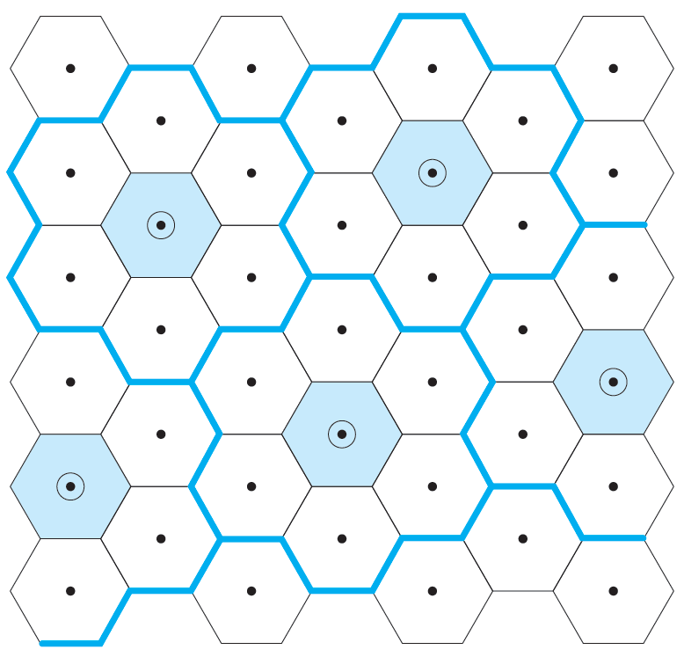
Here’s what it looks like in 2 dimensions…

Slide 28
3.3.5 Why Does CPT Matter?…
Just a pretty academic theory?…
Tell that to the developers of Forest Fair Mall! (and their lenders!)
CPT is location theory
In real estate, three things matter: location, location, & location!

Slide 29
Two practical principles of CPT:
1)  If there is an under-served territory there is room for a new "central site"; and
2)  If there is already a central site effectively located to serve a territory, it is going to be very hard to develop a new such site nearby the existing site.

Slide 30
CPT applies at various levels…
Which cities will grow fastest, and slowest?…
Where can you build a new mall?…
Which sites cast “agglomeration shadows”?…

Slide 31
3.4 Economic Base & the Growth of Cities & Regions
Why would two cities, equally ranked and equally well located, grow at different rates over a period of time?…
CPT cannot tell us.
Enter:
“Economic Base Theory”. . .

Slide 32
Definition: “Economic Base” (of a city or region):
The sources of the city’s (or region’s) income.
The engine that drives & underlies all real estate activity in a region.

Slide 33
Economic Base Analysis is a tool to help:
☞ Identify which cities or regions will grow.
☞ Help characterize what kind of growth (e.g.: "blue collar" vs "white collar").
☞ Help quantify how much growth.

Slide 34
Three major components of the Economic Base:
1. Local production of goods and services both for local needs and for "export" beyond the local urban area;
2. Investment returns to or of capital owned in the local area, such as investment returns on the stored financial wealth of retirees;
3. Government transfers such as social security payments.
(1) (local production) is most important in most urban areas.

Slide 35
3.4.2 The “Export” Base…
In any city or region two types of goods and services are produced by the local economy:

Slide 36
Export Goods
Export goods and services are those produced in greater quantities than needed for local consumption. These goods and services are exported to other cities, regions, and countries. These are referred to as “basic” products (or basic production). The sector of the local economy that produces such goods and services is called the “basic” (or “export”) sector.

Slide 37
Local Goods
Local goods and services are those produced in quantities equal to or less than what is needed for local consumption. These are referred to as “non-basic” goods and services (or non-basic production). The sector of the local economy that produces such goods and services is called the “non-basic” (or “service”) sector. (This sector serves the local population and the export sector.)

Slide 38
Export Base Theory:
According to “Export Base Theory”:
Economic growth of the city or region is dependent entirely on growth in the export ("basic") sector of the local economy.
Because the non-export (service) sector exists only to serve (directly or indirectly) the export sector.

Slide 39
Example:
Suppose Fidelity Investments adds 500 employees to their N.Ky facility. Where do those 500 employees come from?…
Some from out of town (growth), others from the local area.
The employees that come from the local area would have to leave their previous existing jobs in the local area. They will have to be replaced in those jobs. Where will those replacements come from?…
Some from out of town (growth), others from the local area.
Etc., etc., … Eventually all 500 Fidelity jobs are a net addition to the local area total employment.
This is because Fidelity is part of the Cincinnati MSA’s economy’s “export base”.

Slide 40
Example:
Kroger builds a new supermarket on Beechmont Ave, which requires 100 employees to operate. Where do those 100 employees come from?…
Most from the local area, some from out of town.
The ones that came from out of town prevent other local Cincinnati residents from getting those new jobs at Kroger, because the new Kroger jobs do not add to the total jobs in the Cincinnati MSA, because it does not increase Cincinnati’s exports to other regions. The new Kroger does not cause Cincinnati residents to eat more food than they otherwise would without the new Kroger.

Slide 41
Which of the following are examples of Cincinnati’s export base?…
• GE Aircraft Engines
• Fidelity Investments
• Procter & Gamble Research Facility
• Procter & Gamble corporate headquarters
• The Burger-King on McMillan Ave
• The Kroger on Beechmont Ave
• The Lazarus at Kenwood Towne Center
• A new Nordstrom
• Corporex construction of Madison Place

Slide 42
According to export base theory,
2-step process to forecast metro growth:
1) Identify which are the export base industries in the local region;
2) Forecast employment growth in those industries.

Slide 43
Step 1:
Identify which industries are in a given region’s export base (i.e., “characterize” the economic base of the metro area).
How can we do this? . . .

Slide 44
The “Location Quotient”(LQ)
where: N_{mi} = Employment in City “m” in Industry “i”
N_{m} = Total Employment in City “m” in all industries
N_{i} = National Employment in Industry “i”
N = Total National Employment in all industries

Slide 45
The “Location Quotient”(LQ)
LQ = 1.0 → same proportion of local workers work in a particular industry as work in that industry in the nation as a whole.
LQ > 1.0 → local area is more heavily concentrated in that industry than is the average city or region across the country.
In practice, it is usually considered that a location quotient must be significantly greater than 1.0 in order to indicate that the industry is part of the export sector of the local economic base.

Slide 46
Example:
Combine LQ analysis with large employer analysis to identify the economic base and forecast growth trends….

Slide 47
Cincinnati metro top private sector employers…
Are all of the above in the “export base”?…

Slide 48
Information sources…
U.S. Govt Bureau of Labor Statistics (BLS) collects and reports data on employment, by MSA.
Jobs are classified according to the hierarchical Standard Industrial Classification (SIC), identified by SIC Code numbers.
Number of “digits” indicates level of hierarchical classification…

Slide 49
Example (Cleveland, OH):

Slide 50
Example data search . . .
Go to the Bureau of Labor Statistics web site at www.bls.gov
On their home page, under the “Get Detailed Statistics” heading, click on “Create Customized Tables (1 screen)”
Fill in the form to get the data to estimate the location quotient for the Cincinnati MSA for SIC 3724 “Aircraft Engines & Engine Parts”
e.g., for 2000:

Slide 51
The Service Sector and the Export Multiplier
Jobs that are not part of the export sector are dependent on serving the local population. Examples:
o Grocery clerk,
o Divorce attorney,
o Child care worker,
o Utility line repair-person, etc.

Slide 52
The Service Sector and the Export Multiplier
These jobs depend ultimately, directly or indirectly, on the export base of the region.
LQ ≈ 1.0 for non-basic occupations in most cities.
The non-basic sector is also known as the “service sector” of the region.
If the export sector declined there would be less need for the service sector.
Since the service sector is dependent on the export sector, the change in the demand for service sector jobs is a function of the change in the number of export sector jobs.

Slide 53
The Service Sector and the Export Multiplier
The number of jobs in the service sector generally greatly exceeds the number of jobs directly in the export sector.
Therefore:
Expansion in the export sector creates an “employment multiplier effect” on total local employment.

Slide 54
Example:
Toyota USA sets up national headquarters office in Cincinnati MSA (N.Ky), with 300 headquarters employees…

Slide 55
Example (cont’d):
1. Including families, this brings, say, 600 people to Cincinnati MSA.
2. These 600 people spend much of their pay checks on local goods and services (housing, utilities, food, entertainment, schooling, etc.)
3. This expands the demand side of the local economy, adding jobs in the service sector.
4. Such net expansion of service sector jobs in the Cincinnati MSA must be filled (directly or indirectly) either by people previously unemployed in Cincinnati, or by new migrants moving to Cincinnati.

Slide 56
Example (cont’d):
5. This net expansion of the service sector in turn adds to the total demand side of the Cincinnati MSA local economy, requiring further additional workers, and so forth…
6. By the time this expansion ripple-effect runs its course, the original 300 jobs added to the export base of the MSA may result in 700-800 total new jobs (in both the export base and service sector), and perhaps a growth of 1500 in the MSA population. → An “employment multiplier” of 2.5; a “population multiplier” of 5.0.

Slide 57
Multipliers…
Employment Multiplier:
Population Multiplier:

Slide 58
Multipliers…
Employment multipliers are typically in the range of 2.0 to 4.0.
Population multipliers are typically in the range of 2.5 to 9.0.
  Note: Multiplier effects go both ways:
Loss of local export base jobs has a multiplier effect on the overall local economy & population.
  Note: Multiplier effects result only from changes in export base employment (rippling through the local service sector).

Slide 59
Concept check:
Why are real estate people interested in export base & multiplier theory?…

Slide 60
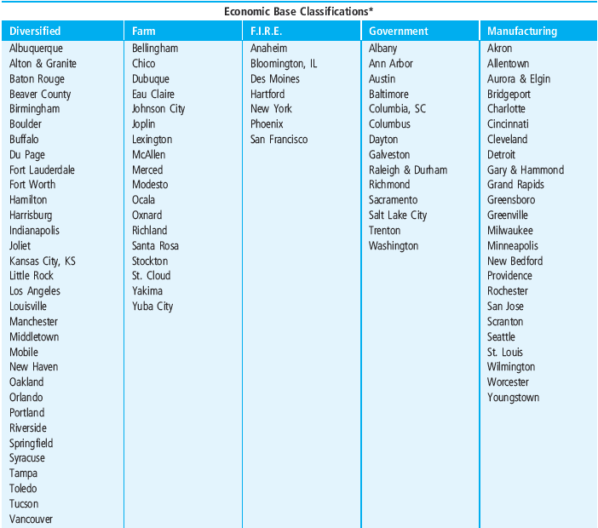
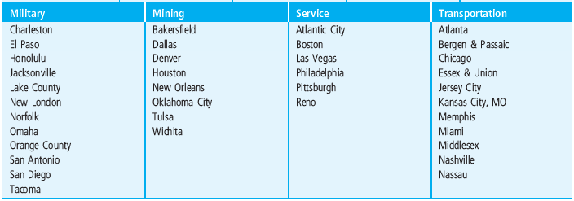
3.4.5 Classification of Cities By Economic Base

Slide 61
3.5 Classification of cities for real estate investment analysis
Need to consider supply side as well as demand side of the space market. . .

Slide 62
Exhibit 3-5: Three Major Groups of Cities with Similarly Performing Real Estate Markets in the Late 20th Century:*

Slide 63
Note also:
Economic bases of cities evolve over time (sometimes rapidly)
Relations between economic sectors change over time (e.g., oil may be cyclical or counter-cyclical).
This makes it difficult to forecast correlations between cities regarding their economic growth rates. On the other hand:
Centrality of location
Availability of developable land
Business climate
Tend to be more stable over time, facilitating general trend forecasting.

