Slide 1
Introduction to Lease Analysis
By Norm Miller, PhD
Click on the speaker icon to hear the content in spoken form along with more detail and description.

Slide 2
Introduction to Leases
A lease is a legal contract between a tenant (lessee) and landlord (lessor)
Specifies the rights and obligations of the owner and user
A lease divides the “bundle of rights” in real estate into two interests
Owner’s Leased Fee Interest
Tenant’s Leasehold Estate

Slide 3
Requirements of a Valid Commercial Lease
Names of owners & tenants with authority to contract
Description of property
Consideration (deposit or something of value)
Legality of leased space (building and zoning code compliance, etc.)
Offer and acceptance of the contract

Slide 4
Lease analysis may intersect with
Corp Site analysis: employer needs
CEO, Key Partner and Employee access
Client access, co-tenants
Government incentives or regulations
Parking needs
Amenities
Other factors that will vary for industrial (power, truck, rail, multimodal hubs), or retail (market and access dominate, signage, and lighting).

Slide 5
Lease Perspectives Vary
Landlord
Maximize Net Present Value
Support Financing with highest quality tenant credit
Minimize parking required
Synergize tenants (retail) so as to maximize productivity
Understand tenant’s business
Shift operating expenses to tenant if possible (there are exceptions)
Diversify expiration risk by term and tenant size as % of property
(Retail) Local flavor and diversity?
Renewals at market or close to it
Tenant
Minimize net present value of lease
Minimize total occupancy costs
Minimize unexpected pass through expenses or significant increases
Minimize up front costs (in some cases)
Maximize flexibility and the need to expand, downsize, exit when desired with the least possible penalties (using options)
Renew on favorable terms

Slide 6
Key lease types
Triple net lease or absolute net lease:
Tenant pays everything, even M&R, typical on retail and industrial, esp single tenant properties.
Industrial gross
Tenant pays CAM, increases in PI and PT over base
Modified gross or Hybrid
Tenant pays CAM, PI, PT, and Utilities, possibly Janitorial
Gross lease
Tenant may pay metered interior utilities, may pay interior cleaning
Landlord pays everything else
Full Service lease: landlord pays everything
Key: Must carefully define anything in between Triple net and full service! Terms vary by market and what is typical varies by market.

Slide 7
Subleases
A tenant typically has the right to sublease space – unless noted otherwise. Often the landlord will have some right to refuse sub-lease tenants but must be reasonable in accommodating requests.
Subleases do not eliminate the tenants (lessee) requirement to guarantee the rent is paid, unless the landlord releases the tenant and then it is no longer a sublease.
Sublease trends usually lead the market.

Slide 8
Defining the space

Slide 9
Building Measurements
Term | Measure | Definition and Use
Gross Building Area | Gross Square Feet (gsf) or GBA | Includes all enclosed area
Total Rentable Area | Rentable Building Area or RBA | Gross less vertical penetrations (i.e. stairs, elevator shafts)
Common Area aka “Core Space” at CoStar | Area shared by all tenants | Common areas of the floor like hallways, bathrooms.
Building Common Area % (CoStar “Core Factor”) Aka “Load factor” or “Loss Factor” | Floor and Building Common area relative to Rentable Area | Common area use of the building (does not include vertical penetrations)
Efficiency Ratio | Ratio of RBA to GBA | More efficiency means more rent per GBA but less architectural interest and less common space.

Slide 10
Rentable, Usable and Common Space
Not Rentable
Usable
Common
B
Elevators
Lobby
Hall
Bath
Bath
Storage
Stairwell
Hall
C

Slide 11
“Core” or Load Factor
Rentable
Load factor or loss factor
Usable
Calculate the load factor:
A Landlord quotes 22,000 SF of Rentable space with 20,000 SF of Usable. Calculate the the “load-factor.”
22,000 = 1.10 or 10% “load”
20,000
Notes:
This is a simple problem for review that can be brought to a higher lever..
Points for discussion:
How many decimals should you go out. Give an example if you rounded to 1.11. What would happen to if you had 100,000 SF building?
Discuss the add on percentage that is used in some markets.
What the add of factor is called in different markets.
Focus on hold the three formulas are interrelated.

Slide 12
Efficiency Ratio or inverse of Load factor
Usable
ER
Rentable
20,000 = 90.91%
22,000

Slide 13
Commercial Leases
Commercial leases can be gross “full service” leases or triple net leases.
Most multi-tenant buildings use some sort of net lease, but single tenant buildings are more likely to be triple net.
Most Common
“Net Lease” where we pay see some pass through items (i.e. property taxes and insurance)
Gross Lease
Triple or Absolute Net Lease
Notes:
Most leases fall between the two

Slide 14
Key rent clauses
Base rent (flat, indexed, graduated)
Measured space (RBA, defined by BOMA)
Tenant improvements (who pays, how much, removal, how generic, work letters, who does the work)
Lease term (commences, renewals, cancellation, penalties)
How indexed? If at all, peer group defined if “market based”
Options to renew, move, expand, contract or downsize.
Parking allowances (free, paid, utilization)
Lighting and power use
Operating expenses, maintenance and repair expenses
Non-disturbance
Deposits and guarantees, Authority to modify
Many others depending on market and property type

Slide 15
What are the operating expenses?
CAM (Common area expenses: defined)
Maintenance defined so as not to include capital improvements without approval.
i.e. Janitorial, cleaning supplies, landscaping, snow removal, sweeping, etc.
Security
Property Taxes
Property Insurance
Sewer and water, utilities, trash removal, credits for recycling salvage
Management (?) and admin charges on pass throughs.
For retail there are many more, i.e. advertising and marketing fees, events and specialty promotions

Slide 16
Key Proforma considerations
Forecasting rents starts with the rent roll
Vacancies are then considered based on:
Current property vacancy
Market vacancy for peer set
Probability of lease renewal
Type of tenant, size, tenant improvements
Time to re-lease is a critical assumption and often runs years not months
Lease commissions and renewals must be factored in.
Every lease must be part of a detailed lease by lease proforma so that stops and caps can be considered for operating expenses that may be paid by landlord.
Sometimes the discount rate for DCF analysis can vary by tenant risk weight in the rent roll.
Tenant retention is a marketing and management art.

Slide 17
Keep in mind the need to segment market by quality, location and tenant size

Slide 18
How long does it take to re-lease Class A office space? (as of Oct 24, 2013)
Atlanta 34.7 months
Boston 26.5 months
Detroit 49.6 months
San Francisco 22.8 months

Slide 19
What affects the probability of renewal?
Below market rent adjustment based on a fixed or modest increase.
Financial distress of tenant as indicated by high space per worker (downsizing)
The level of TI invested by the tenant or the customization of the space.
Size of tenant.
Age of tenant business and if they have renewed before.
Proactive management. Asking them if they are happy?

Slide 20
What are the contentious negotiation issues for all leases?
Prorating formulas for pass-throughs
The right to audit for tenant or landlord
Caps on specific expense items or totals per year
Capital improvements vs maintenance and repair
Questionable operating expenses like accounting, legal, memberships, travel, data maintenance and data backup.
Assignment of lease space, sublet rights, signage.
Acts of nature: fire, flood, earthquake, or crimes and required responses by each.
Mold and toxic materials on site.
Enforcement mechanisms on any issues of dispute (arbitration, LOC, termination penalties)
Other issues vary by property type

Slide 21
Office Key Issues
Lease term and options to renew
Base rent adjustment formulas (i.e. PPI, CPI, % of CPI, Fixed rates, min’s, maxes by year or term and time period used to determine)
Lease renewals at market (how defined, when determined)
TI (tenant improvements) and how spent, access to site, who’s contractors used, free rent, access prior to lease starting date, indemnity from TI work issues.
Parking may or may not be a key issue depending on site use intensity
Cleaning timing, lights, recycling, LEED requirements.
Removal of electronics and wireless equipment
Others? Exclusive floor, exclusive elevators, signage?

Slide 22
Retail
Right to go dark
Right to terminate, move, expand, contract
Right to lease in nearby sites (radius restrictions)
Break point sales, if any
Percentage of sales for overage and excluded items
Exclusive merchandise clauses and enforcement mechanisms
Contingency to terminate based on certain anchors not going dark or percentage of total center operating (Co-tenancy)
Remedies when rogue tenants violate lease clauses

Slide 23
Industrial
In addition to those in the office list, add
Power availability and K-watts
Power back up
Water and sewer access
Hazardous substances on site and handling
Who gets benefits of green house gas credits, if any?

Slide 24
The Building Block of Investment Value Begins With the Tenant and Lease
The value of a building is primarily the summed value of the net productivity of leased space, as now constrained by lease contracts and as affected by operating expenses, market trends and longer term prospects. If each stone is the size of the tenant,
which stack is riskier?

Slide 25
Economics of Lease Analysis
The pattern of the cash flow matters to both the landlord and tenant and requires some way to compare leases. Which of these leases is best for the landlord? Tenant?
Rent
A
B
C
Time

Slide 26
Types of Lease Financial Analysis
The net present value of the lease for the entire period of the lease
The lease costs per period on a level average basis (note many brokers incorrectly call this effective rent)
The total dollar outflow or to be received
The net present value of the lease per square foot
The effective level rent payment or receipt per square foot. (our preferred method)

Slide 27
Effective Annualized Rent or “Annuitized Lease Value” : Once the present value of the rent is calculated it can be converted to the mathematically equivalent present value flow based on a steady annual or monthly flow of level payments.
Annuitized Rent Per Square Foot allows you to adjust for different sizes.

Slide 28
Effective Rent Calculation for the landlord
CF2 CF3 CFt
LPV =CF1 + ------ + -------- + .....+ ---------
1+k (1+k)² (1+k)^{t-1}
CF is the net cash flow received after all periodic operating expenses,
usually paid at the beginning of the period.
CF1 is the net cash flow to the landlord at the beginning of the lease in month 1
While CFt is the net cash flow in the last month of the lease at time t.
From the tenant perspective the cash flow is not the net received but the total paid.
K is the discount rate used to bring the cash flows back to present value.
Last we convert this present value to a level annuity like a flat payment as follows:
k(LPV)
Effective Rent per period = ------------------------
(1+k)[1 - 1/(1+k)^{T}]
This could be monthly or annual.
Confusing? Try a visual example……

Slide 29
Rent Pattern is converted to an equivalent flat payment for the entire lease period.
Period 1 | 2 | 3 | 4 | 5
TI = $25 PSFT No rent | Free rent | Rent $40 PSF | Rent $50 PSF | Rent $60 PSF
$60
$50
$40
-$25
Effective Rent Annual Calculation using 10% discount rate = $20.77
Could you guess at $20.77 from the above pattern or compare to another lease
with a different pattern? That is why we need the calculation, so we can compare
Leases. Note: discount rates need not be the same for landlords and tenants.

Slide 30
One more time: Annuitized or Effective Rent Calculation Procedure
Step 1) Calculate the Lease Present
Value, LPV, as described earlier (monthly or annual) using beginning of period payments
Step 2) Calculate the Annuitized Value
("Level Annuity Payment") of the LPV
where "k" is the same discount rate as
above, and "T" is again the term of the lease

Slide 31
Numerical Example of Effective Rent per Sq Ft Calculation
Lease "A":
Term: 5 years
Rent: $20/SF, net
Concessions: 1 year free rent, up front

Slide 32
Effective Rent Calculation (Contd.)
Lease “B":
Term: 6 years
Rent: $25/SF, net
Concessions: 2 years free rent, up front
Landlord would prefer Lease A over Lease B,
even though lease B has a higher future "nominal
rent" ($25/SF vs. $20/SF) but there may be circumstances when B is preferred, when?
The tenant would generally prefer Lease B

Slide 33
A Note on Lease Cycles
Why?
Habits of owners to use similar lease terms and durations.
Cycle of new construction is lumpy as are large projects.

Slide 34
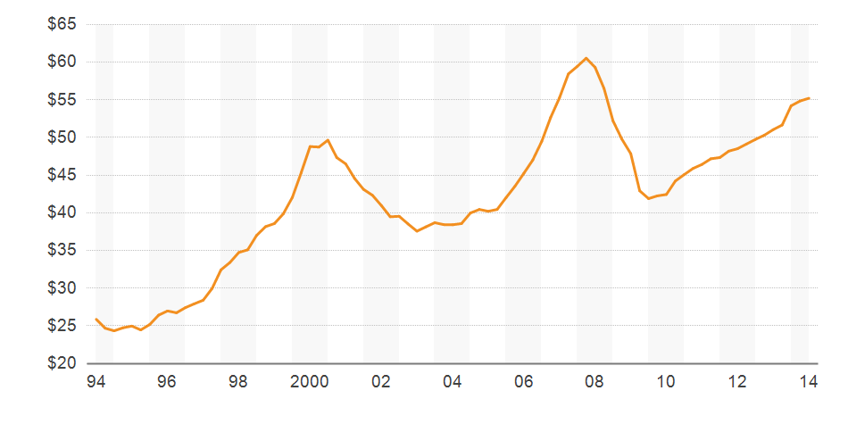
New York City Gross Office Asking Rents
CoStar Data

Slide 35
Columbus Ohio Gross Office Asking Rents
CoStar Data

Slide 36
Thank you

