Slide 1
How big is the commercial real estate industry in terms of stock?
By Norm Miller based on a paper with Jay Spivey and Andy Florance
Click on the sound icon below each slide to hear the audio

Slide 2
Why do we care?
When someone wants to own the market portfolio do they know what proportion they need to own by property type?
When a large investor targets a particular property type, say core office or student housing or surface parking lots they need to know if they will affect the prices by significantly affecting demand. The reverse is also true when someone wants to sell, so there are good reasons to look at typical volume, liquidity and both of these depend first on how much is there?
By knowing how much is out there we can also gauge if a property type sample is representative or stratified appropriately by size or geography or age or class.
Last, knowing how much is out there allows us to gauge how big are potential debt markets, equity investment markets and other interests within the capital stack like Mezzanine.

Slide 3
The following is based upon the CoStar database as of 2010. Here is the count by type:

Slide 4
We estimated the total stock in each metro based on the number of years that data has been collected as an estimate of a total (100% coverage)

Slide 5
Data collection as a function of time for 378 metros:
x = Years canvassing market

Slide 6
Value of U.S. Commercial Real Estate by Property Type Using 2009 Average Prices
Prices were based on averages for the middle of 2009 for the entire nation, all classes. The prices as shown are about 39% less than 2007 suggesting a loss of at least $4 trillion in value from mid 2007 to 2009.

Slide 7
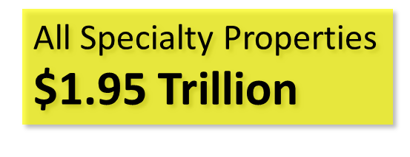
Specialty Property 2009

Slide 8
Office Space Per Capital U.S. Average = 40.06

Slide 9
Industrial RBA per Capita U.S. Average 76.6 Sq Ft

Slide 10
Population Per Hospital Mapped from Lowest Population Per Hospital (green)

Slide 11
Retail Space Per Capita U.S. Ave = 56.4 sq ft per capita

Slide 12
Multifamily Properties By State

Slide 13
Largest Office Metros

Slide 14
Largest Office Metro Sq Ft Per Capita

Slide 15
Largest Industrial in Sq Feet

Slide 16
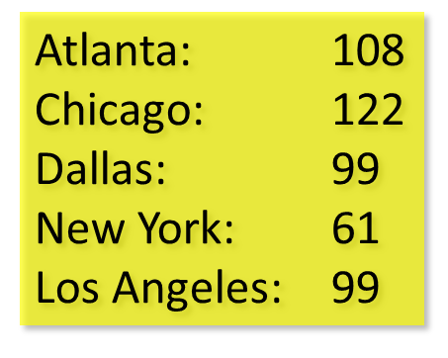
Largest Industrial Per Capita

Slide 17
Largest Retail in Sq Ft

Slide 18
Thank You

