Slide 1
Building Classification Systems and Criteria
By Norm Miller, University of San Diego and Anthony Guma, while at CoStar, 2013.
Click on the sound icon below.

Slide 2
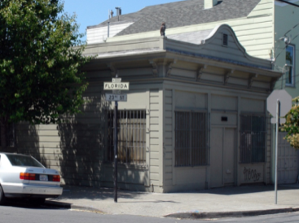
Classifying Buildings
No two buildings are exactly the same.
But the industry needs a way to group them and compare property. We use the term “peer” property for those that compete with a subject property.

Slide 3
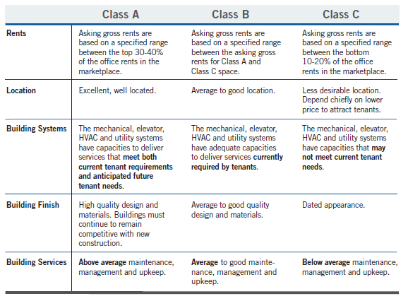
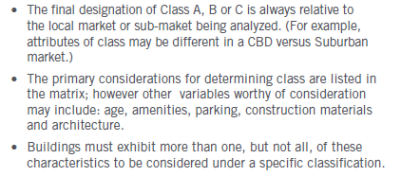
Building Class are locally dominated and relative in nature.
Typically building class is based on BOMA and NAIOP descriptions, but also openly interpreted by local brokers and owners to serve their purposes. see. www.boma.org and www.naiop.org
Source:

Slide 4
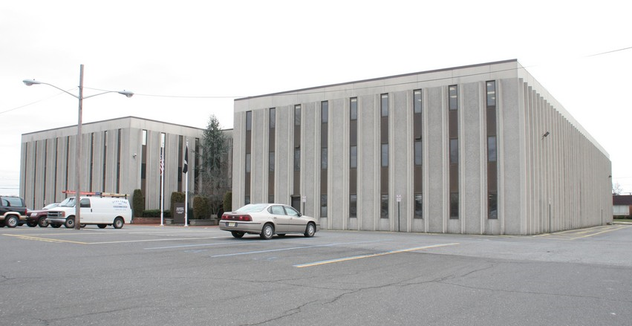
Building Class: Local Interpretations
From a local broker you may hear
“1. All of the bathrooms have been completely renovated with high-end marble amenities; 2. Over $1 million has been invested in new HVAC; 3. New landscaping and signage have been erected within and outside the building; 4. All common hallways have been upgraded with new carpet and wall coverings; 5. The lobby has been completely renovated with high-end marble amenities; 6. The parking lot has been resurfaced; 7. The building has on-site security.
8. It is my opinion that the office building qualifies as "Class A" office space. Its high-end renovation, high-demand location and prestigious clients, including a regional law firm and government tenants. This clearly places it at the upper end of desirable buildings in our market.”

Slide 5
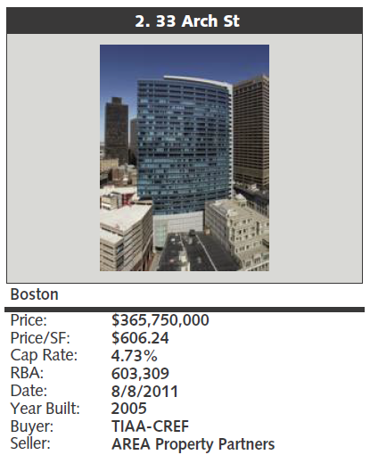
Components of Building Class
Building
Location
Value
Architectural aesthetic & design
Materials
Glazing
Interior Dimensions
HVAC and circulation systems
Amenities
Landscaping
Common areas
LEED, Energy Star, etc.
Metro and submarket fundamentals
Proximity to off-site amenities
Proximity to transit systems, etc.
Surrounding building quality.
Rent
Sales price
Occupancy

Slide 6
The Building itself is only part of the Class
Building
Building
Location
Value
Architectural aesthetic & design
Materials
Glazing
Interior Dimensions
HVAC and circulation systems
Amenities
Landscaping
Common areas
LEED, Energy Star, etc.
Architectural aesthetic & design
Materials
Glazing
Interior Dimensions
HVAC and circulation systems
Amenities
Landscaping
Common areas
LEED, Energy Star, etc.
Metro and submarket fundamentals
Proximity to off-site amenities
Proximity to transit systems, etc.
Experience
Rent
Sales price
Occupancy

Slide 7
Why a CoStar Building Rating System
CoStar researches everything from skyscrapers to the smallest buildings, and differentiation is essential.
Effective comparisons between buildings.
A centrally managed systems that strives for consistency.
A national system for comparison across markets.

Slide 8
What is Building Rating System?
A consistent, national rating.
A 1 - 5 Star rating for additional granularity on a familiar scale.
A rating for all property types.

Slide 9
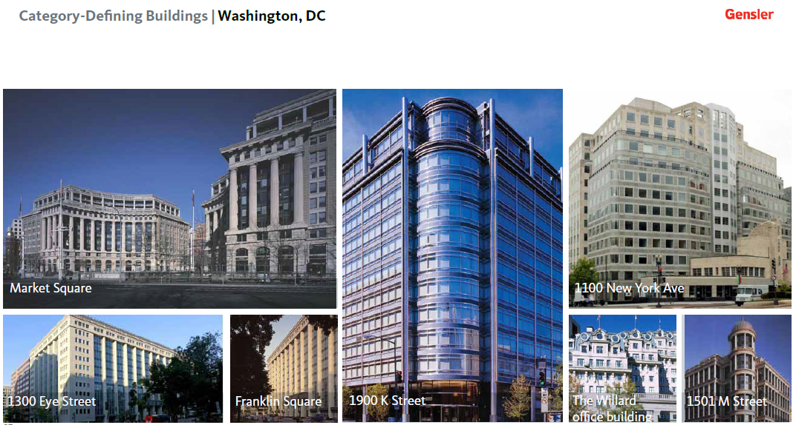
Office Building Trends
These once were Class A buildings but might be very energy inefficient or hard to retrofit for more natural light and collaborative working styles so are they still Class A?
Source: Gensler

Slide 10
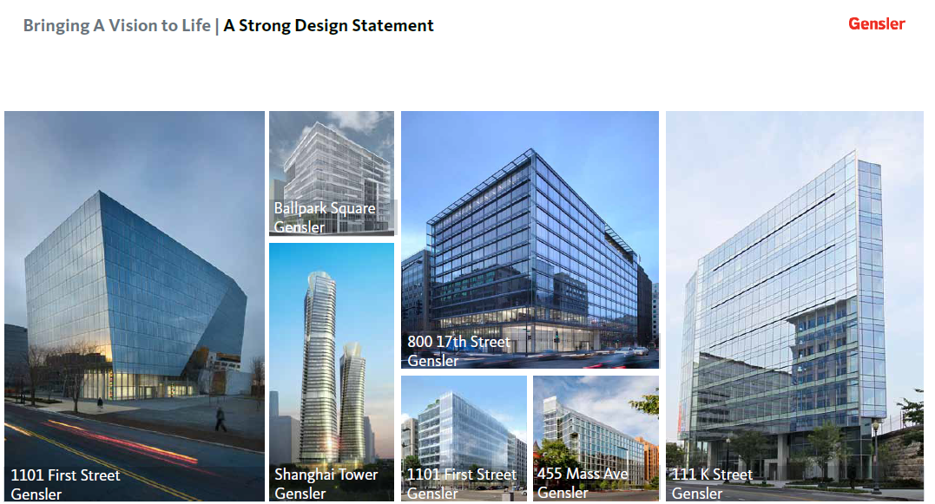
More natural light…
Source: Gensler

Slide 11
Greener
Source: Gensler

Slide 12
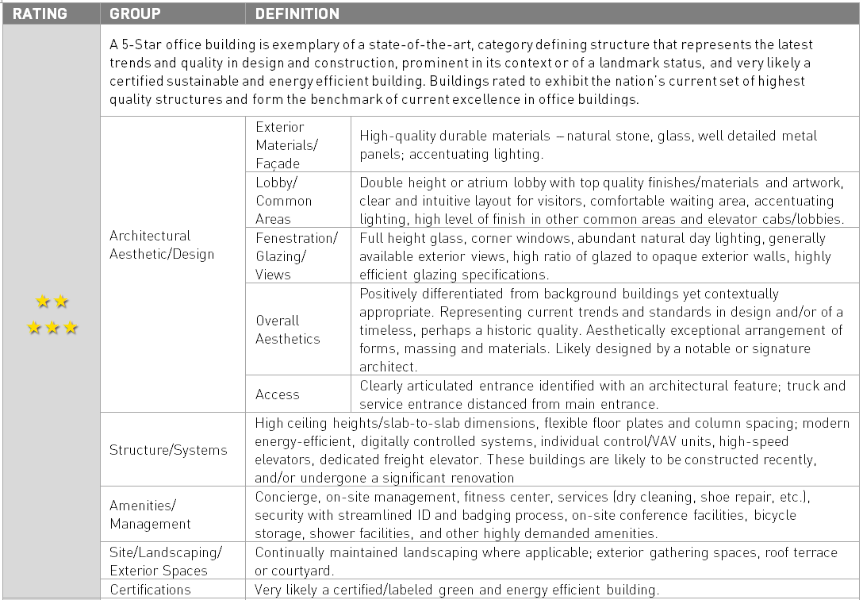
CoStar Rating Definitions

Slide 13
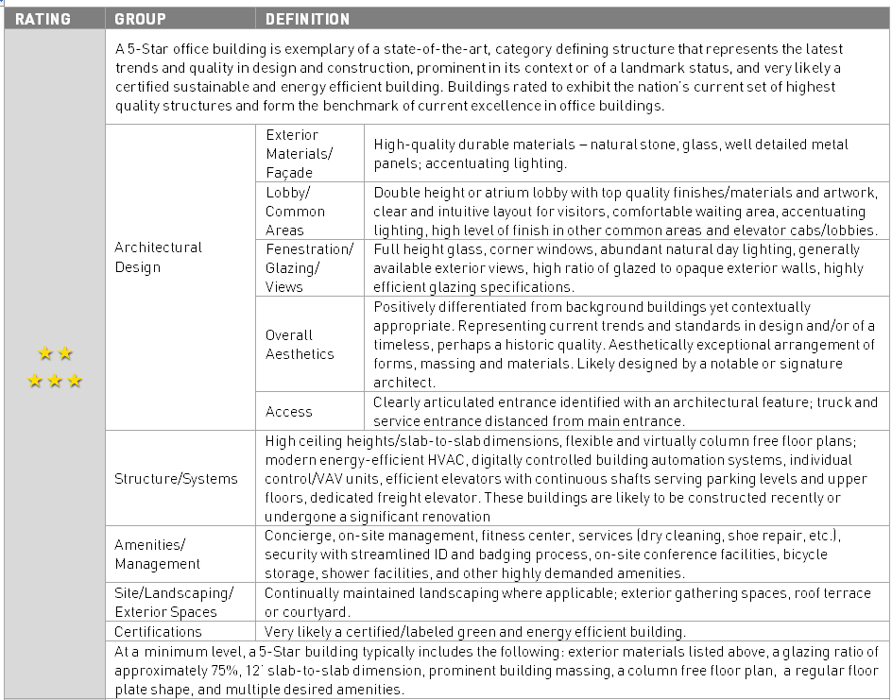
Class vs. Rating
vs.

Slide 14
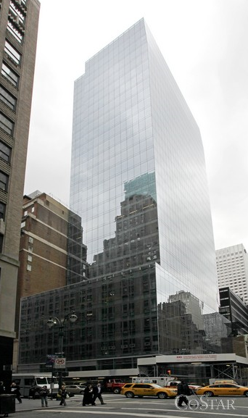
Rating Definitions
=
?

Slide 15
Building Rating Mechanisms at CoStar
Property Research:
Researchers interrogate building specifications, images, brochures, and floor plans to ensure that building ratings are consistent.
Field Research:
Located across all markets to conduct site visits and use this direct experience to grade various aspects of buildings.
Checks:
Building ratings are continuously reviewed through a series of checks against aggregated rating and market trends.
Building Rating
Analytical Models:
Analyses on property and market level data are used to support the prediction and quality assurance of building ratings.
Market Visits:
CoStar engages industry professionals though local advisory meetings to gather input on the rating system and individual ratings.

Slide 16
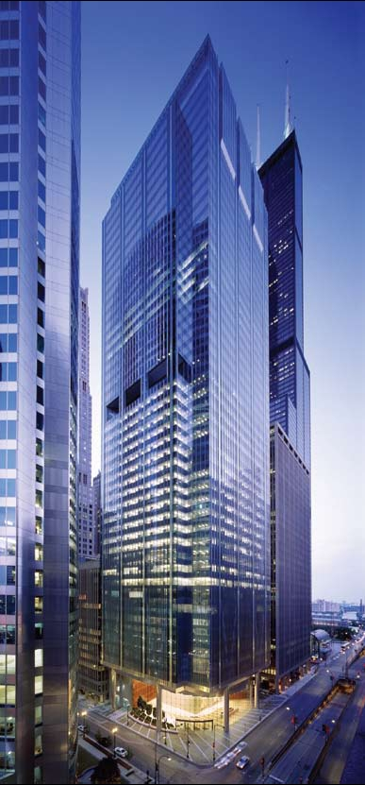
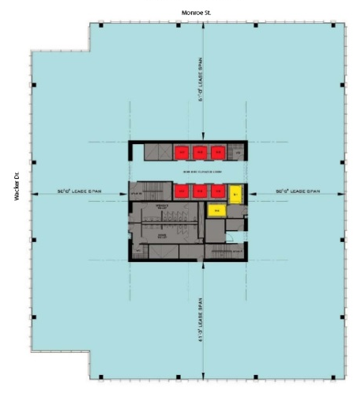
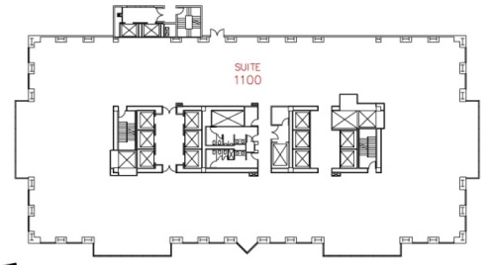
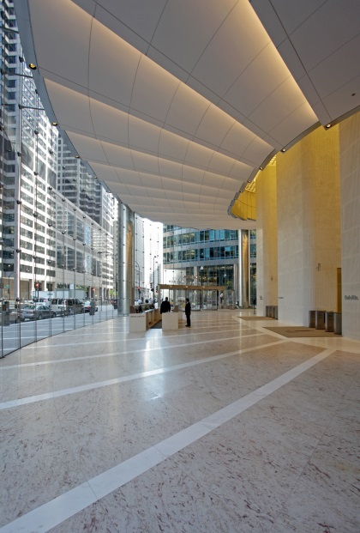
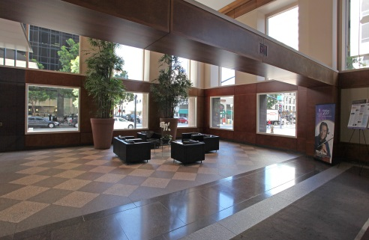
The Same? Which is easier to layout and achieve more natural light coverage?

Slide 17
Building Characteristics
Source: CoStar

Slide 18
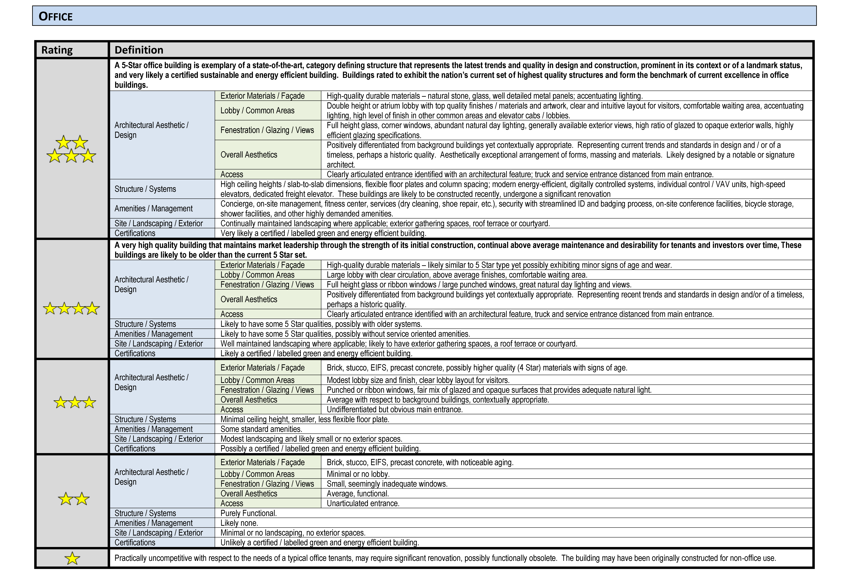
CoStar Office Ratings

Slide 19
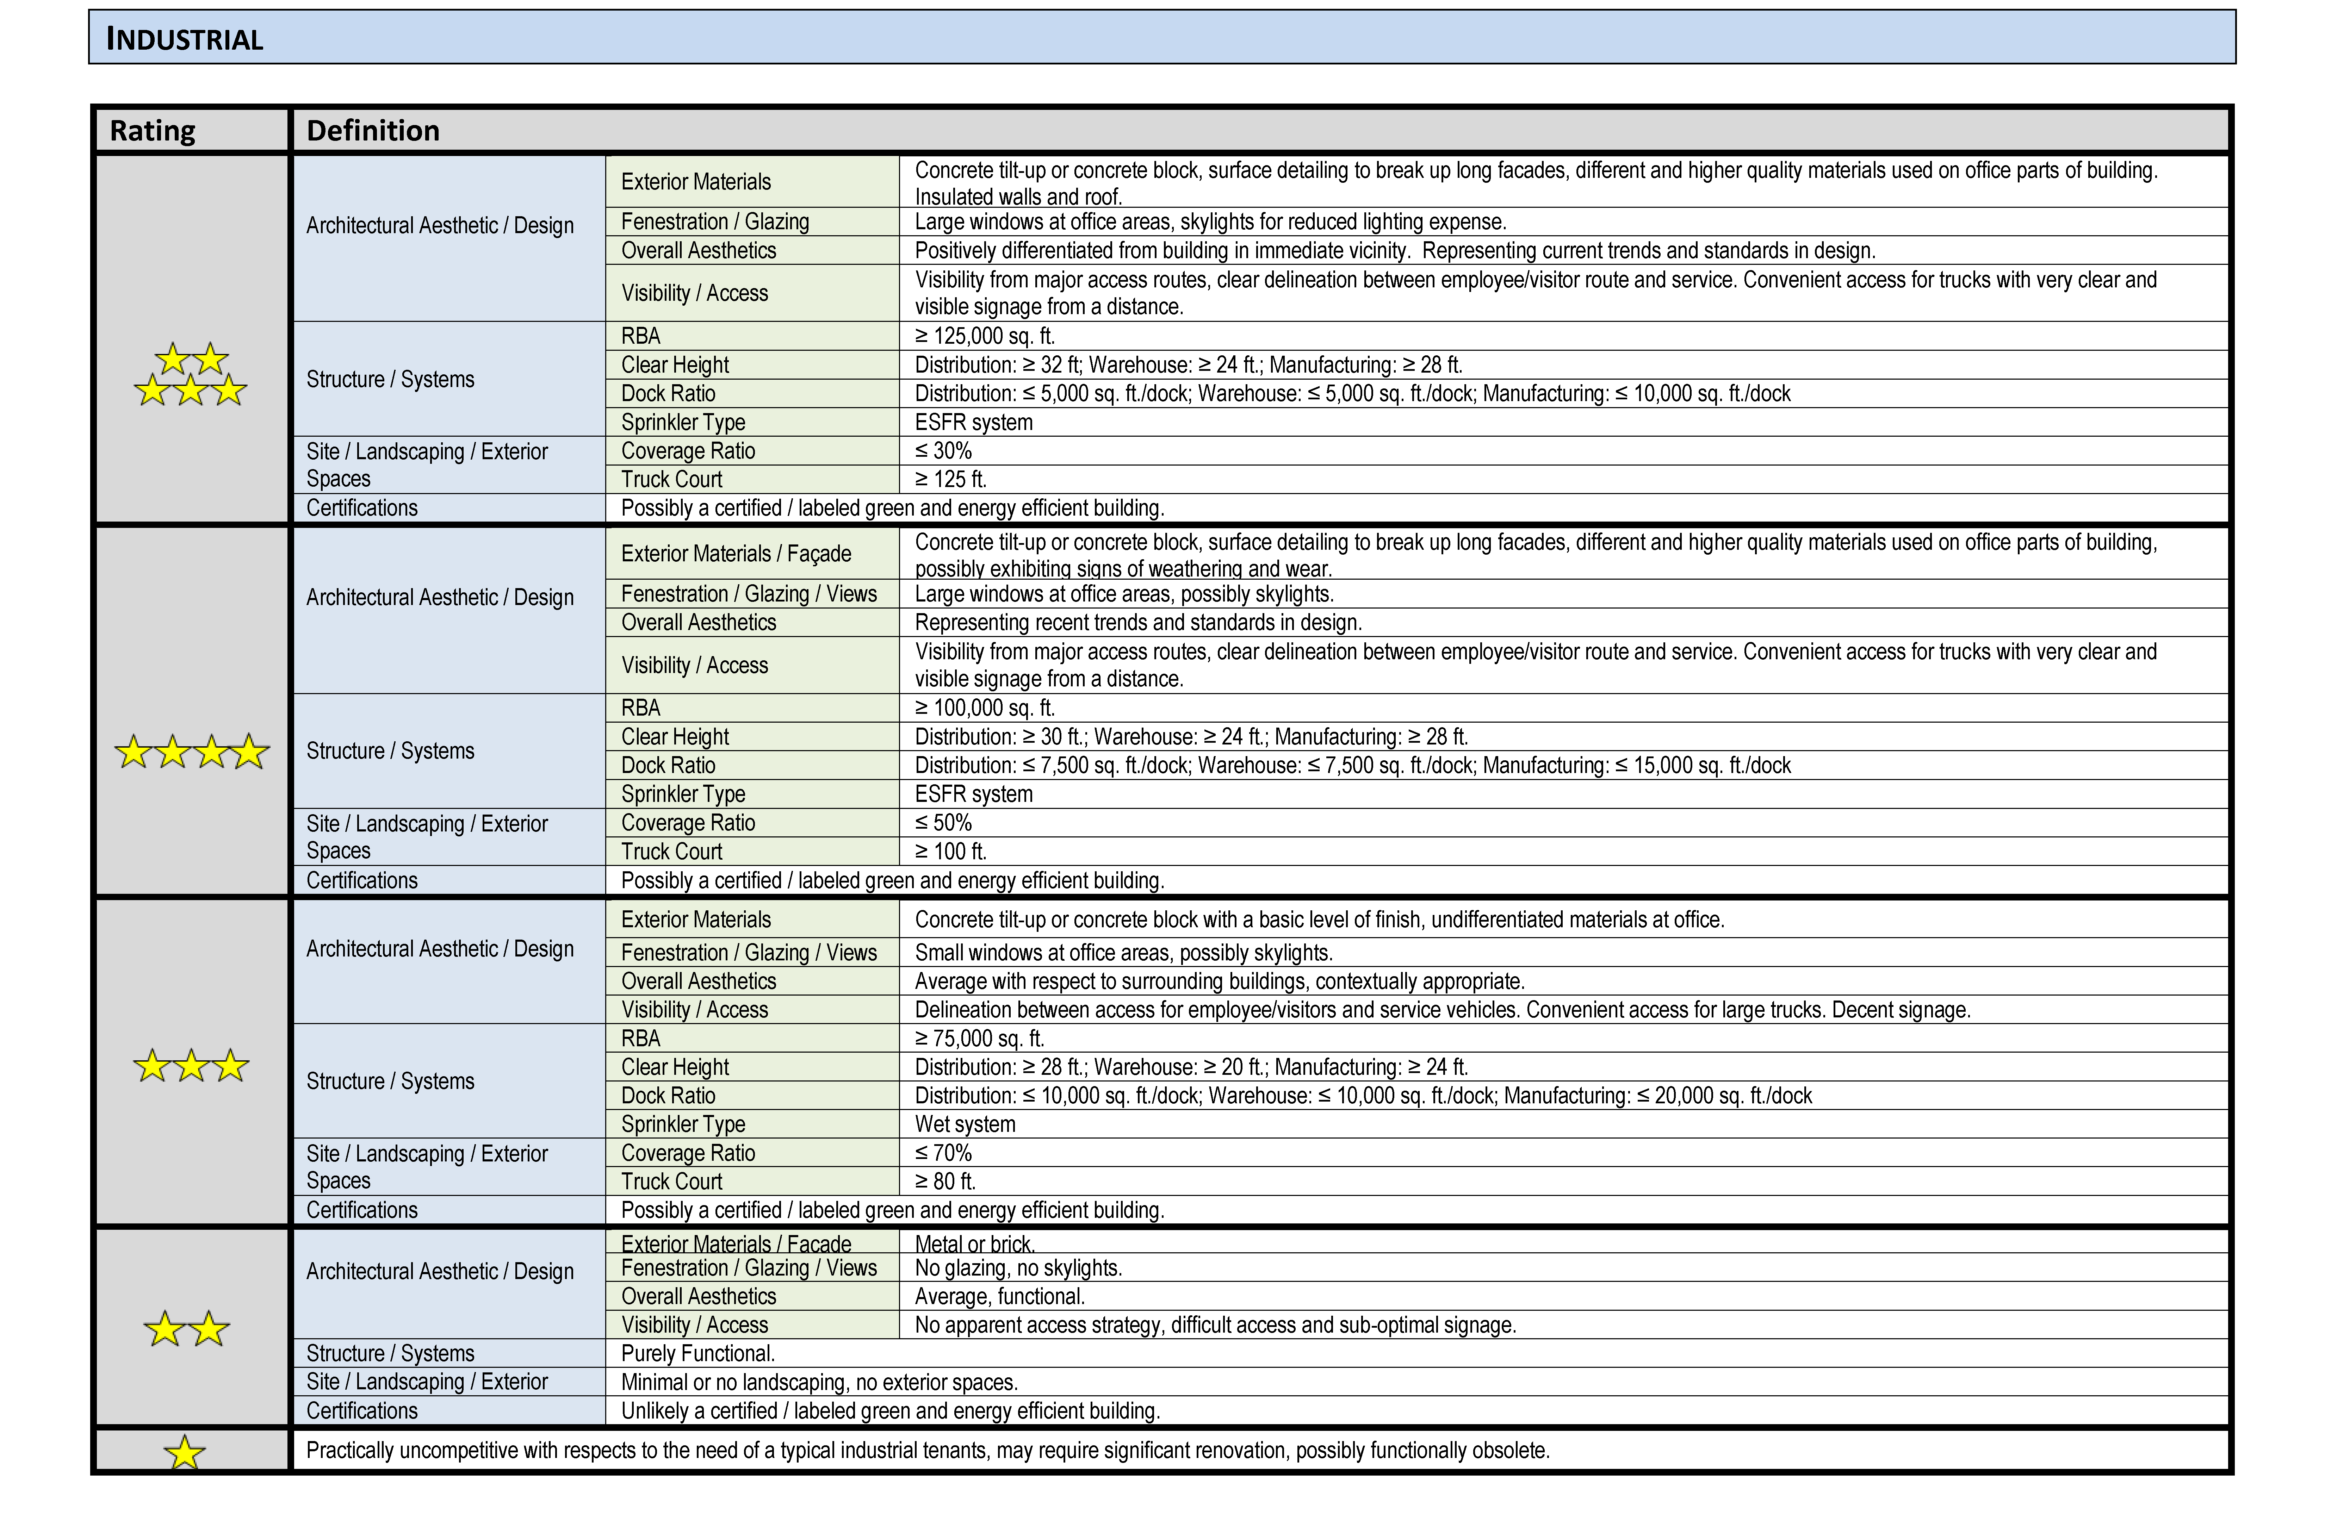
CoStar Industrial Ratings

Slide 20
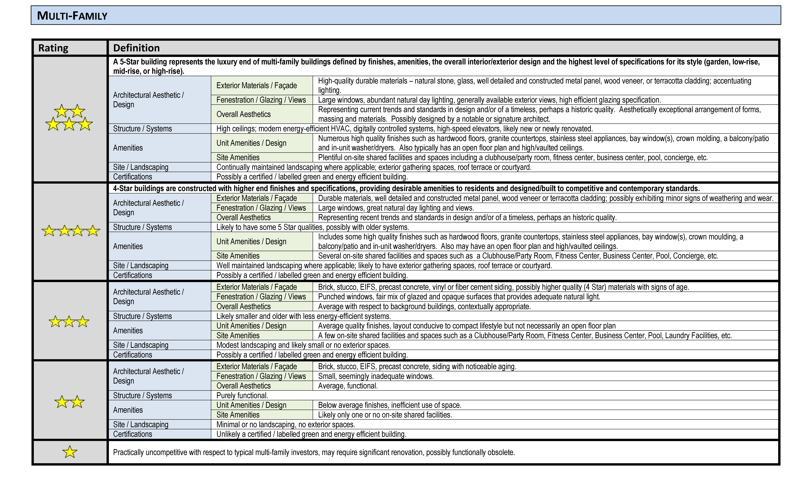
CoStar Multi-family Ratings

Slide 21
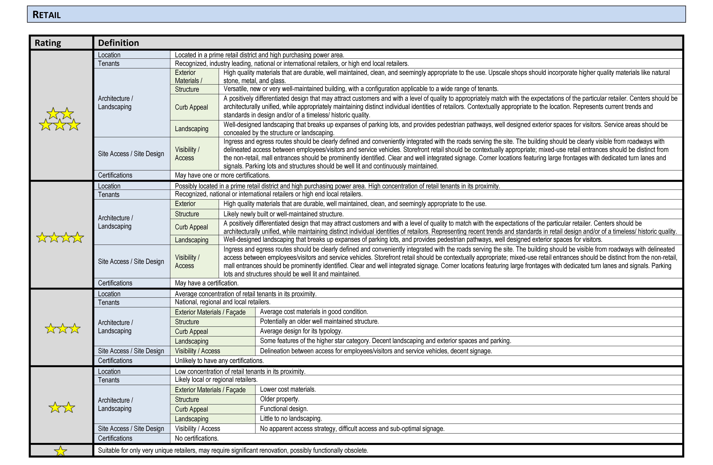
CoStar Retail Ratings

