Slide 1
Introduction to Valuation of Real Estate
By Norm G. Miller
University of San Diego
nmiller@sandiego.edu

Slide 2
Valuation: Topics
Definitions
Price versus Value and appraisal bias
Traditional methods of valuation
Brief discussion the market approach to value
Income approach to value
Generating a cash flow Proforma
Some key financial ratios
Theory behind cap rate drivers
Gordon growth rate model
GRM (Gross Rent Multiplier) techniques

Slide 3
Introduction
Value as a concept is theoretical in nature
PRICE is usually factual in nature
Value by nature is an opinion
In the absence of a perfectly competitive market, there can be no certainty that the value sought is resolutely true or unchallengeable

Slide 4
Definitions
Subject Property: The property being analyzed or appraised
Appraisal: A professional opinion and written report that is defensible and supported for a defined real estate value
Cost: Either an estimate based on a bid or the actual cost of a parcel of land, building or component of these
Reservation Price or Investment Value: The maximum price a buyer would pay or minimum price a seller would accept on a property of interest.
Market Value: The highest price a willing buyer would pay and a willing seller would accept, both fully informed and without duress or unusual financing.

Slide 5
Definitions (Contd.)
Going Concern Value: Recognizes that in some cases it is very difficult to separate real estate value from the value generated by the operations of the business or businesses which use the property.
The going concern value represents the value of the property with the existing businesses.
Highest and Best Use: The most productive use of the property that is legal, physically possible, economically viable and maximizes the value of the site.
Highest and Best Use “As Is” Considers the costs to demolish and rebuild, or grandfathered non-conforming use, whereby the new use value may not justify demolishing and rebuilding.

Slide 6
Price and Value Formation
The shaded area is where actual transactions will occur and market prices will be formed through negotiation
The distributions of buyers and sellers need not be equal in size
Buyer’s Distribution of bids
Seller’s Distribution of bids
Most Probable Price
Low Price
High Price

Slide 7
Price and Value Formation
Slowing “cold market” or a “buyer’s market”
Buyer’s Distribution of bids
Seller’s Distribution of bids
Most Probable Price
Low Price
High Price

Slide 8
Price and Value Formation
Hot market or
a “seller’s
market”
Price trend
Buyer’s Distribution of bids
Seller’s Distribution of bids
Most Probable Price
Low Price
High Price

Slide 9
Properties are undervalued when markets are going up….especially today when there is less of a penalty for under valuation.
Price
Actual sales
Market Trend
Appraised value based on comps
time

Slide 10
Properties are overvalued when markets are going down…. although the bias tends to be negative as there is less penalty especially now for a low value error.
Price
Actual sales
Appraised value based on comps
Market Trend
New Listing
Time

Slide 11
A word on the Importance of Price and Value Information
Access to accurate data like CoStar is enormously beneficial.
The transparency of the US markets helps produce more efficient markets with narrower price ranges.
Knowing "value" is essential to the working of a free and open economy and essential for financing.
Yet, in most countries of the world, the non-industrialized nations, such data does not exist which is why most countries have no mortgage markets.

Slide 12
Traditional Methods of Valuation
Market or Sales Comparison
Compare the subject property being appraised to similar comparable properties or "comps" that have sold recently or near the date of the appraisal.
Cost Approach
Compare subject property to the cost to build new, less accrued depreciation for wear and tear and obsolescence plus the value of the site at highest and best use. (Most miss-used approach)
Income Approach
Discount future benefits to own the subject property using stabilized Net Operating Income, NOI and a capitalization rate, R. Value, as V = NOI/R

Slide 13
Defining the Submarket or Peer Group
Prior to selecting comparable properties for a market or income approach, the analyst must define the relevant submarket.
Defined as a set of properties that would be considered substitutes in the mind of the typical buyer or renter of such property.

Slide 14
Steps in the Market Approach process:
Define the submarket of comparable properties
Screen and select the comparable property sales
Adjust the comps towards the subject property
Develop a conclusion of value
History is the demon of the market approach to value under the assumption that we wish to know current market value.
Thin markets with few transactions that require an appraiser to go back further in time result is a less confident conclusion of value. Every sale counts!

Slide 15
Adjusting the Comps
The analyst is trying to answer the following question:
“What would the comp sell for if it were identical to the subject property?”
The types of adjustments may include:
Time (price trends over time looking at past and recent trends)
Size
Quality
Features and Lot Size
Location

Slide 16
Subject Property Value Based on Cubic Feet Adjustment for Industrial
 | Height | Size in Cubic Feet | Price in Cubic feet | Adjustment | Adjusted Price
Subject | 32 | 8,000,000
Comp 1 | 30 | 8,250,000 | $2.182 | ($545,455) | $17,454,545
Comp 2 | 24 | 4,800,000 | $2.188 | $7,000,000 | $17,500,000
Comp 3 | 24 | 6,720,000 | $2.158 | $2,761,905 | $17,261,905
Comp 4 | 32 | 7,680,000 | $2.148 | $687,500 | $17,187,500

Slide 17
Conclusion of value
Comp | Degree of comparability | Adjusted Value | Weight
1 | High | $17,454,545 | .30
2 | Good | $17,500,000 | .20
3 | Good | $17,261,905 | .20
4 | High | $17,187,500 | .30
Conclusion of value = $17,344,994.50
Say $17.35 million

Slide 18
Income Approaches to Value
We will focus on the overall income approach to value using market capitalization rates from peer property comps.
But first some background on calculating NOI and then on cap rates and what drives them.

Slide 19
Developing a Proforma
The Proforma is an accounting style projection of the operating statement over time
Proformas start with the initial operation of the property after the development and lease up phase
Alternatively, the proforma could begin after acquisition of an existing property and run through the anticipated sale
Typically derived on an annual projection basis although it could be done monthly
Its primary benefit is that it provides the information that drives investment, financing decisions and management decisions
It is a forecast of the future

Slide 20
Steps to Develop a Proforma
Step 1. Estimate Potential Gross Income, PGI
Step 2. Subtract Estimated Vacancy
Step 3. Add other income
= EGI (Effective Gross Income)
Step 4. Subtract Operating Expenses
= NOI (Net Operating Income)
Step 5. Subtract Debt Service
= BTCF (Cash Flow before Taxes)

Slide 21
1. Potential Gross Income
“Proforma” (Contd.)
PGI is the rent that might be collected on a property if 100% occupied (Maximum Rent)
Projections of gross rent should consider:
Existing leases
Market rents on peer properties
Projected supply and demand
In a stable market rents might be expected to grow at the expected rate of inflation.
The notion of stabilized rent or NOI is based on adjustments for unusual circumstances

Slide 22
2. Estimated Vacancy
“Proforma” (Contd.)
Vacancy results from:
Normal mobility of tenants, downsizing, upsizing, etc.
Time needed to retrofit units for new tenants
Over supply of similar property
Estimate of forward vacancy rates should consider:
Local peer group property vacancy rates
Existing tenant leases and probability of renewal

Slide 23
3. Other Income
“Proforma” (Contd.)
Other sources of income:
Laundry vending
Parking
Percentage rents on retail leases
Cable or network access
Other additional services

Slide 24
4. Operating Expenses
“Proforma” (Contd.)
Based on historical information and portfolio benchmarks
Estimated using simple per SF figures or through a detailed analysis of all the potential operating expense accounts:
Management expense Property insurance Property taxes Cleaning/Security Landscaping Utilities not charged to tenants Exterminators Advertisements | Maintenance Supplies Cap X Expenses, ex. Leasing commissions Tenant improvements Roof repair HVAC replacement

Slide 25
Operating Expenses
May be passed through to the tenants, especially if a Net Net Net lease
Gross leases are full service without pass through of expenses
Leases will be covered in more depth in a few weeks.

Slide 26
Net Operating Income
EGI
Less Operating expenses not passed through
=NOI
And we project this out for several years
So we need to think about growth rates for rents and consider leases and each operating expense item.

Slide 27
5. Debt Service only for BTCF
“Proforma” (Contd.)
Debt service is the sum of all mortgage payments required for the year including principal loan repayment as well as interest payments
Mortgage payment is a level annuity
Business Calculator steps
Input:
PV- Projected mortgage loan
N - Number of periods
I - Interest rate per period
Solve for “PMT” i.e. payment
Multiply PMT by 12 to get debt service

Slide 28
BTCF, Before Tax Cash Flow
NOI – debt service = BTCF

Slide 29
REIT Note
A Note on REIT (Real Estate Investment Trust)
REITs use the term FFO for "funds from
operation" instead of the net operating
income, NOI, of the property
The term AFFO is for "adjusted funds
from operation" and is the same as an
NOI or FFO calculation before the
deduction for reserves for building
improvements that have been
capitalized but wear out over time

Slide 30
The treatment of Management Expense
when Self-Managed
Property management expenses should
be identified and charged as an
operating expense (i.e., above the "NOI"
bottom line), even if the owner/investor
will be managing the property
Property management is an
"opportunity cost", absorbing the time
and energy of whoever is performing
this job
For small properties this is often in the
range of 5 to 10 percent of the effective
gross income (EGI) per year

Slide 31
Notes
Tenant Improvement Expenditures,
Leasing Commissions
A major on going expense for all rental
property is TI or tenant improvements
Leasing commissions paid to leasing
firms tend to run about 5% or 6% of the
base rent to be paid by the tenant over
the initial term of the lease.
With respect to the operating expenses
both TI and leasing commissions occur
as a function of tenant turnover and it is
unrealistic except for a single tenant
long term leased building to expect no
turnover

Slide 32
Important Notes (Contd.)
Reserves for Replacement, Reserve
Games and Capital Improvements
Reserves or Cap X are required for capital
improvement items that wear out over time, such
as the roof, HVAC, parking lot surface,
flooring, etc.
Some property analysts calculate NOI without reserves and after reserves or NOI Less CapX
Ignoring reserve costs overstates
true returns when NOI is used as a
measure of return or to calculate value

Slide 33
Summary of Proforma
Potential Gross Income
Less Vacancy
= Effective Gross Income
Less Operating Expenses
= Net Operating Income
Less Debt Service
= BTCF or CTOE
Then to Calculate Taxable Income
BTCF
Plus Principal Loan Repaid
Less Depreciation
Less amortization of points
Equals Taxable Income
Net Operating Income
Less Mortgage Interest paid
Less Depreciation
Less Amortization of points
Equals Taxable Income
OR

Slide 34
Proforma Summary (Contd.)
Taxable Income Times the Tax Rate
= Taxes Owed if Taxable Income is positive
= Taxes Saved if Taxable Income is Negative
BTCF
Less Taxes Due OR Plus Taxes Saved
= After Tax Cash Flow (ATCF)

Slide 35
Financial Analysis
Key financial ratios
Leverage and Operating Ratios:
Loan to Value Ratio (LTV)
Debt Coverage Ratio (DCR)
Breakeven Point
Expense Ratio
Single Period Profitability Measures:
Cash on Cash
Return on Asset (ROA)
Value
Multiple Period Return Measures:
NPV from a required rate of return
IRR

Slide 36
LTV Ratio
Mortgage Loan Balance
Purchase Price
Loan To Value Ratio = --------------------------------
Loan to Value ratio affects the financial risk of the investment
Higher the LTV ratio, to more risk to lender and the greater the volatility of cash returns to equity of property owner

Slide 37
Debt Coverage Ratio (DCR)
Net Operating Income (NOI)
Debt Service
Debt Coverage Ratio = ----------------------------------
The debt coverage ratio must exceed 1.0 in order for the property to be able to make the mortgage payments and have something left over
DCR can be used to calculate the supportable mortgage debt

Slide 38
Breakeven Point
Operating expenses + Mortgage payments
Gross Rent
Breakeven Pt. = --------------------------------------------------
The breakeven point is the percentage of occupancy that a building must achieve in order to be able to pay all if it’s cash expenses and carry the financing
The lower the breakeven point the better
Supportable Mortgage with a given DCR = NOI/ DCR/ 12/ Monthly Mortgage Constant (MMC)

Slide 39
Expense Ratio
Operating expenses
EGI (Effective Gross Income)
Expense Ratio = ---------------------------------------
Expense ratio is used in comparison with similar property, but alone gives no information
Too high an expense ratio compared to peer properties may indicate that operating expenses are not being controlled properly

Slide 40
Cash on Cash
Before Tax Cash Flow
Cash Equity*
Cash on Cash = -------------------------------
* Cash Equity = Purchase price
- Mortgage
+ points
Cash on Cash, is a crude but useful indicator of “going in” profitability of a property

Slide 41
Going In Cap Rate or Return on Asset
Net Operating Income
Purchase Price or Value
Return on Asset = ---------------------------------------
The return on asset, also known as “cap rate”
Used to determine ability of property to carry debt as well as a measure of overall returns

Slide 42
Back to Value
Net Operating Income
Cap Rate
Value = -----------------------------
Here cap rate is the “market cap rate”
The market cap rate reflects the returns required for similar property:
Similar risk
Similar growth prospects

Slide 43
Before we get the cap rate
WHERE DO DISCOUNT RATES, the Y, the required rate of return COME FROM?...

Slide 44
Broad Answer: THE CAPITAL MARKETS
That is, competing investment opportunities.

Slide 45
THEORY
Return
Capital Market Line
Stocks
Expected Returns Based on Risk
Real Estate
Bonds
R_{f = risk free rate}
Risk

Slide 46
Math for THE DISCOUNT RATE IS...
Disc. Rate = Required Return, or “Y” for yield
= Opportunity Cost of Capital
= Expected total return per period
= Y which we can break up as
Y = r_{f} + RP based on similar risk
r_{f} = risk free rate such as 10 Yr Treasuries
RP is the risk premium or spread over the risk free rate

Slide 47
Recall the definition for the income approach to value as “V = NOI/R” so a cap rate must be defined as NOI/Value or NOI/Price
A cap rate will equal approximately the total yield or return required, Y, less the growth rate, GR, of the net operating income, NOI.
Cap Rate or “R” = Y – GR (Gordon growth rate model)

Slide 48
Let’s interpret this for a moment
“R” = Y – GR
A cap rate will equal approximately the total yield or return required, Y, less the growth rate, GR, of the net operating income, NOI.

Slide 49
Example
R = Y – GR
So if we want a 12% yield and the expected growth rate of NOI is 4% then the Cap rate is approximately 8%.
R = 12% - 4% = 8%
If the property NOI = $100,000 and the cap rate is 8% what is the property worth?
$100,000/.08 = $1,250,000

Slide 50
Cap Rates will…
Go up if the treasuries go up
Go up if risks go up
Go up if less debt is available.
Go down if cheaper money is available.
What is going on now with the 10 year treasuries?
Note we could also use a discounted cash flow analysis to find total property value but that will wait for another discussion.

Slide 51
Market Conditions Matter
Can affect both appreciation rates and risk
A market becoming over supplied will increase the uncertainty of income which implies higher risk and also reduce rental growth rates thus cap rates will move higher
If the market demand is getting stronger with little possibility of new supply, we will see faster rental growth and lower cap rates
Property Age and Cap Rates
Older properties tend to have more uncertain repairs and capital improvement expenditures, and tend to be located in lower appreciation areas
Both these factors cause a higher cap rate

Slide 52
Summarized Influences on Cap Rate
Valuation Factor | Impact on Cap Rate
Growth in Income | Faster growth means a low cap rate and higher value, i.e. Gordon Growth Rate Model
Risk | Higher risk means a higher cap rate and lower value
Economic obsolescence | Shorter economic life means a higher cap rate and lower value
Interest Rates or Cost of Capital | Higher interest rates imply higher cap rates and lower value
Market Conditions | Stronger rental market imply lower cap rates and higher values
Property Age | Older properties typically have more risk as a result of greater repair volatility. More risk means higher cap rates and lower values

Slide 53
Comparing Income Valuation Methods
GRM = Price/Potential Gross Rent
Then Subject Property PGI x GRM = Value
EGIM = Price/Effective Gross Income
Then Subject Property EGI x EGIM = Value
Cap Rate based on Price/Net Operating Income = R
Then Subject Property NOI/R = Value
Or Discounted Cash Flow based on a required rate of return applied to all returns discounted to Present Value and added to the financing assumed for total property value.

Slide 54
 | Subject | Comp 1 | Comp 2 | Comp 3
Sales Price |  | $1,020,000 | $977,000 | $1,675,000
GRM |  | 5.37 | 5.75 | 6.44
EGIM |  | 5.96 | 6.25 | 6.57
R |  | 12.35% | 12.12% | 11.93%
Potential Gross Income | $280,000 | $190,000 | $170,000 | $260,000
Vacancy Rate | 1.00% | 10.00% | 8.00% | 2.00%
Effective Gross Income | $277,200 | $171,000 | $156,400 | $254,800
Operating Expenses Paid by Landlord Including VAT | ($66,000) | ($45,000) | ($38,000) | ($55,000)
NOI | $211,200 | $126,000 | $118,400 | $199,800
NOI/Sales Price =R

Slide 55
Subject Value Based on |  | Comp 1 | Comp 2 | Comp 3
Based on GRM |  | $1,503,158 | $1,609,176 | $1,803,846
Based on GRM Average | $1,638,727
Based on EGIM |  | $1,653,474 | $1,731,614 | $1,822,253
Based on EGIM Average | $1,735,780
Based on Cap Rate |  | $1,709,714 | $1,742,757 | $1,770,571
Based on Average Cap Rate | $1,741,014

Slide 56
Subject Property Indicated Value Range
Using GRM
Using EGIM
Using R
The value of the subject property is highest using V = NOI/R since the operating expenses are lower than two of the comps and the vacancy rate is lower than all of the comps. But this requires more information and a more transparent market.
$300,688
Such a
decline is
what you would
expect in an informed market.
$168,779
$60,856

Slide 57
Some Sample Cap Rates

Slide 58
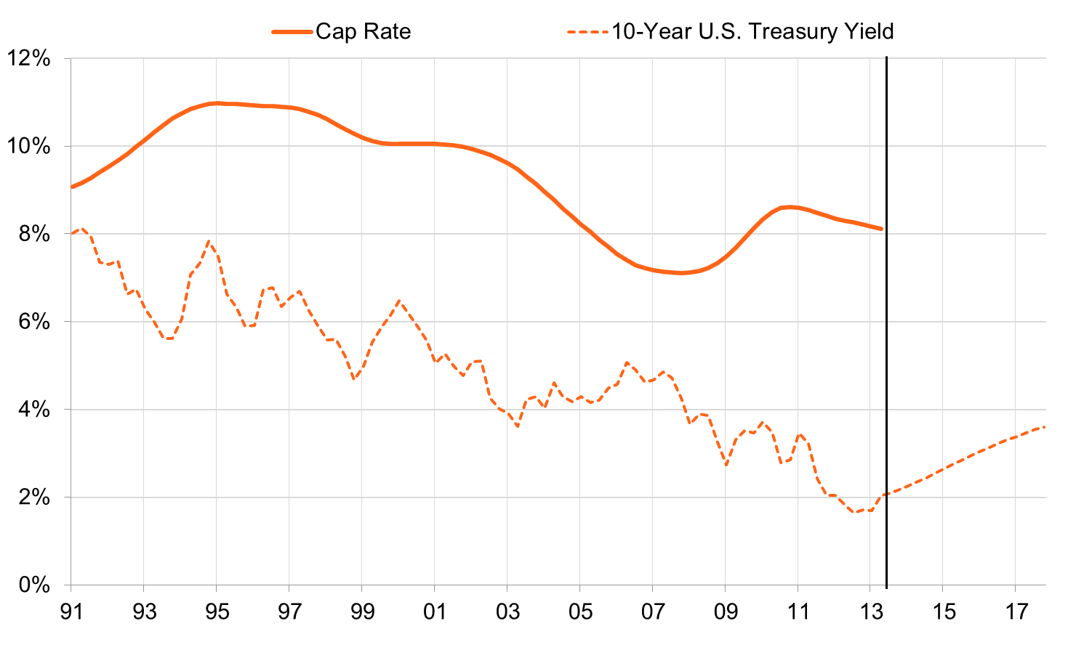
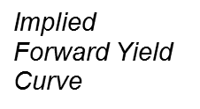
Retail Cap Rates Compressing, But Interest Rates Are Rising
Source: CoStar Group, Moody’s Analytics
Notes:
C:\Documents and Settings\jspivey\My Documents\My Work Files\Presentations\2 - Presentation Data\CoStar Data\CoStar Webinar Automation.xlsm
Sheet: Federal Exposure

Slide 59
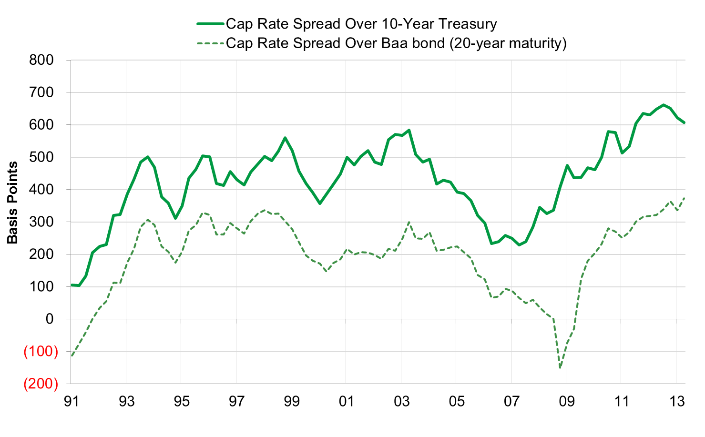
Where Will Retail Cap Rates Go?
Source: CoStar Group, Moody’s Analytics
Notes:
C:\Documents and Settings\jspivey\My Documents\My Work Files\Presentations\2 - Presentation Data\CoStar Data\CoStar Webinar Automation.xlsm
Sheet: Federal Exposure

Slide 60
Office Cap Rates By Size Mid 2013
Bldg Size | RBA | Price/sq ft | Cap Rate
<50,000 | 66.6 m | $154 | 8.13%
50K-250K | 119 m | $170 | 7.78%
250K-500K | 65 m | $226 | 6.70%
500K+ | 93 m | $275 | 6.71%

Slide 61
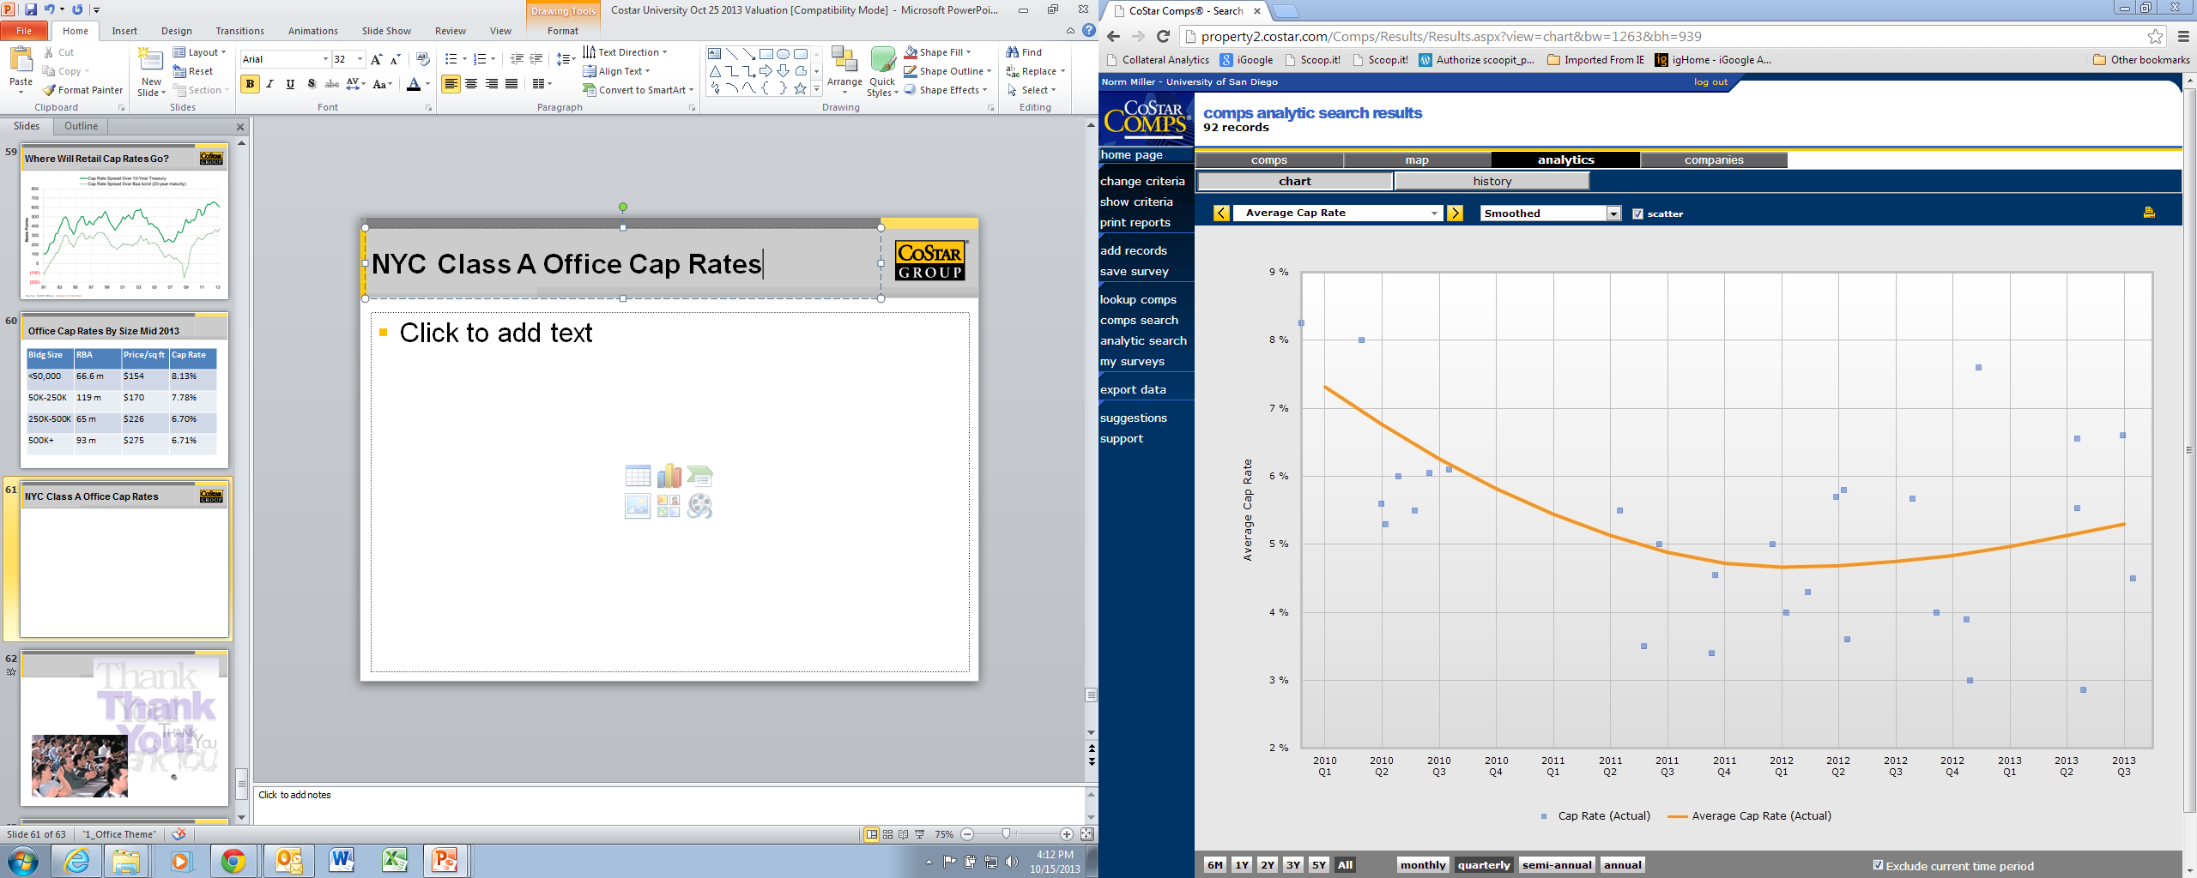
NYC Class A Office Cap Rates
5%

Slide 62
A Sample quick analysis

Slide 63
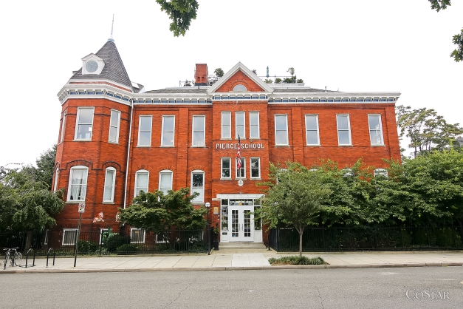
Asking price $7,250,000 1375 G ST NE in Wash DC

Slide 64
Facts
10 units average unit size 2525 sq ft
Gross building is 32,000 sq ft
Assume rents are $1.75 per sq ft per month
Assume Operating Expenses are 65 cents PSF per month.
What kind of mortgage can this support if 80% LTV at 5.75% 25 year amortization is available?
Note the MMC = .006291064
MMC x 12 = .075492768 AMC

Slide 65
NOI estimate & supportable mortgage
2525 x 10 = 25,250 sq ft x $1.75 = $44,187.50 x 12 = $530,250 PGI
Less vacancy from market assumed at 7% = (37,117)
EGI = $493,133
Less Op Expenses at .65 psf per month x 12 = $196,950
NOI = $296,183
NOI/DCR of 1.25 = $236,946.40
Divide this by the AMC = $236,946.40/.075492768 = $3,138,663 as the supportable mortgage at this rent, vacancy and operating expense assumptions.
This is less than half of the current asking price of $7,250,000

Slide 66
Summary
Values are a function of expected future income and residual values.
V = NOI/R is a perpetuity formula that simplifies the process
R includes a return on and of capital
Risk, growth rates and obsolescence all matter along with capital market appetites which influence spreads between property types and sizes.

