Slide 1
Introduction to Retail Property
Norm Miller, PhD
University of San Diego
nmiller@sandiego.edu

Slide 2
Property Types
Strip Center (Convenience)
Neighborhood or Community Center
Lifestyle Center (open)
Power Center (Big Box Mall with Category Killers)
Regional Mall (often closed)
Super Regional Mall ( often closed )
Outlet Center

Slide 3
 | Key Tenants | Typical Size | Drawing Distance
Strip | Convenience | 10k to 30k | .5 to 1 mile
Neighborhood | Grocer, Drugstore | 30k to 120k | 2 to 5 miles
Lifestyle | Restaurants, Clothes | 80k to 250k | To 10 miles
Power | Category killer big boxes | 3 to 6 boxes @ 20k-80k each | To 15 miles
Regional | 1 or 2 Department Stores | .5 m <1 million sq ft | To 10 miles
Super Reg | 2 to 5 Department Stores | >1 million sq ft | To 20 miles
Outlet | Discount Solo Brands | >1 million | To 50 miles

Slide 4
Tenants may be classified by size and drawing power
Anchors
In line tenants or those that exists only based on the drawing power of the anchors.

Slide 5
Trade Areas for Centers are a function of:
Anchor merchant trade areas and nearest competitors
The mix of tenants: Agglomeration effects (combined market drawing power)
Density of population
Access speed measured in time

Slide 6
Key decisions
Maximizing drawing power by trading off agglomerative benefits with competitive effects of competing tenants.
Note: 8 shoe stores may not all compete, e.g.
2 are sporting shoes
1 is a walking natural shoe
3 are high end women’s shoes
2 are kids shoes

Slide 7

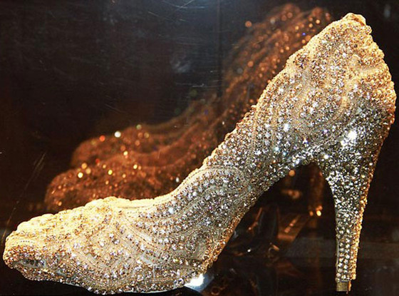
Which types of centers are growing or declining?
Department Stores Versus Specialty Stores
and
Value versus Quality

Slide 10
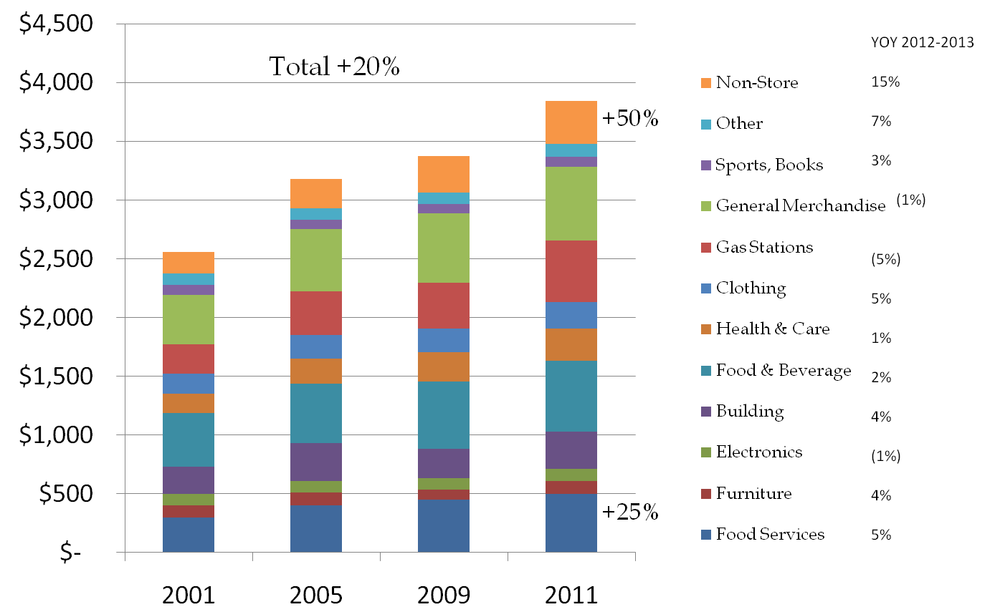
US Retail Sales
5% growth
2012-2013
+20%
+40%
+30%
+10%

Slide 11
What should normal sales growth be?
Equilibrium: Population growth rate in trade area + inflation rate
Growth: A better tenant mix with above average same store sales.
Decline: An obsolete category (books) or poor mix.
Key term: same stores sales

Slide 12
E Commerce, Profit Margins and Supply Chain Trends
The Internet has allowed instant comparison shopping.
This has squeezed profit margins which has put downward pressure on rents.
At the same time better inventory management has allowed quicker turns and more productivity which allows higher rents. It has also resulted in smaller stores.

Slide 13
Key Trends Continued
Per capita retail space has increased, but rather than presume this is excess space, we can explain some of it by the following:
More service tenants that sell nothing physical, e.g. Fitness centers, financial services, etc. now 24% of space versus 15% in the year 2000.
A higher level of consumption per capita overall led by higher income and higher wealth households.

Slide 14
Key Trends Continued: Income disparity
  The top 10% of households by income now have 45% of total aggregate income.
  The middle income households have been stagnant with more households just getting by, so we see in lower income markets more pawn shops and more pay day money lenders. This reduces consumption as well, shifting some earnings to high interest payments.

Slide 15
Key Trends Continued
The mix of tenants has changed, not only with more service tenants but also more value tenants and re-sellers of goods.
E.g. Goodwill, Thrift shops, Consignment Shops.

Slide 16
Occupancy Cost
Occupancy costs may include base rents, CAM or common area maintenance, pass thru expenses like property taxes, insurance and utilities, and misc fees for marketing as well as percentage rent on some tenants.

Slide 17
Maximizing Potential Rent
Feasible rents tends to be equal to approximately the following formula:
Sales per square foot times the profit margin of the merchant type times 1%.
For example:

Slide 18
Costco's margin = 10%, thus feasible rent is about 1% of sales.
Kroger's margin = 21%, thus feasible rent is about 2.1% of sales.
Starbuck's margin = 49%, thus feasible rent is about 5% of sales.

Slide 19
Rent is thus a function of
Expected sales
Profit margin
Drawing power and importance to the center in generating sales for other tenants
Number of retail centers the landlord has that the tenant wants to be in, based on existing tenants and market socio-economic factors. (Landlord power)
Number of centers that the tenant currently has or could have in existing centers of the landlord. (Tenant power)

Slide 20
Overage Rent
Base rent
Overage is based on sales above a break point
Also called percentage rent and it could apply to all sales or only some as defined
Example: Base = $25 and overage is 1% of all sales over $250 a year.
Overage rent runs 5% to 10% of NOI in some super regional malls but is rare for anchors and rare for smaller centers and Mom and Pop stores.

Slide 22
Retail demand is concentrated just like supply
Top 100 retailers have 65% of the space
Top 500 retailers have 85% of the space
Top 1000 retailers have 90% of the space
Top 3500 retailers have 95% of the space

Slide 23
Public Retail Player Examples
Retailers
M
TGT
HD
LTD
KR
WMT
REITS
SPG
DDR
REG
NNN

Slide 26
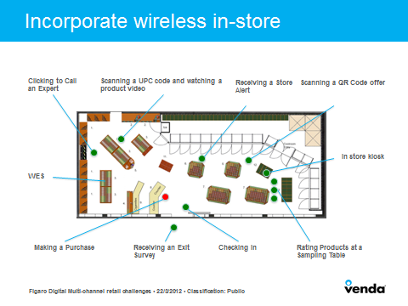

Slide 27
How should landlords deal with e-commerce?
What will affect the ability to collect rent in the future?

Slide 28
Will total retail sq ft continue to grow or shrink?
Floor plates are shrinking for most tenants.

Slide 29
Again: what drives retail rents?
What is the expected sales growth rate?
A note on leasing: Most leasing is not based on new tenants but stealing existing tenants or landing those with who there are existing relationships.

Slide 30
What drives supply?
It should be gaps in the market and seeking out growing markets, but for some retailers we have capital driven supply.
They leverage a track record to raise capital via an IPO and we promise to open stores.
They are confident that they will beat out the competition and it does not matter if that particular good or service is over supplied.

Slide 31
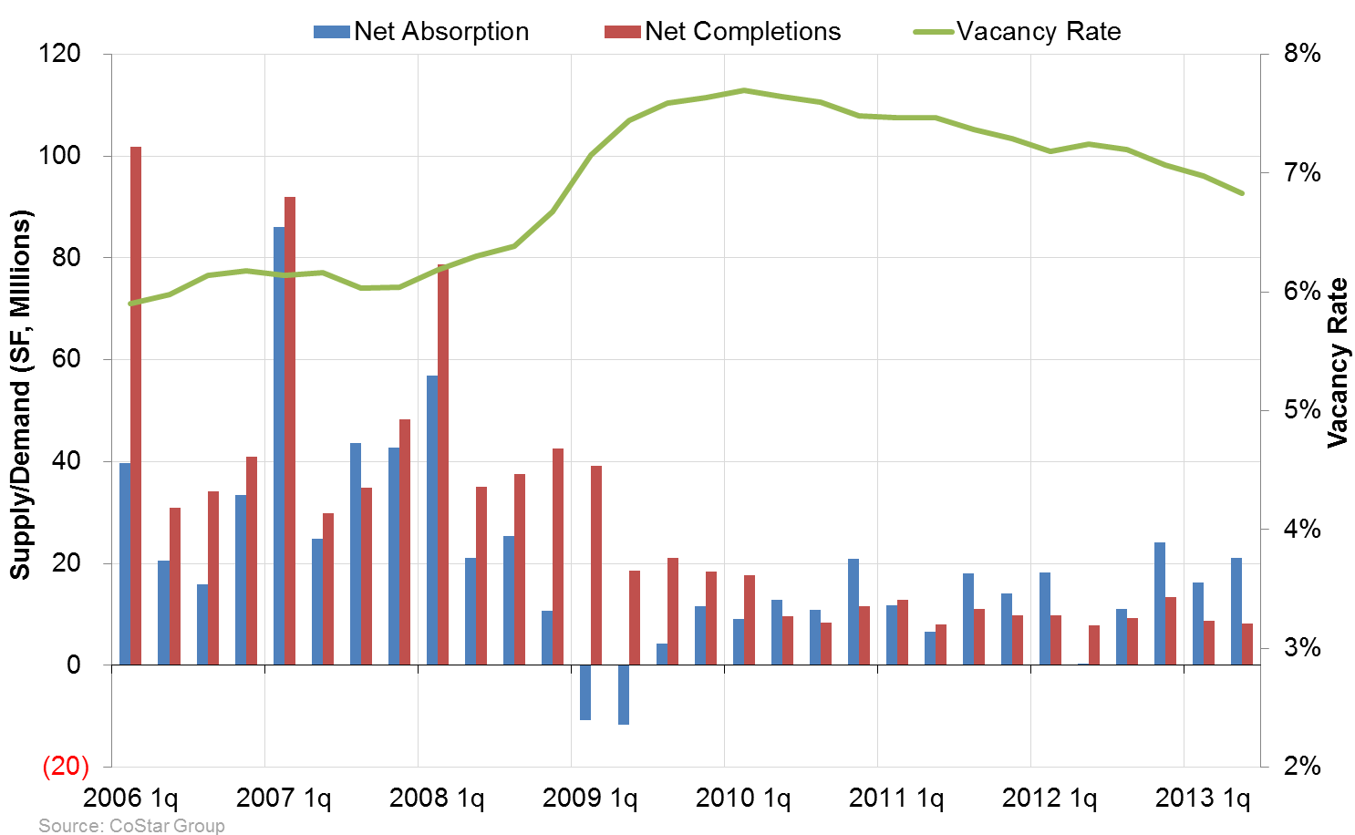
PPR’s Demand and Supply Model
Notes:
C:\Documents and Settings\jspivey\My Documents\My Work Files\Presentations\2 - Presentation Data\CoStar Data\CoStar Webinar Automation.xlsm
Sheet: Federal Exposure

Slide 32
A look at some specific markets

Slide 33
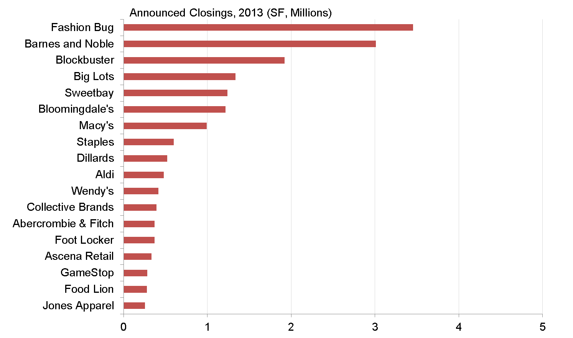
Hangover From 2012?
Are these a surprise?
Sources: CoStar Group, SEC Filings, About.com
Notes:
C:\Documents and Settings\jspivey\My Documents\My Work Files\Presentations\2 - Presentation Data\CoStar Data\CoStar Webinar Automation.xlsm
Sheet: Federal Exposure

Slide 34
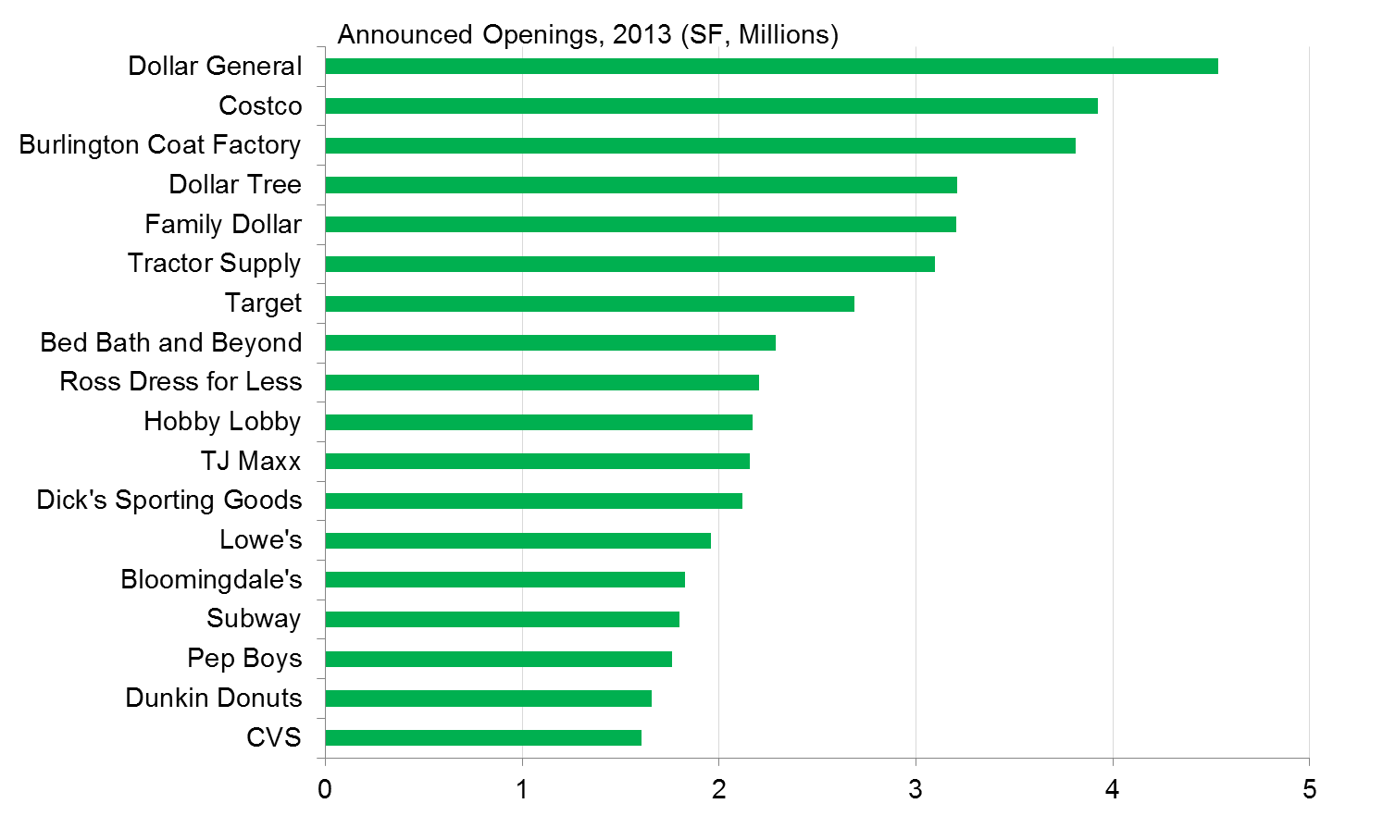
Not All Retailers Are Retrenching
Sources: CoStar Group, SEC Filings, About.com, ChainLinks
Notes:
C:\Documents and Settings\jspivey\My Documents\My Work Files\Presentations\2 - Presentation Data\CoStar Data\CoStar Webinar Automation.xlsm
Sheet: Federal Exposure

Slide 35
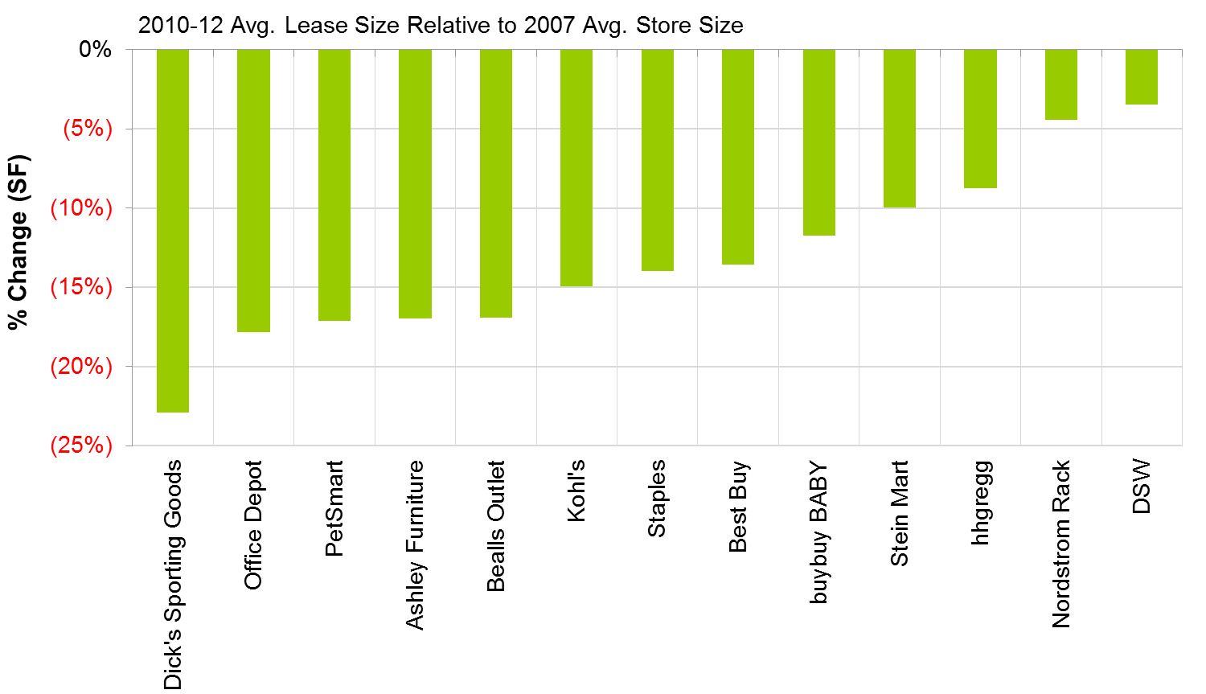
Retailers Getting Smaller
Sources: CoStar Group, SEC Filings
Notes:
C:\Documents and Settings\jspivey\My Documents\My Work Files\Presentations\2 - Presentation Data\CoStar Data\CoStar Webinar Automation.xlsm
Sheet: Federal Exposure

Slide 36
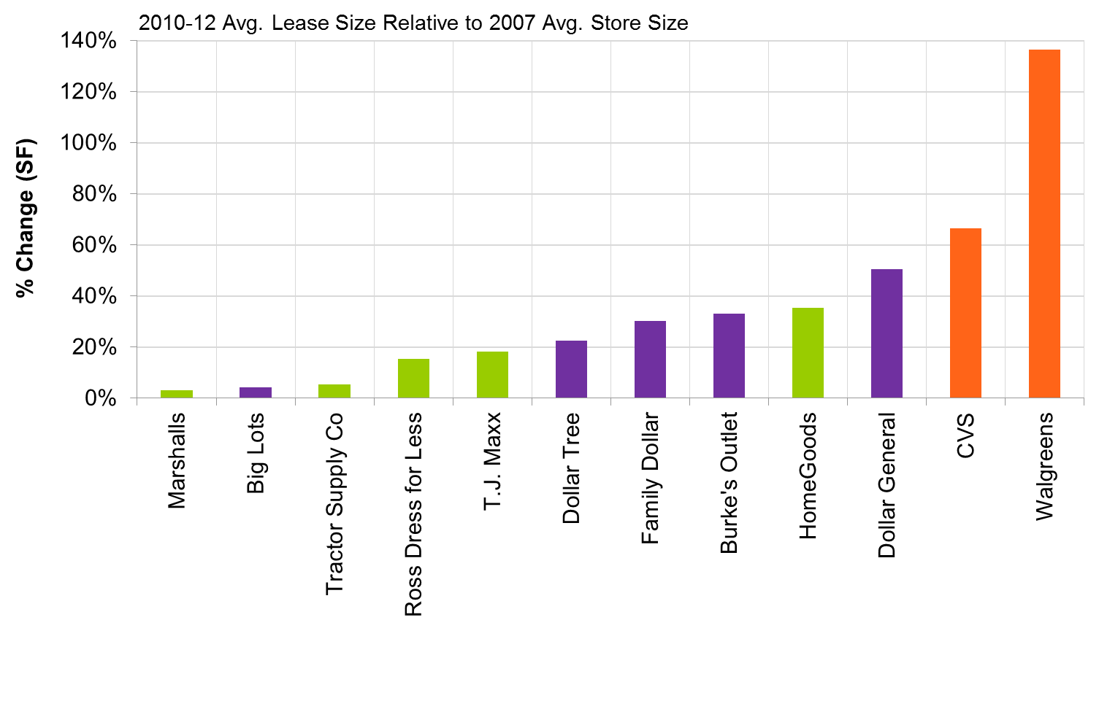
Discounters, Drug Stores Going Bigger
Drug
Discounter
General
Sources: CoStar Group, SEC Filings
Notes:
C:\Documents and Settings\jspivey\My Documents\My Work Files\Presentations\2 - Presentation Data\CoStar Data\CoStar Webinar Automation.xlsm
Sheet: Federal Exposure

